Slide 1
Maryland Situation Update on Coronavirus Disease (COVID-19) for BHA
Maryland Department of Health
Infectious Disease Epidemiology and Outbreak Response Bureau
February 12, 2021

Slide 2
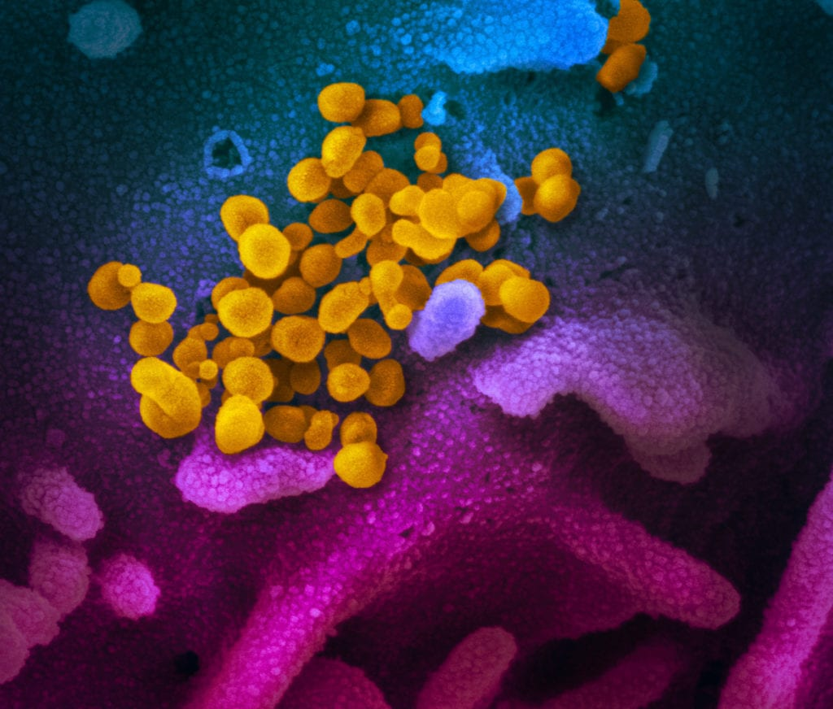
Call Agenda
Picture Courtesy of NIAID-RML
Review current situation of COVID-19
Influenza Updates
CDC Updates
Q and A

Slide 3
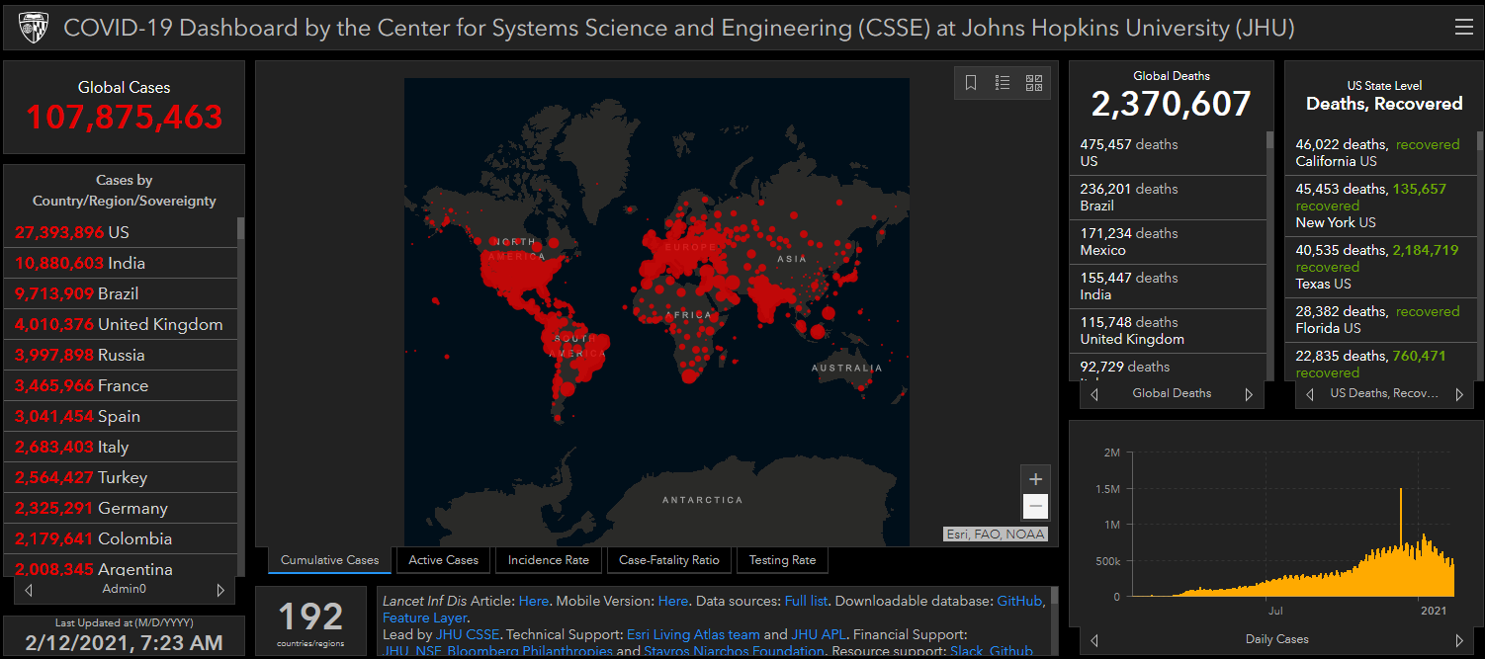
COVID-19 Global Situation Summary
https://gisanddata.maps.arcgis.com/apps/opsdashboard/index.html#/bda7594740fd40299423467b48e9ecf6

Slide 4
US Case Counts and Rates
https://www.cdc.gov/coronavirus/2019-ncov/cases-updates/cases-in-us.html Accessed 2/12/2021

Slide 5
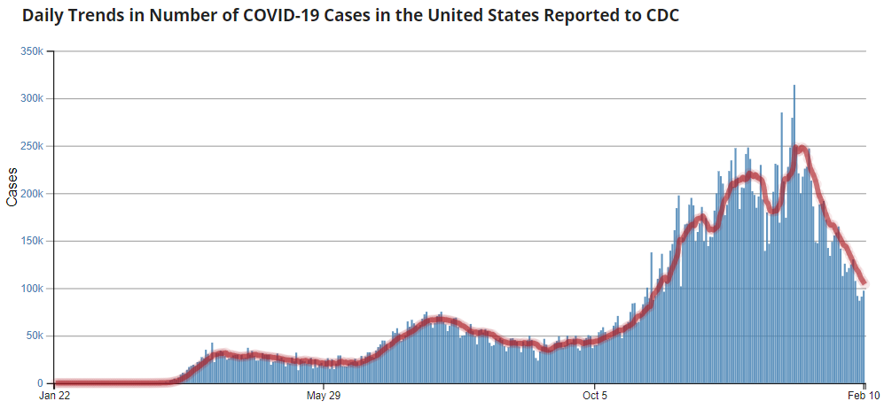
Number of Cases Reported in the USA, by Day
https://covid.cdc.gov/covid-data-tracker/#trends_dailytrendscases
Updated 2/12/2021

Slide 6
COVID-19 Vaccinations in the United States

Slide 7
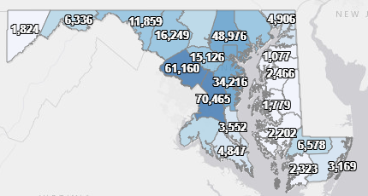
Maryland: COVID-19 Cases
http://health.maryland.gov/coronavirus
Data current as of 2/12/2021
Cases: 368,977
1,112 new
Deaths: 7,324
36 new
Hospitalizations: 32,687
Current: 1,225 ( Down 80)
Total tests performed: 7,388,614
Case rate: 19.8 per 100,000

Slide 8
https://coronavirus.maryland.gov/ 2/12/2021

Slide 9
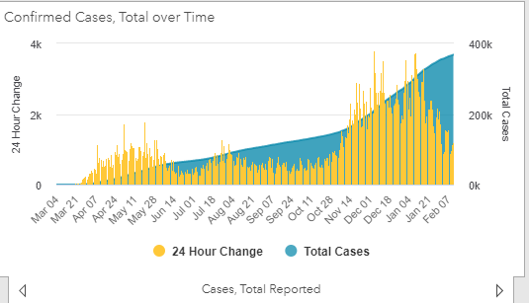
https://coronavirus.maryland.gov/ 2/12/2021

Slide 10
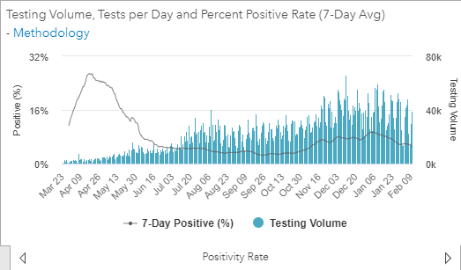
Testing Volume and % Positivity

Slide 11
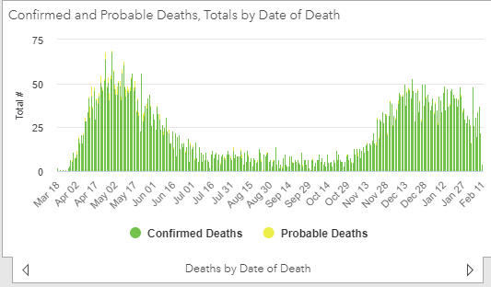

Slide 12
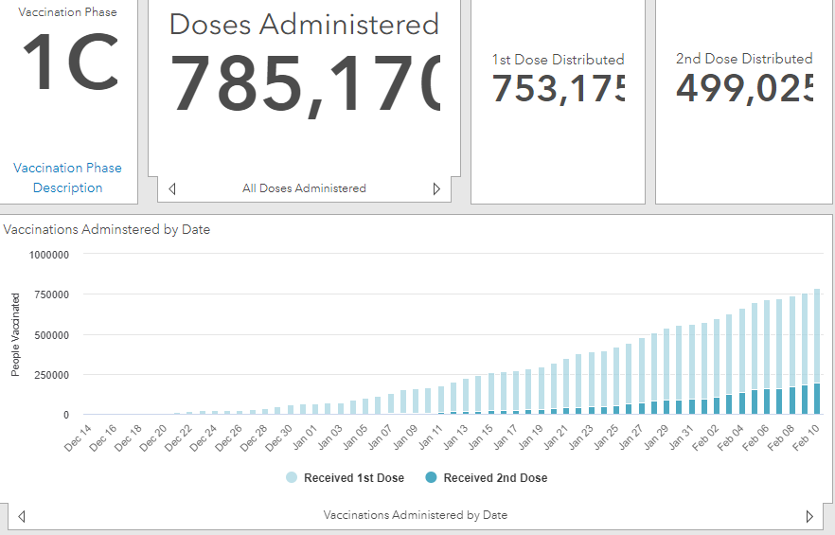
Maryland Vaccine Dashboard
https://coronavirus.maryland.gov/#Vaccine accessed February 12, 2021

Slide 13
Maryland Influenza Epi Update
Week Ending January 30th, 2021
Influenza-like illness (ILI) activity in Maryland was minimal

Slide 14
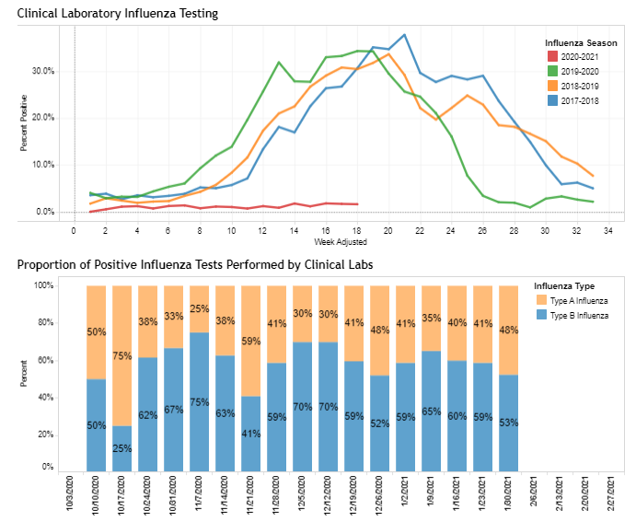
https://phpa.health.maryland.gov/influenza/Pages/flu-dashboard.aspx

Slide 15
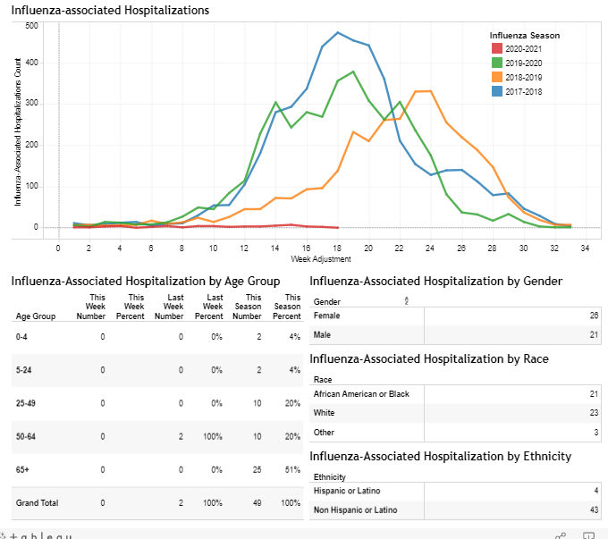
https://phpa.health.maryland.gov/influenza/Pages/flu-dashboard.aspx

Slide 16
CDC Updates

Slide 17
Considerations to Improve Ventilation
Increase outdoor air ventilation
increase fresh outdoor air by opening windows and doors
Use fans to increase the effectiveness of open windows
Increase airflow to occupied spaces when possible
Open outdoor air dampers beyond minimum settings to reduce or eliminate HVAC air recirculation
Improve central air filtration
Consider portable high-efficiency particulate air (HEPA) fan/filtration systems to help enhance air cleaning
Consider using ultraviolet germicidal irradiation (UVGI) as a supplement to help inactivate SARS-CoV-2
https://www.cdc.gov/coronavirus/2019-ncov/community/ventilation.html

Slide 18
Maximizing Fit for Cloth and Medical Procedure Masks to Improve Performance and Reduce SARS-CoV-2 Transmission and Exposure, 2021
Emphasizes the importance of a close fitting medical mask
“modifications to improve fit might result in equivalent improvements, regardless of the masks’ baseline filtration efficiencies”
Knotting the sides of the medical mask can improve the fit
Still do not recommend the use of cloth masks in health care settings
https://www.cdc.gov/mmwr/volumes/70/wr/mm7007e1.htm?s_cid=mm7007e1_w

Slide 19
Quarantine for vaccinated people
In NON-HEALTHCARE settings, vaccinated people with an exposure to a confirmed or suspect COVID-19 case do not need to quarantine if they:
Are fully vaccinated (i.e., ≥2 weeks following receipt of the second dose in a 2-dose series, or ≥2 weeks following receipt of one dose of a single-dose vaccine)
Are within 3 months following receipt of the last dose in the series
Have remained asymptomatic since the current COVID-19 exposure
As an exception to the above guidance no longer requiring quarantine for fully vaccinated persons, vaccinated inpatients and residents in healthcare settings should continue to quarantine following an exposure to someone with suspected or confirmed COVID-19
https://www.cdc.gov/vaccines/covid-19/info-by-product/clinical-considerations.html#phrecs

Slide 20
Racial and Ethnic Disparities in the Prevalence of Stress and Worry, Mental Health Conditions, and Increased Substance Use Among Adults During the COVID-19 Pandemic — United States, April and May 2020
What is already known about this topic?
Racial and ethnic minority groups have experienced disparities in mental health and substance misuse related to access to care, psychosocial stress, and social determinants of health.
https://www.cdc.gov/mmwr/volumes/70/wr/mm7005a3.htm?s_cid=mm7005a3_w

Slide 21
Summary
Combined prevalence estimates of current depression, initiating or increasing substance use, and suicidal thoughts/ideation among U.S. adults aged ≥18 years were 28.6%, 18.2%, and 8.4%, respectively.
Hispanic adults reported a higher prevalence of psychosocial stress related to not having enough food or stable housing than did adults in other racial and ethnic groups.
Addressing psychosocial stressors, mental health conditions, and substance misuse among U.S. adults during the COVID-19 pandemic is important, as are interventions tailored for racial and ethnic minority groups.

Slide 22
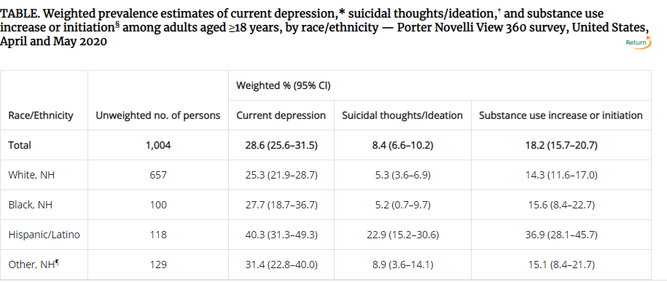

Slide 23
Questions?
Email : mdh.ipcovid@Maryland.gov

