Slide 1
Maryland Situation Update on Coronavirus Disease (COVID-19) for BHA
Maryland Department of Health
Infectious Disease Epidemiology and Outbreak Response Bureau
January 8, 2021

Slide 2
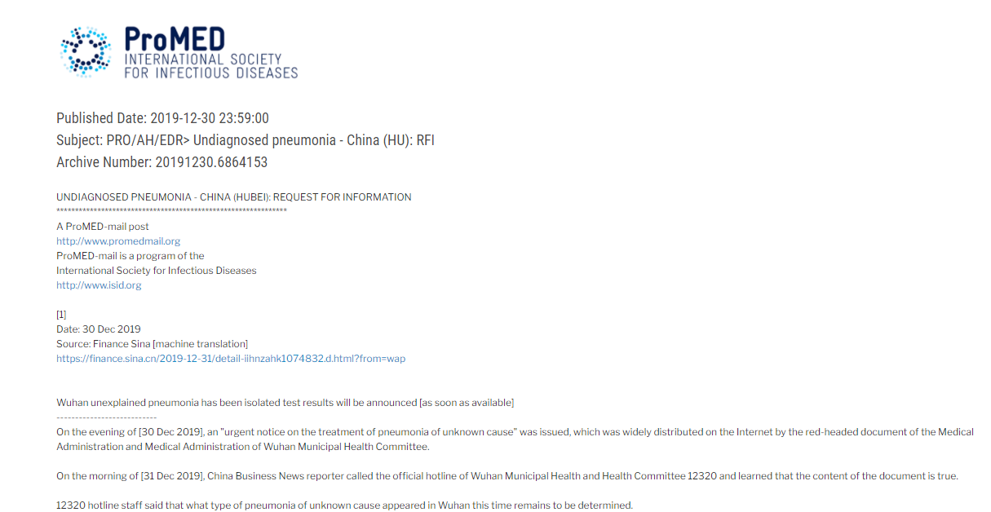
https://promedmail.org/promed-post/?id=6864153

Slide 3
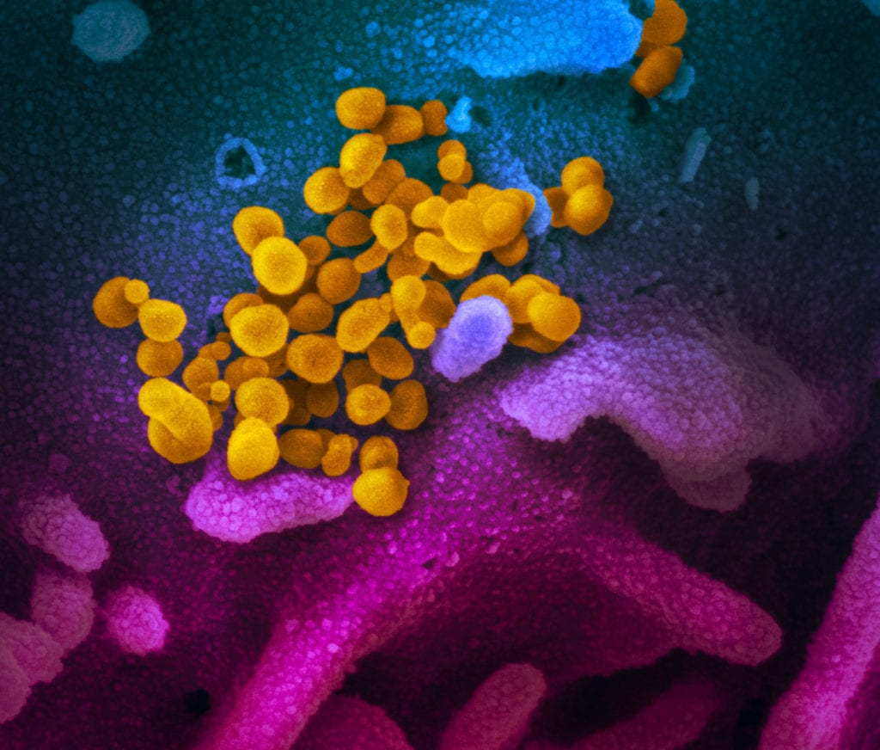
Call Agenda
Picture Courtesy of NIAID-RML
Review current situation of COVID-19
Novel Variant Updates
CDC Vaccine information
Q and A

Slide 4
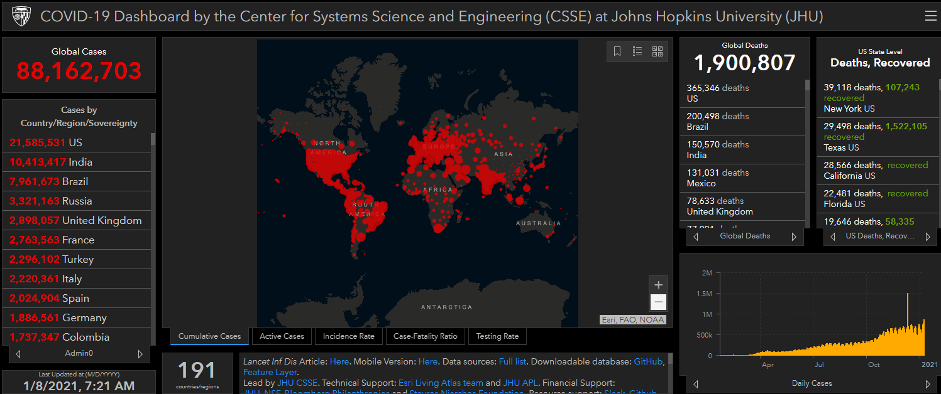
COVID-19 Global Situation Summary
The last time we met, 12/18 case count was 75,075,064

Slide 5
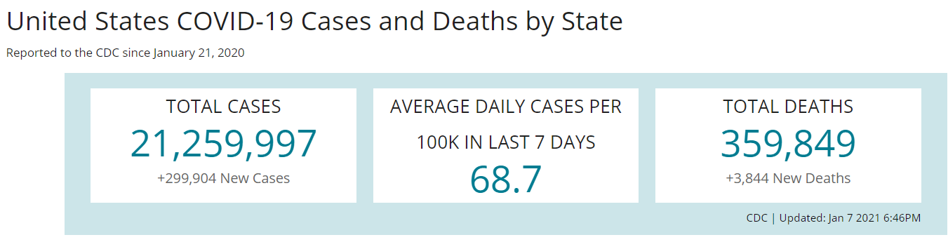
US Case Counts and Rates
On 12/18:
Total Cases: 16,756,581
New 236,913
Total Deaths: 306,427
New 3,435
Cases in the last 7 days per 100,000: 64.8
https://www.cdc.gov/coronavirus/2019-ncov/cases-updates/cases-in-us.html Accessed 1/8/2021

Slide 6
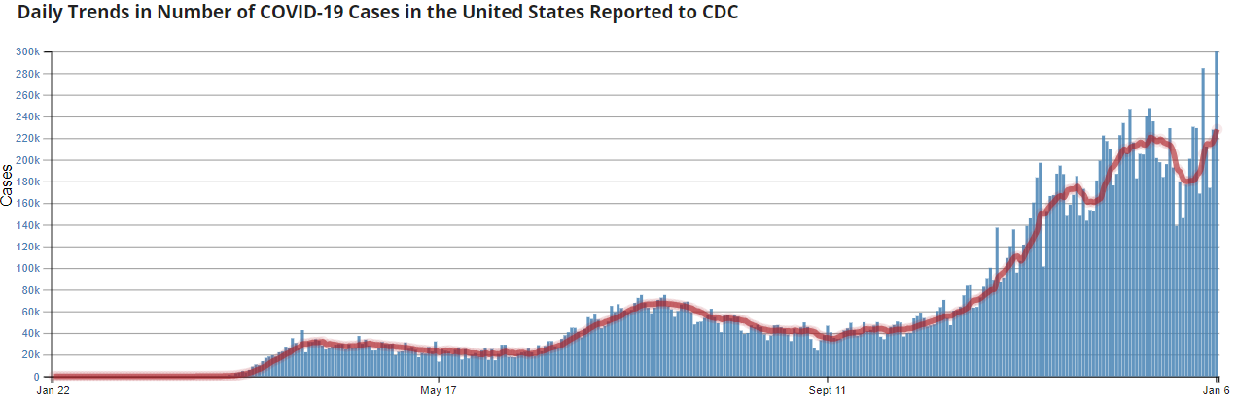
Number of Cases Reported in the USA, by Day
https://covid.cdc.gov/covid-data-tracker/#trends_dailytrendscases
Updated 1/8/2021

Slide 7
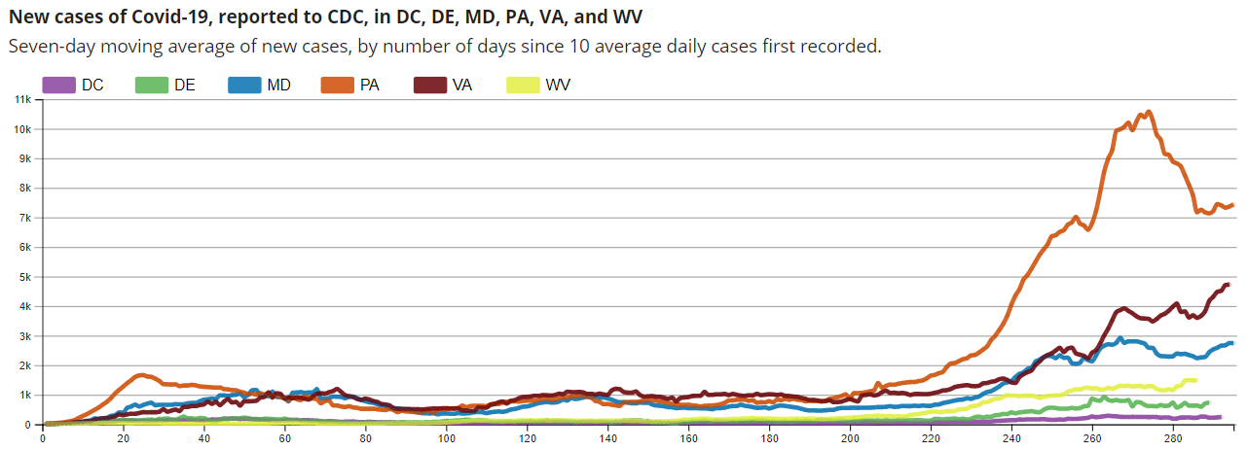
Regional Trends
https://covid.cdc.gov/covid-data-tracker/#compare-trends_newcases 1/8/2021

Slide 8
Maryland: COVID-19 Cases
http://health.maryland.gov/coronavirus
Data current as of 1/8/2021
12/18/2020
Cases: 228,471
2,569 new
Deaths: 5,188
36 new
Hospitalizations: 24,123
Current: 1,686 ( down 16)
Total tests performed: 5,205,154
Case rate: 42.8 per 100,000
1/8/2021
Cases: 299,606
3,732 new
Deaths: 6,047
43 new
Hospitalizations: 28,068
Current: 1,885 ( up 51)
Total tests performed: 6,029,482
Case rate: 45.4 per 100,000

Slide 9
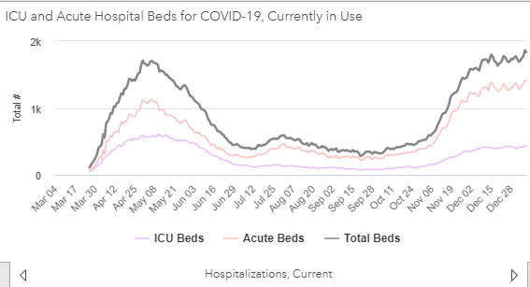
https://coronavirus.maryland.gov/ 1/8/2021

Slide 10
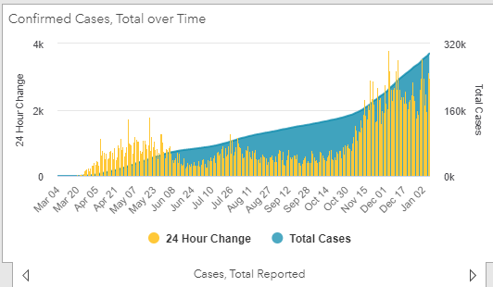
https://coronavirus.maryland.gov/ 1/8/2021

Slide 11
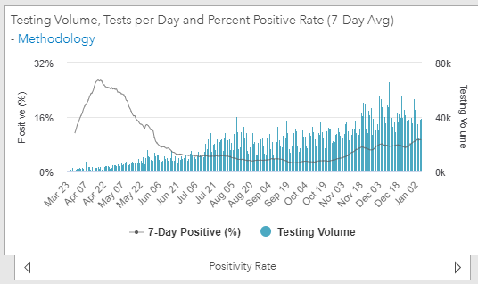
Testing Volume and % Positivity

Slide 12
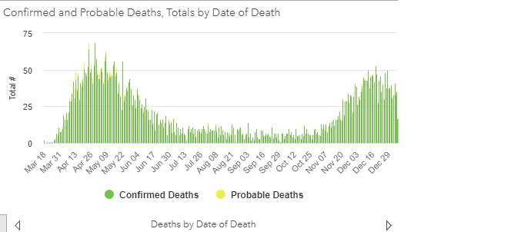

Slide 13
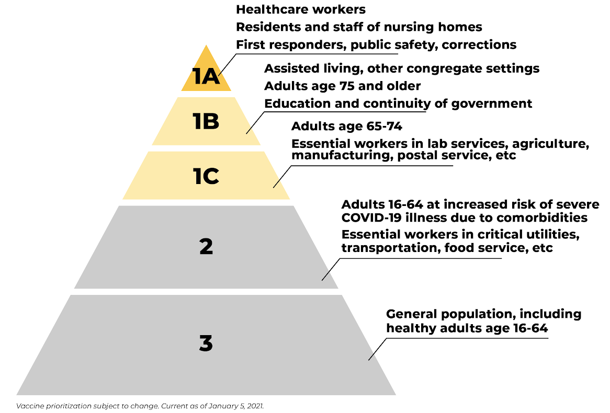
Vaccinations Expand in Maryland
https://governor.maryland.gov/2021/01/05/governor-hogan-announces-statewide-actions-to-accelerate-covid-19-vaccinations-in-maryland/ -

Slide 14
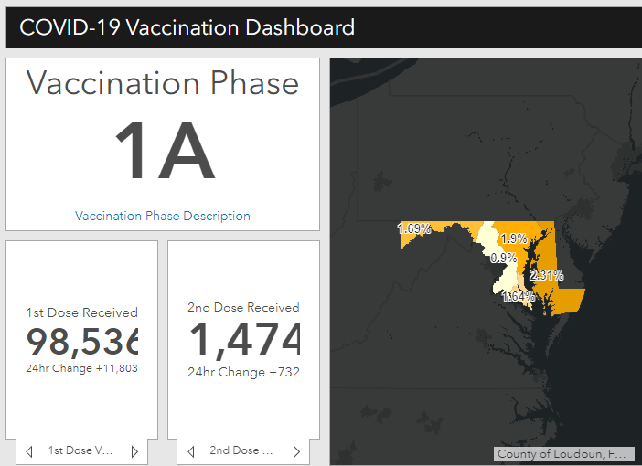
Maryland Vaccine Dashboard
https://coronavirus.maryland.gov/#Vaccine accessed January 8, 2021

Slide 15
New COVID-19 Variant Updates

Slide 16
CDC Scientific Brief: Implications of the Emerging SARS-CoV-2 Variant VOC 202012/01
A new variant strain of SARS-CoV-2 that contains a series of mutations has been described in the UK and become highly prevalent in London and southeast England.
Mutation in the receptor binding domain of the spike protein at position 501, where amino acid asparagine (N) has been replaced with tyrosine (Y). Shorthand: N501Y, or S:N501Y.
This variant carries many other mutations, including a double deletion (positions 69 and 70).
Predicted to potentially be more rapidly transmissible than other circulating strains of SARS-CoV-2.
No evidence that this variant causes more severe illness or increased risk of death.
https://www.cdc.gov/coronavirus/2019-ncov/more/scientific-brief-emerging-variant.html

Slide 17
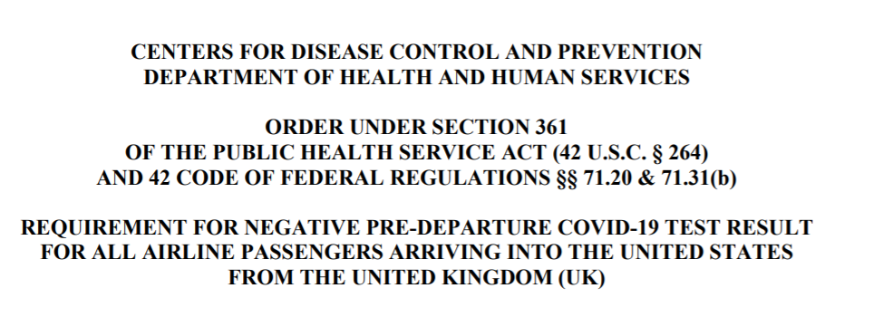
In effect December 27 at 7:01 PM (EST)
Requires proof of a negative COVID-19 test for all air passengers (aged 2 years and older) arriving from the UK to the US
https://www.cdc.gov/coronavirus/2019-ncov/travelers/testing-UK-air-travelers.html

Slide 18
CDC: Emerging SARS CoV-2 Variants
B.1.1.7 lineage (a.k.a. 20B/501Y.V1 Variant of Concern (VOC) 202012/01)
First emerged in the UK during September 2020
Several other countries, including U.S., have since reported cases
Associated with increased transmissibility
B.1.351 lineage (a.k.a. 20C/501Y.V2)
First identified in South Africa, dating back to October 2020, and cases have since been detected outside of South Africa.
https://www.cdc.gov/coronavirus/2019-ncov/more/science-and-research/scientific-brief-emerging-variants.html

Slide 19
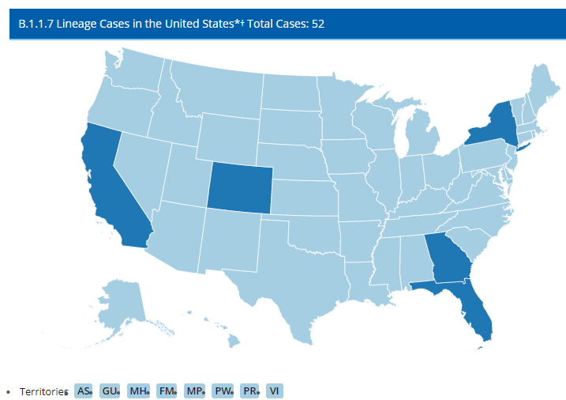
https://www.cdc.gov/coronavirus/2019-ncov/transmission/variant-cases.html

Slide 20
Vaccination Resources
https://www.cdc.gov/vaccines/covid-19/index.html
https://www.cdc.gov/vaccines/covid-19/info-by-product/clinical-considerations.html
https://www.cdc.gov/vaccines/hcp/acip-recs/vacc-specific/covid-19.html
https://www.cdc.gov/mmwr/volumes/69/wr/mm695152e2.htm?s_cid=mm695152e2_w

Slide 21
Questions?
Email : mdh.ipcovid@Maryland.gov

