Slide 1
Maryland Situation Update on
Coronavirus Disease (COVID-19) for BHA
Maryland Department of Health
Infectious Disease Epidemiology and Outbreak Response Bureau
January 22, 2021

Slide 2

Call Agenda
Picture Courtesy of NIAID-RML
Review current situation of COVID-19
Influenza Updates
Emerging Variants of Concern
Q and A

Slide 3
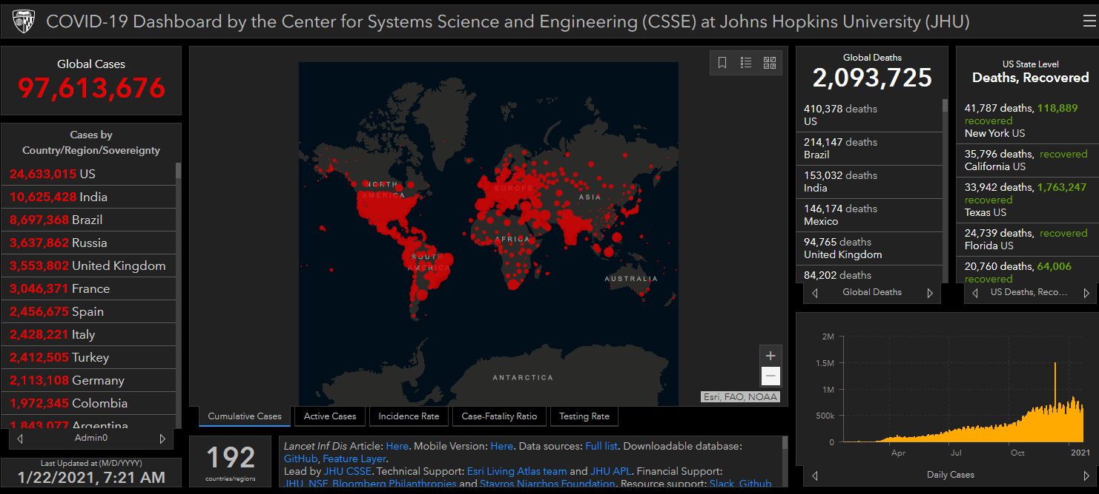
COVID-19 Global Situation Summary
https://gisanddata.maps.arcgis.com/apps/opsdashboard/index.html#/bda7594740fd40299423467b48e9ecf6

Slide 4
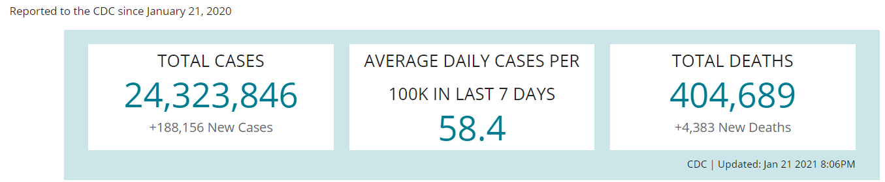
US Case Counts and Rates
https://www.cdc.gov/coronavirus/2019-ncov/cases-updates/cases-in-us.html Accessed 1/22/2021

Slide 5
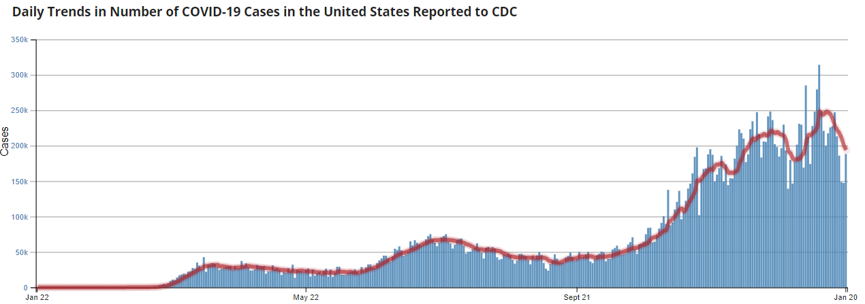
Number of Cases Reported in the USA, by Day
https://covid.cdc.gov/covid-data-tracker/#trends_dailytrendscases
Updated 1/22/2021

Slide 6
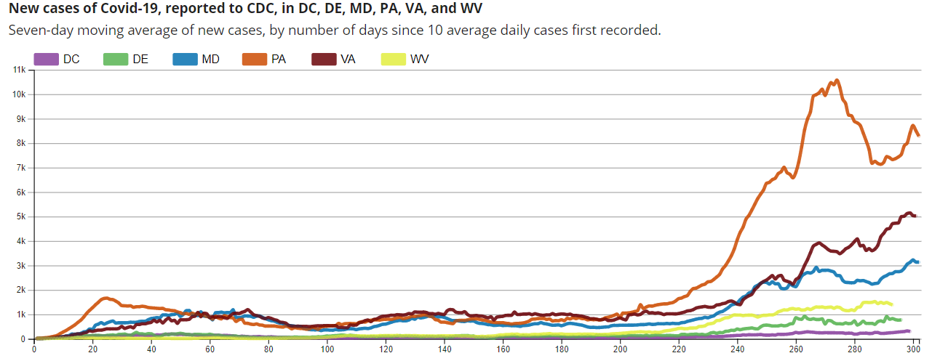
Regional Trends
https://covid.cdc.gov/covid-data-tracker/#compare-trends_newcases 1/15/2021

Slide 7
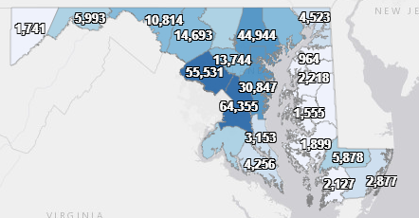
Maryland: COVID-19 Cases
http://health.maryland.gov/coronavirus
Data current as of 1/22/2021
Cases: 336,915
  2,396new
Deaths: 6,322
  57 new
Hospitalizations: 29,285
  Current: 1,768 ( down 44)
Total tests performed: 6,630,564
Case rate: 38.2 per 100,000

Slide 8
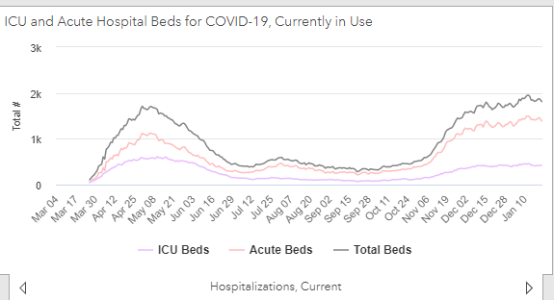
https://coronavirus.maryland.gov/ 1/22/2021

Slide 9
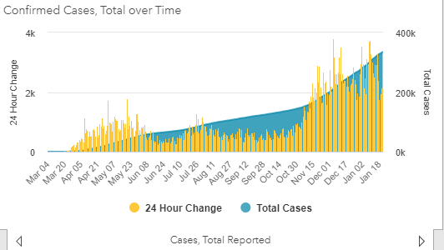
https://coronavirus.maryland.gov/ 1/22/2021

Slide 10
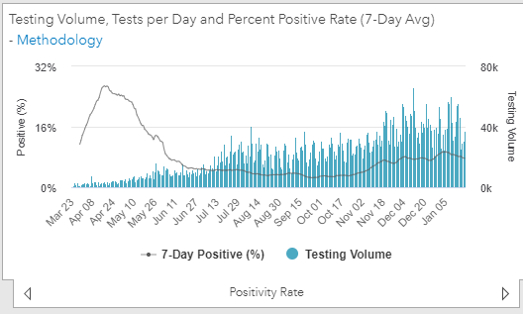
Testing Volume and % Positivity

Slide 11
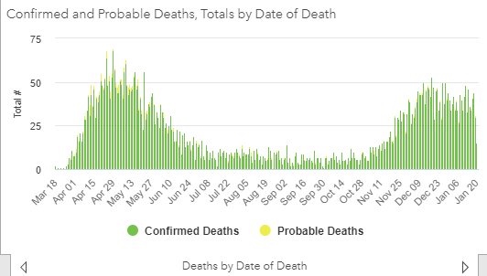

Slide 12
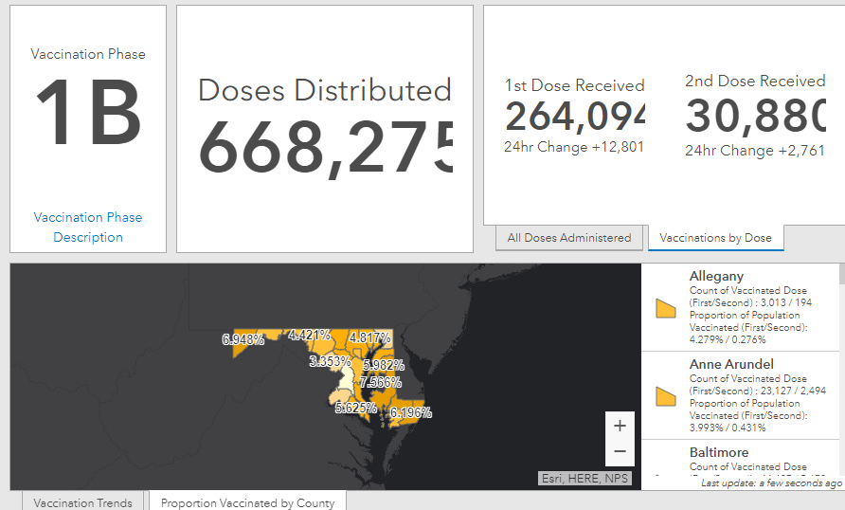
Maryland Vaccine Dashboard
https://coronavirus.maryland.gov/#Vaccine accessed January 22, 2021

Slide 13
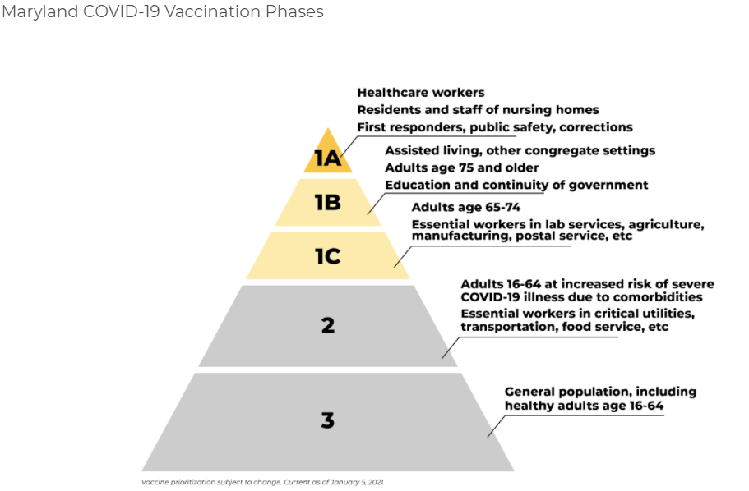
Maryland COVID-19 Vaccination Phases
Maryland will move into Phase 1C on Mon., Jan. 25

Slide 14
Maryland Influenza Epi Update
Week Ending January 15nd, 2021
Influenza-like illness (ILI) activity in Maryland was minimal

Slide 15
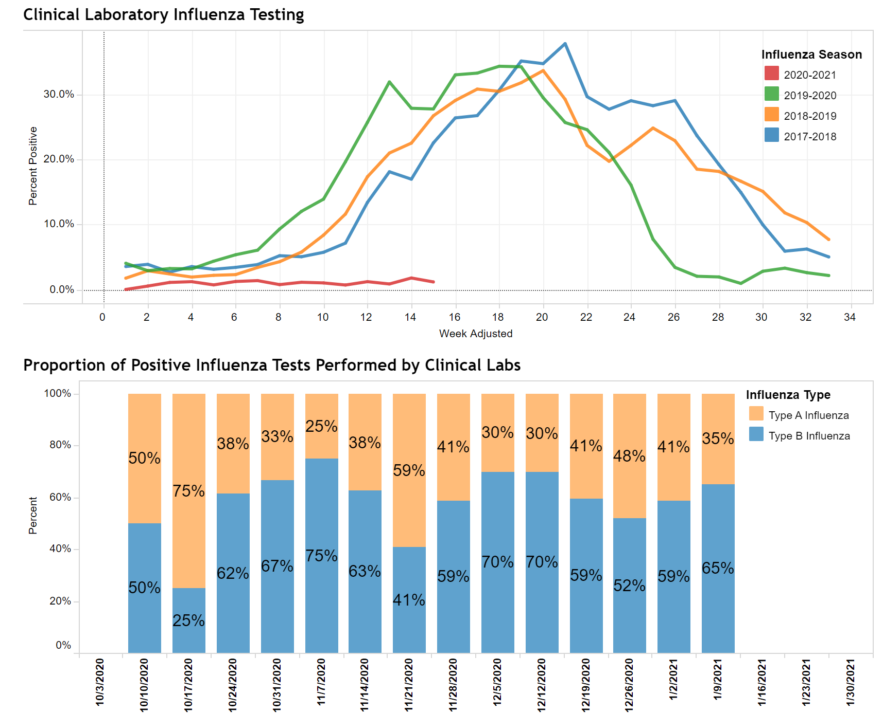
https://phpa.health.maryland.gov/influenza/Pages/flu-dashboard.aspx

Slide 16
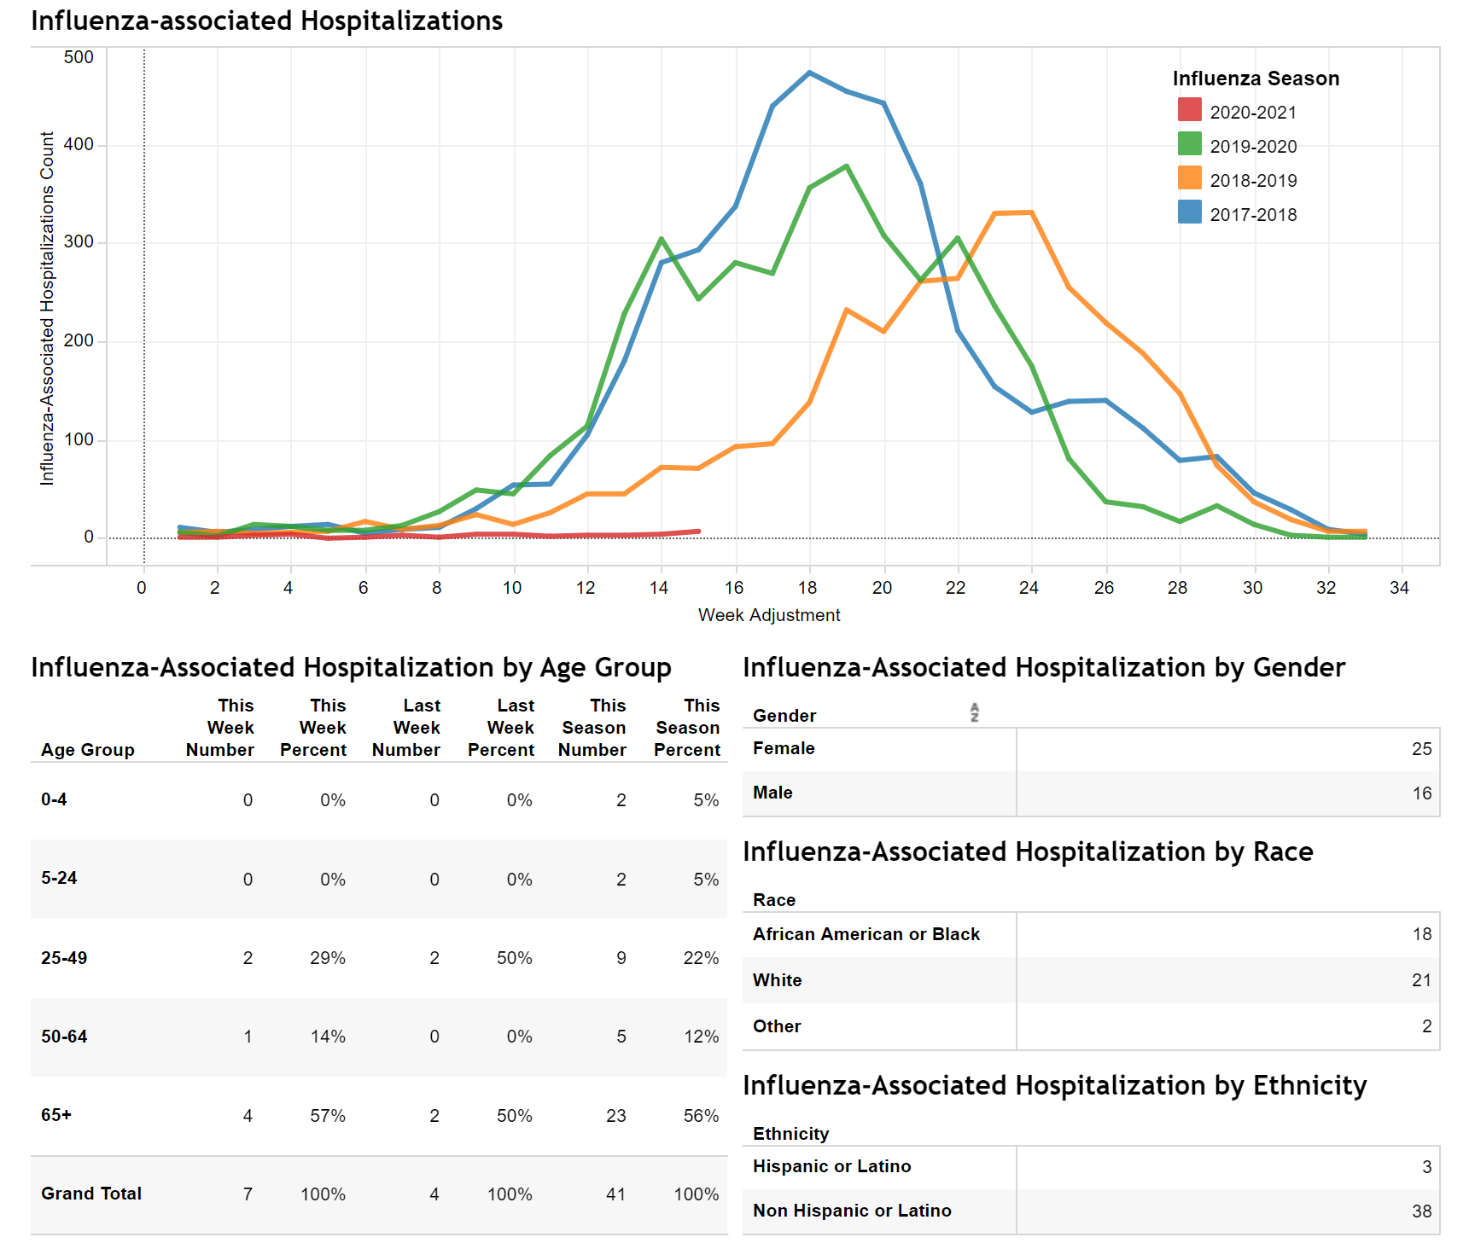
https://phpa.health.maryland.gov/influenza/Pages/flu-dashboard.aspx

Slide 17
SARS-CoV-2 Emerging Variants of Concern
Monique Duwell, MD, MPH
Chief, Center for Infectious Disease Surveillance and Outbreak Response

Slide 18
CDC: Variants of Concern
B.1.1.7 lineage
Emerged in United Kingdom, found in U.S. and many other countries
Associated with increase transmissibility
B.1.351 lineage
Emerged in South Africa
Some evidence that one mutation may affect neutralization by some polyclonal and monoclonal antibodies
P.1 lineage (a.k.a. 20J/501Y.V3)
First reported by Japan in four travelers from Brazil
Some evidence that some mutations may affect transmissibility and antigenic profile, which may affect the ability of antibodies generated through a previous natural infection or through vaccination to recognize and neutralize the virus.
Not yet identified in the U.S.
https://www.cdc.gov/coronavirus/2019-ncov/more/science-and-research/scientific-brief-emerging-variants.html, Accessed Jan. 19, 2021

Slide 19
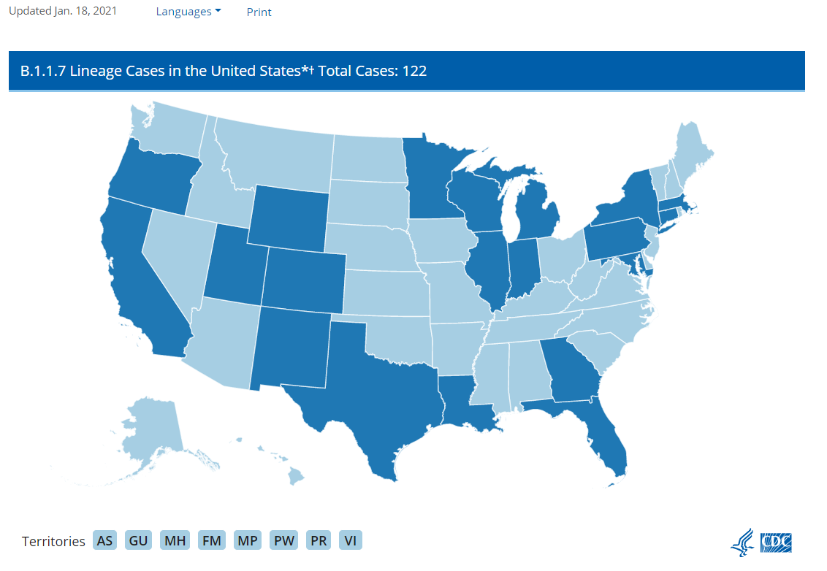
U.S.: COVID-19 Variant Cases
https://www.cdc.gov/coronavirus/2019-ncov/transmission/variant-cases.html, Accessed January 19, 2021
Notes:
The COVID-19-Associated Hospitalization Surveillance Network (COVID-NET) conducts population-based surveillance for laboratory-confirmed COVID-19-associated hospitalizations in select counties participating in the Emerging Infections Program (EIP) and the Influenza Hospitalization Surveillance Project (IHSP).
A total of 106,532 laboratory-confirmed COVID-19-associated hospitalizations were reported by sites between March 1, 2020 and December 26, 2020. The overall cumulative hospitalization rate was 326.7 per 100,000 population. The overall weekly hospitalization rate reached its highest point at 16.9 per 100,000 during the week ending December 5, 2020 (Week 49) and remains elevated. Rates in recent weeks have declined but these rates are likely to change as additional data are reported for those weeks.

Slide 20
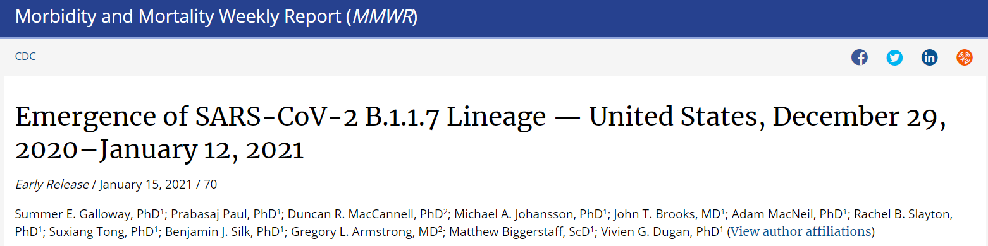
CDC MMWR: Emergence of SARS-CoV-2 B.1.17 Lineage
https://www.cdc.gov/mmwr/volumes/70/wr/mm7003e2.htm?s_cid=mm7003e2_w
Notes:
The COVID-19-Associated Hospitalization Surveillance Network (COVID-NET) conducts population-based surveillance for laboratory-confirmed COVID-19-associated hospitalizations in select counties participating in the Emerging Infections Program (EIP) and the Influenza Hospitalization Surveillance Project (IHSP).
A total of 106,532 laboratory-confirmed COVID-19-associated hospitalizations were reported by sites between March 1, 2020 and December 26, 2020. The overall cumulative hospitalization rate was 326.7 per 100,000 population. The overall weekly hospitalization rate reached its highest point at 16.9 per 100,000 during the week ending December 5, 2020 (Week 49) and remains elevated. Rates in recent weeks have declined but these rates are likely to change as additional data are reported for those weeks.

Slide 21
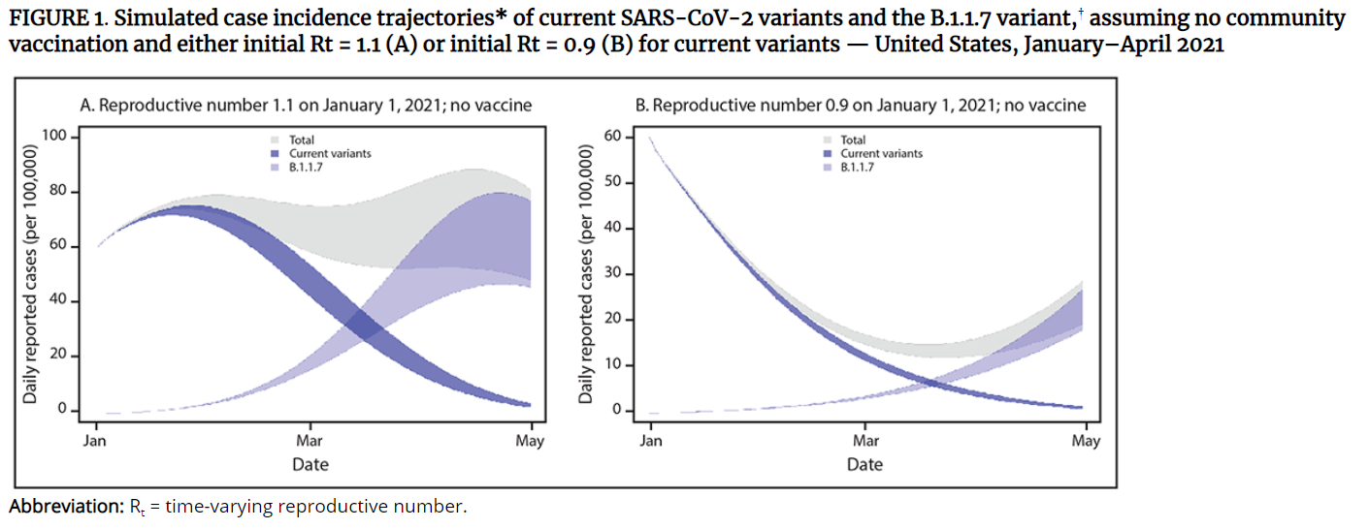
CDC MMWR: Emergence of SARS-CoV-2 B.1.17 Lineage
https://www.cdc.gov/mmwr/volumes/70/wr/mm7003e2.htm?s_cid=mm7003e2_w
Notes:
The COVID-19-Associated Hospitalization Surveillance Network (COVID-NET) conducts population-based surveillance for laboratory-confirmed COVID-19-associated hospitalizations in select counties participating in the Emerging Infections Program (EIP) and the Influenza Hospitalization Surveillance Project (IHSP).
A total of 106,532 laboratory-confirmed COVID-19-associated hospitalizations were reported by sites between March 1, 2020 and December 26, 2020. The overall cumulative hospitalization rate was 326.7 per 100,000 population. The overall weekly hospitalization rate reached its highest point at 16.9 per 100,000 during the week ending December 5, 2020 (Week 49) and remains elevated. Rates in recent weeks have declined but these rates are likely to change as additional data are reported for those weeks.

Slide 22
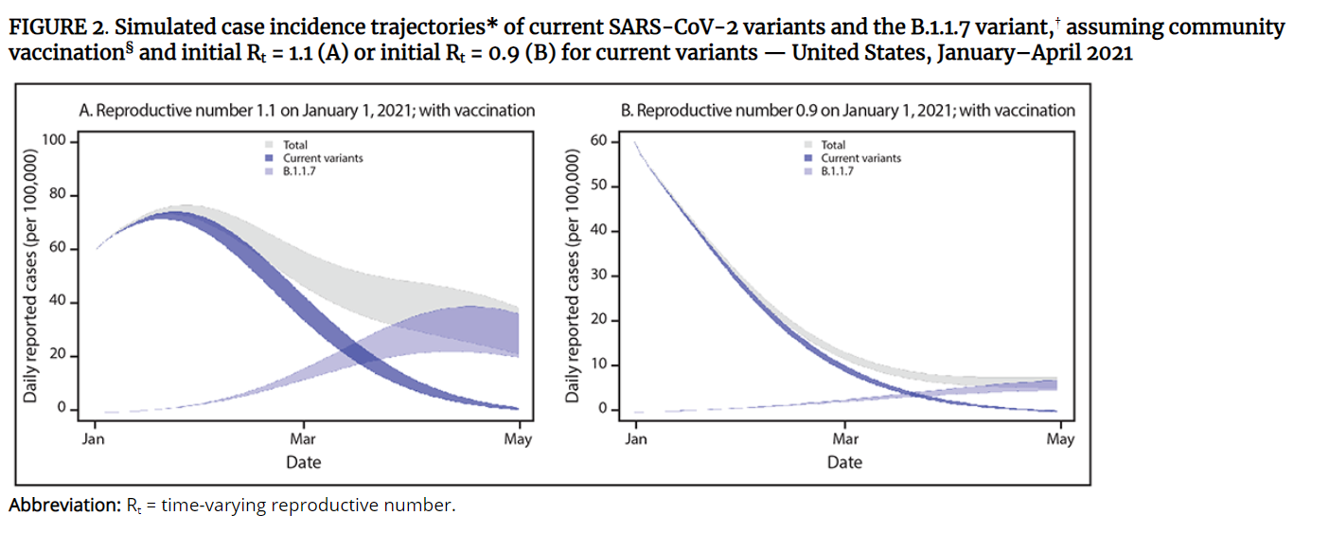
CDC MMWR: Emergence of SARS-CoV-2 B.1.17 Lineage
https://www.cdc.gov/mmwr/volumes/70/wr/mm7003e2.htm?s_cid=mm7003e2_w
Notes:
The COVID-19-Associated Hospitalization Surveillance Network (COVID-NET) conducts population-based surveillance for laboratory-confirmed COVID-19-associated hospitalizations in select counties participating in the Emerging Infections Program (EIP) and the Influenza Hospitalization Surveillance Project (IHSP).
A total of 106,532 laboratory-confirmed COVID-19-associated hospitalizations were reported by sites between March 1, 2020 and December 26, 2020. The overall cumulative hospitalization rate was 326.7 per 100,000 population. The overall weekly hospitalization rate reached its highest point at 16.9 per 100,000 during the week ending December 5, 2020 (Week 49) and remains elevated. Rates in recent weeks have declined but these rates are likely to change as additional data are reported for those weeks.

Slide 23
CDC MMWR: Emergence of SARS-CoV-2 B.1.17 Lineage
Model main findings:
B.1.1.7 prevalence is initially low, exhibits rapid growth in early 2021, and becomes the predominant variant in March.
  Whether transmission of current variants is increasing (initial R_{t} = 1.1) or slowly decreasing (initial R_{t} = 0.9) in January, B.1.1.7 drives a substantial change in the transmission trajectory and a new phase of exponential growth.
With vaccination, the early epidemic trajectories do not change and B.1.1.7 spread still occurs.
  However, after B.1.1.7 becomes the dominant variant, its transmission was substantially reduced.
  The effect of vaccination on reducing transmission in the near term was greatest in the scenario in which transmission was already decreasing (initial R_{t} = 0.9).
Early efforts that can limit the spread of the B.1.1.7 variant, such as universal and increased compliance with public health mitigation strategies, will allow more time for ongoing vaccination to achieve higher population-level immunity.
https://www.cdc.gov/mmwr/volumes/70/wr/mm7003e2.htm?s_cid=mm7003e2_w
Notes:
The COVID-19-Associated Hospitalization Surveillance Network (COVID-NET) conducts population-based surveillance for laboratory-confirmed COVID-19-associated hospitalizations in select counties participating in the Emerging Infections Program (EIP) and the Influenza Hospitalization Surveillance Project (IHSP).
A total of 106,532 laboratory-confirmed COVID-19-associated hospitalizations were reported by sites between March 1, 2020 and December 26, 2020. The overall cumulative hospitalization rate was 326.7 per 100,000 population. The overall weekly hospitalization rate reached its highest point at 16.9 per 100,000 during the week ending December 5, 2020 (Week 49) and remains elevated. Rates in recent weeks have declined but these rates are likely to change as additional data are reported for those weeks.

Slide 24
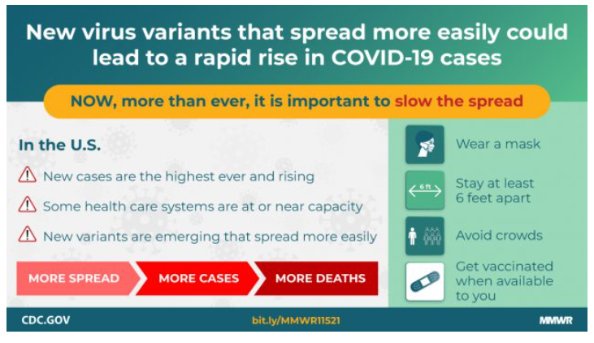
U.S.: COVID-19 Variant Cases
https://www.cdc.gov/mmwr/volumes/70/wr/mm7003e2.htm?s_cid=mm7003e2_w
Notes:
The COVID-19-Associated Hospitalization Surveillance Network (COVID-NET) conducts population-based surveillance for laboratory-confirmed COVID-19-associated hospitalizations in select counties participating in the Emerging Infections Program (EIP) and the Influenza Hospitalization Surveillance Project (IHSP).
A total of 106,532 laboratory-confirmed COVID-19-associated hospitalizations were reported by sites between March 1, 2020 and December 26, 2020. The overall cumulative hospitalization rate was 326.7 per 100,000 population. The overall weekly hospitalization rate reached its highest point at 16.9 per 100,000 during the week ending December 5, 2020 (Week 49) and remains elevated. Rates in recent weeks have declined but these rates are likely to change as additional data are reported for those weeks.

Slide 25

Questions?
Email : mdh.ipcovid@Maryland.gov

