Slide 1
Maryland Situation Update on
Coronavirus Disease (COVID-19) for BHA
Maryland Department of Health
Infectious Disease Epidemiology and Outbreak Response Bureau
November 6, 2020

Slide 2
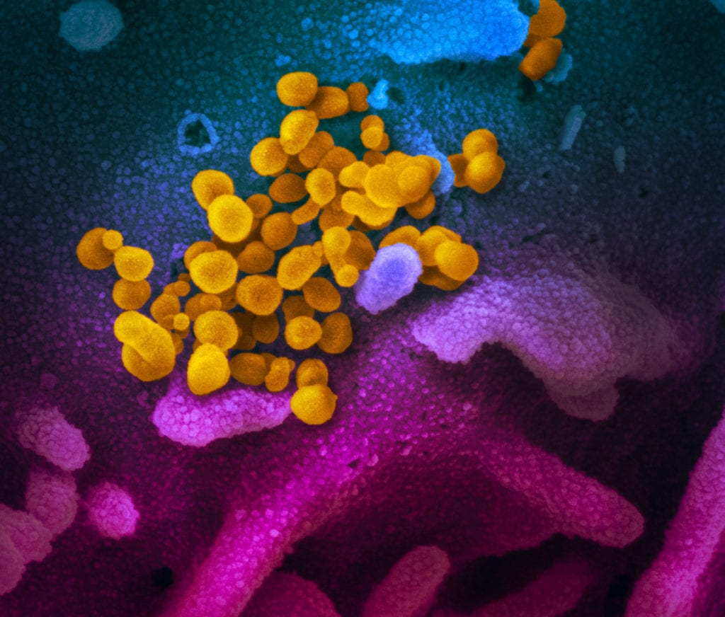
Call Agenda
Picture Courtesy of NIAID-RML
Review current situation of COVID-19
Maryland updates
CDC COVID Vaccine FAQs

Slide 3
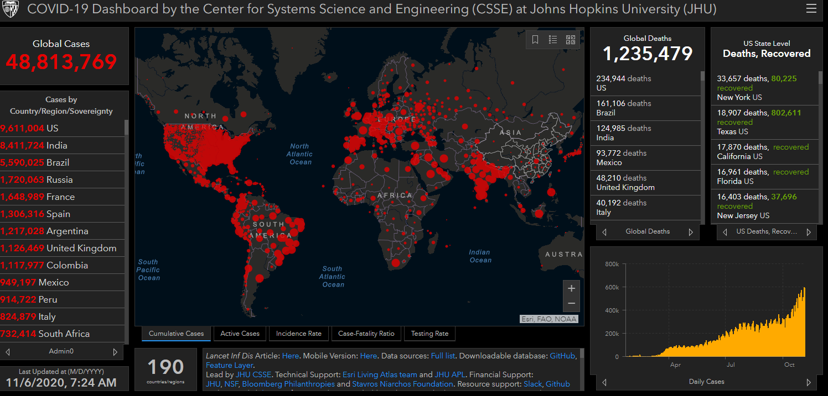
COVID-19 Global Situation Summary

Slide 4
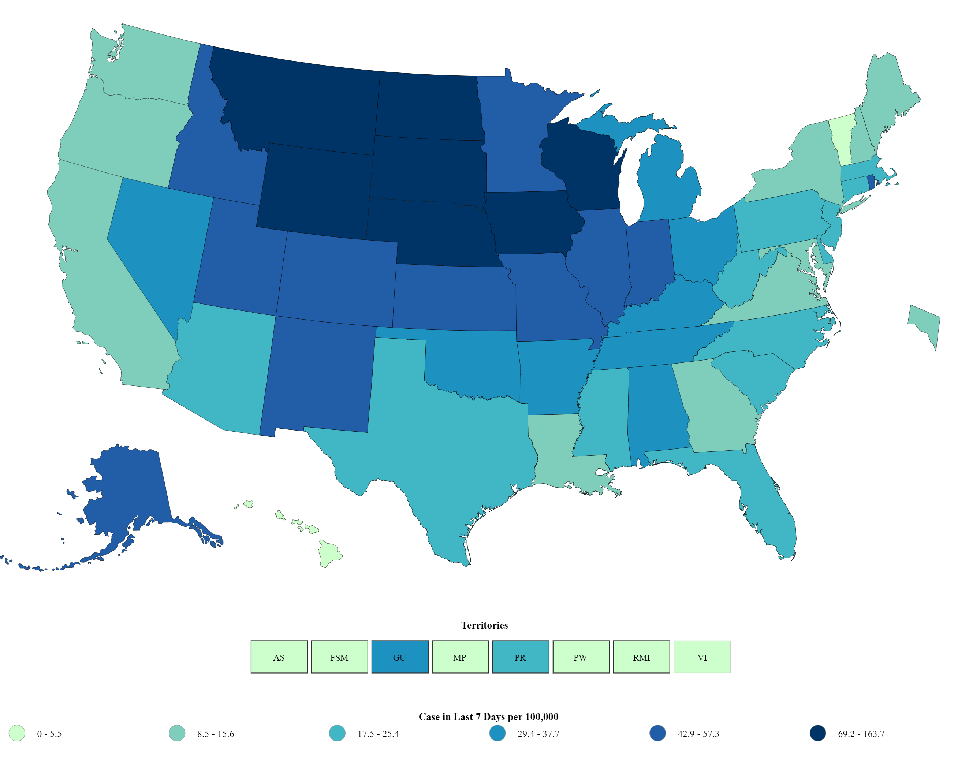
US: COVID-19 Case Rate per 100,000 in the last 7 days
Total Cases: 9,463,782
  New 106,537
Total Deaths: 233,129
  New 1,141
https://www.cdc.gov/coronavirus/2019-ncov/cases-updates/cases-in-us.html Accessed 11/6/2020

Slide 5
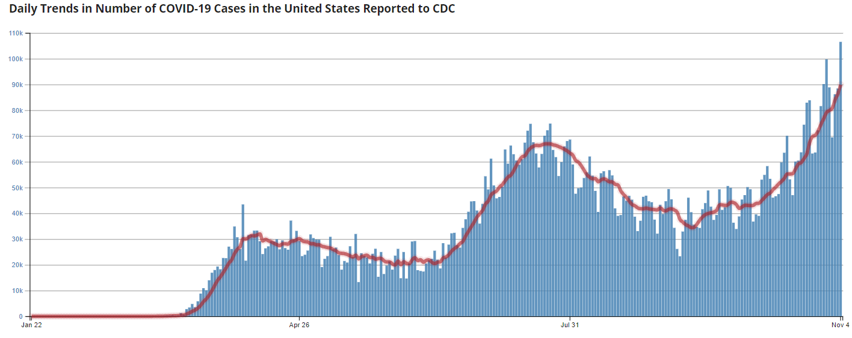
Number of Cases Reported in the USA, by Day

Slide 6
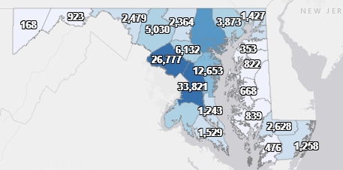
Maryland: COVID-19 Cases
http://health.maryland.gov/coronavirus
Data current as of 11/6/2020
Cases: 151,505
  1,541 new
Deaths: 4,046
  11 new
Hospitalizations: 17,537
  Current: 609
Total tests performed: 3,587,697
Case rate: 15.5 per 100,000

Slide 7
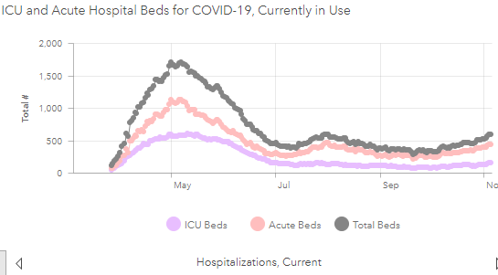
https://coronavirus.maryland.gov/ 11/6/2020

Slide 8
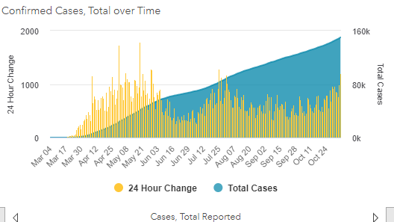

Slide 9
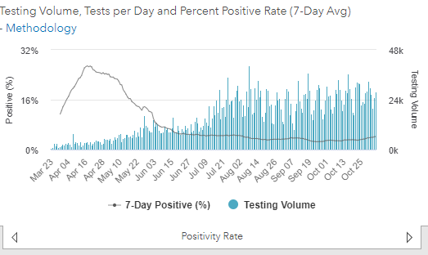
Testing Volume and % Positivity

Slide 10
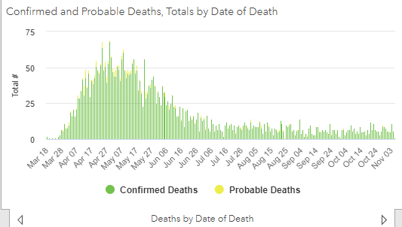
=

Slide 11
Press conference 11/5
No changes in restrictions
Continue to wear a mask and social distance

Slide 12
CDC COVID -19 Vaccine Myth Busters
Reminder: Deadline to sign up for pharmacy partnership in NHSN is tomorrow!
In the United States, there is not yet an authorized or approved vaccine to prevent coronavirus disease 2019 (COVID-19). With the possibility of a limited supply of one or more COVID-19 vaccines becoming available before the end of 2020, accurate vaccine information is critical.
FACT: COVID-19 vaccines will not give you COVID-19
FACT: COVID-19 vaccines will not cause you to test positive on COVID-19 viral tests
FACT: People who have gotten sick with COVID-19 may still benefit from getting vaccinated
FACT: Getting vaccinated can help prevent getting sick with COVID-19
https://www.cdc.gov/coronavirus/2019-ncov/vaccines/about-vaccines/vaccine-myths.html

Slide 13
Questions?
Email : mdh.ipcovid@Maryland.gov

