Slide 1
Maryland Situation Update on Coronavirus Disease (COVID-19) for BHA
Maryland Department of Health
Infectious Disease Epidemiology and Outbreak Response Bureau
November 20, 2020

Slide 2
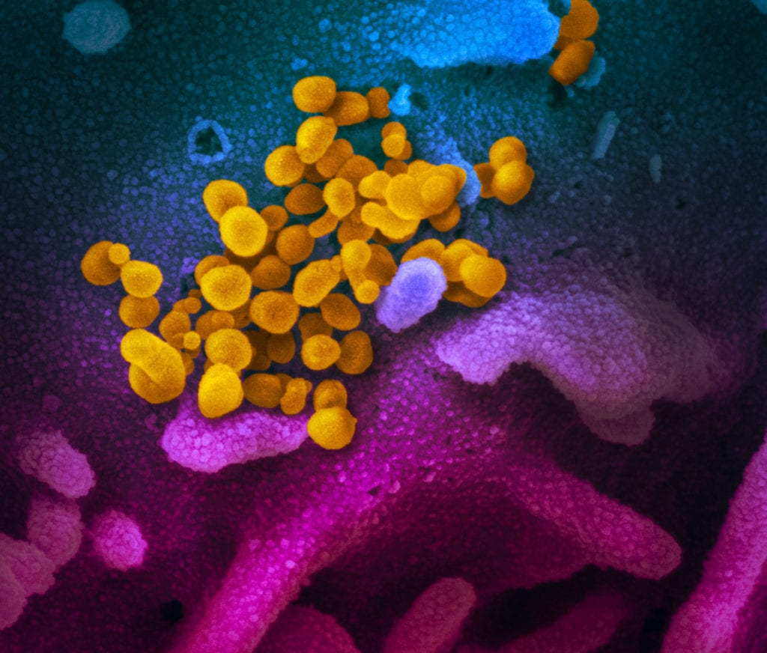
Call Agenda
Picture Courtesy of NIAID-RML
Review current situation of COVID-19
CDC Quarantine Update
MDH Quarantine Guidance
Q and A

Slide 3
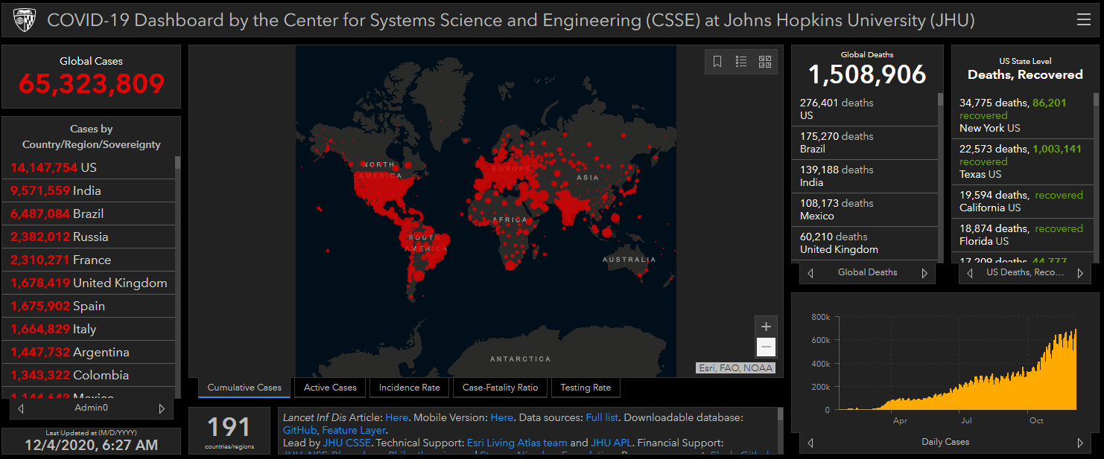
COVID-19 Global Situation Summary

Slide 4
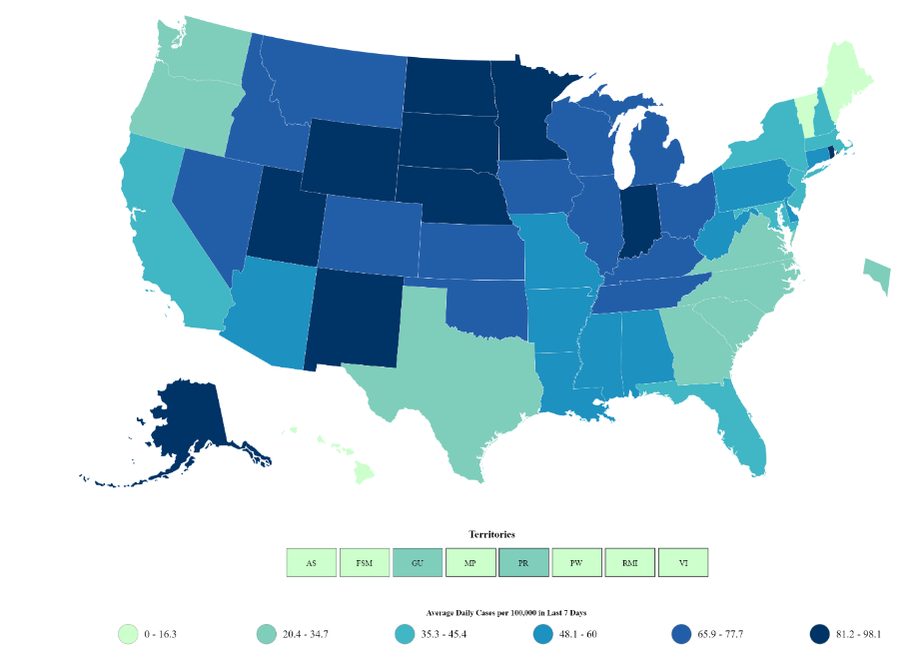
US: COVID-19 Case Rate per 100,000 in the last 7 days
Total Cases: 13,822,249
New 196,227
Total Deaths: 272,525
New 2,762
Cases in the last 7 days per 100,000: 49.9
https://www.cdc.gov/coronavirus/2019-ncov/cases-updates/cases-in-us.html Accessed 12/4/2020

Slide 5
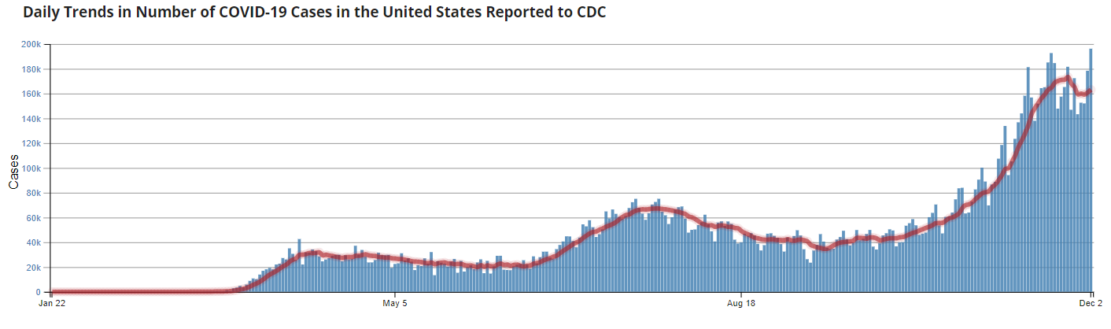
Number of Cases Reported in the USA, by Day

Slide 6
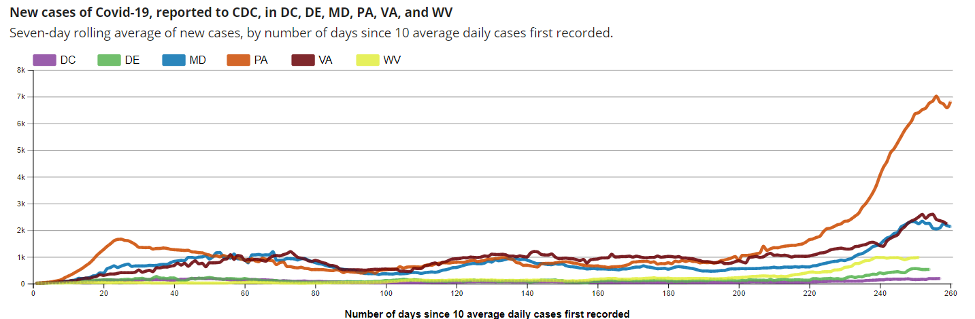
Regional Trends

Slide 7
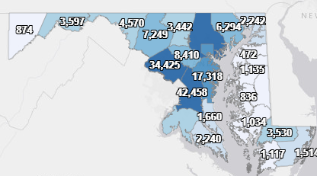
Maryland: COVID-19 Cases
http://health.maryland.gov/coronavirus
Data current as of 12/4/2020
Cases: 209,191
3,792 new
Deaths: 4,630
24 new
Hospitalizations: 21,756
Current: 1,594 ( up 21)
Total tests performed: 4,583,228
Case rate: 35.3 per 100,000

Slide 8
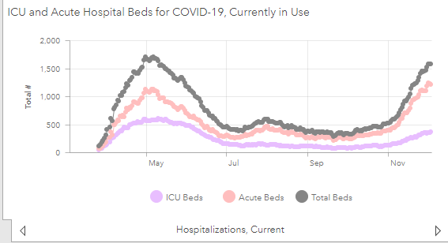
https://coronavirus.maryland.gov/ 12/3/2020

Slide 9
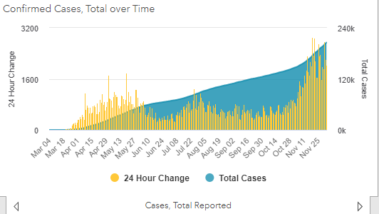

Slide 10
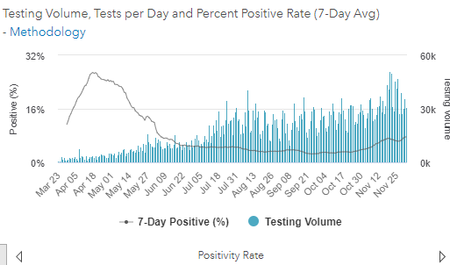
Testing Volume and % Positivity

Slide 11
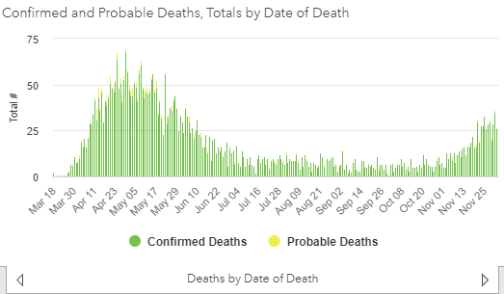

Slide 12
Maryland Updates

Slide 13
Newly Released Amended Orders and Advisories
Tuesday, December 1st, MDH released several amended orders, advisories, and letters, including:
Amended Various Healthcare Matters Orders
MDH Notice to Hospitals/Nursing Homes
Governor Letter to Nursing Programs
https://coronavirus.maryland.gov/pages/cdc-resources

Slide 14
Topics Covered in New Advisory/Orders
Additional orders/directives on surge capacity planning for hospitals
Advisory to hospitals and nursing homes that they should use the Maryland Board of Nursing’s March 2020 flexibilities to use unlicensed individuals as health care extenders and to perform nursing support tasks with appropriate training and supervision.
Recommends cancelling non-essential time off for staff through January 31, 2021 and that hospitals look at addressing staff barriers to work

Slide 15
Resident Quarantine Guidance

Slide 16
CDC Amended Quarantine Guidance
Amended guidance on 12/1 reduces traditional quarantine period
2 alternative options offered
Quarantine can end after Day 10 without testing and if no symptoms have been reported during daily monitoring.
Quarantine can end after Day 7 if a diagnostic specimen test is negative and if no symptoms were reported during daily monitoring. The specimen may be collected and tested within 48 hours before the time of planned quarantine discontinuation but quarantine cannot be discontinued earlier than after Day 7.
Options to Reduce Quarantine for Contacts of Persons with SARS-CoV-2 Infection Using Symptom Monitoring and Diagnostic Testing | CDC

Slide 17
MDH Quarantine Guidance: General Population
After Day 7 with a Negative Test: When diagnostic testing resources are sufficient and available, quarantine can end after Day 7:
If no symptoms were reported during daily monitoring; AND
If a diagnostic specimen tests negative.
Note: The specimen may be collected and tested within 48 hours before the time of planned quarantine discontinuation, but quarantine cannot be discontinued earlier than after Day 7. Therefore, the specimen must be collected on or after Day 5.
After Day 10 Without a Test: Quarantine can end after Day 10 without testing if no symptoms have been reported during daily monitoring.
When people meet these criteria and end quarantine early, these individuals must continue symptoms monitoring and meticulous mask use through day 14.

Slide 18
MDH Quarantine Guidance: SNF and AL Residents
Given the increased consequences of unidentified COVID being transmitted within the facility, quarantine of asymptomatic newly admitted residents and asymptomatic residents in observation/quarantine units because of potential exposures to COVID can:
End after 10 days if:
a diagnostic specimen (PCR or Antigen) collected on or after Day 10, tests negative
AND if no symptoms were reported during daily monitoring.
If a resident in observation/quarantine does not have a negative test collected on or after Day 10, that resident should remain in observation/quarantine for the full 14-day period.

Slide 19
Questions?
Email : mdh.ipcovid@Maryland.gov

