Slide 1
Maryland Situation Update on
Coronavirus Disease (COVID-19) for BHA
Maryland Department of Health
Infectious Disease Epidemiology and Outbreak Response Bureau
November 13, 2020

Slide 2
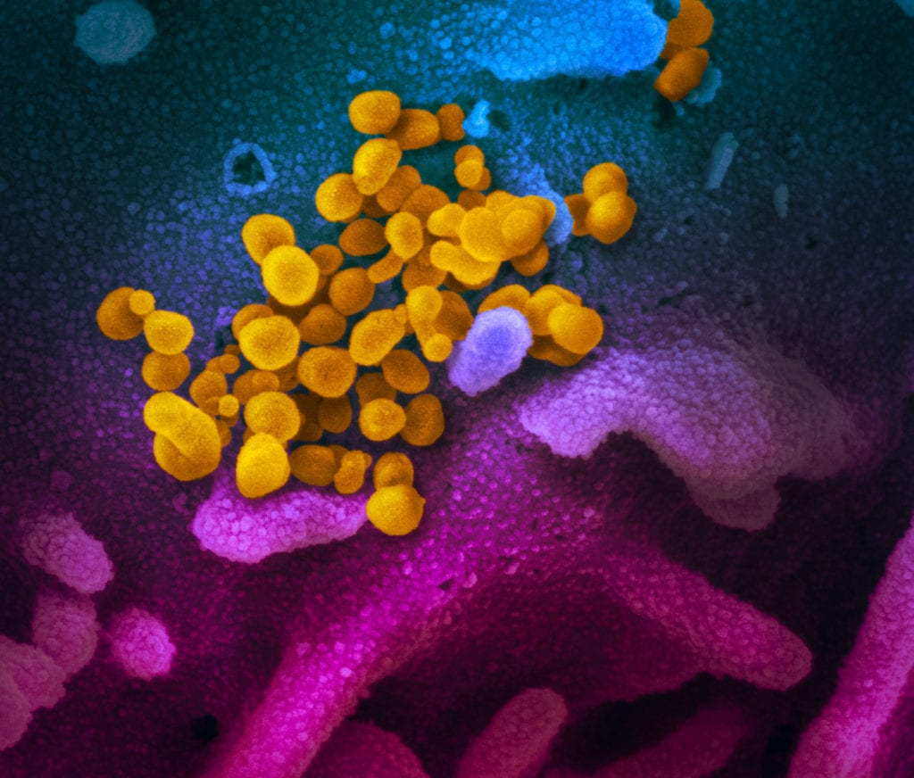
Call Agenda
Picture Courtesy of NIAID-RML
Review current situation of COVID-19
Maryland updates
COVID and Psychiatric Disorders

Slide 3
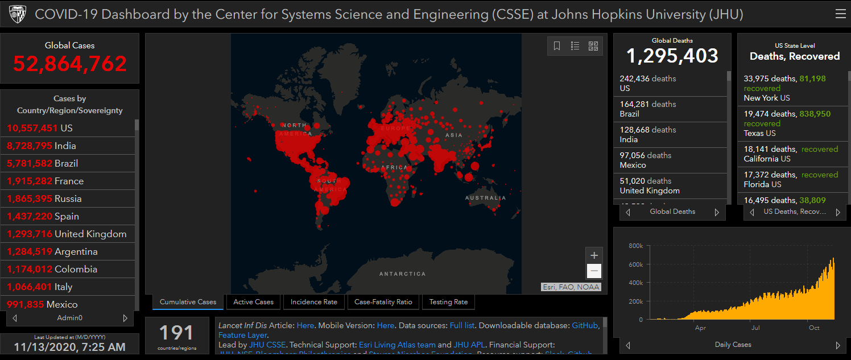
COVID-19 Global Situation Summary

Slide 4
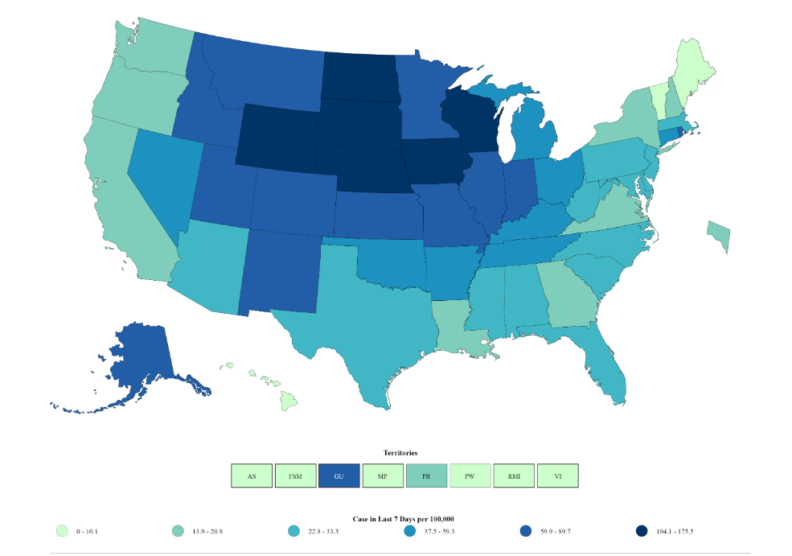
US: COVID-19 Case Rate per 100,000 in the last 7 days
Total Cases: 10,314,254
  New 143,408
Total Deaths: 241,069
  New 1,479
https://www.cdc.gov/coronavirus/2019-ncov/cases-updates/cases-in-us.html Accessed 11/13/2020

Slide 5
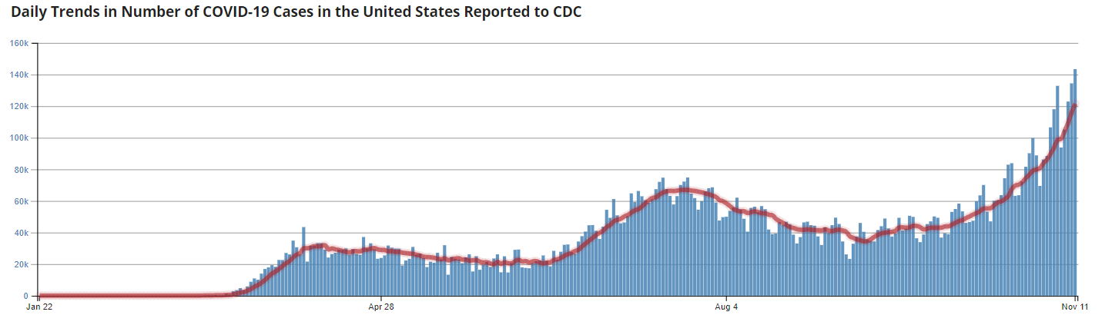
Number of Cases Reported in the USA, by Day

Slide 6
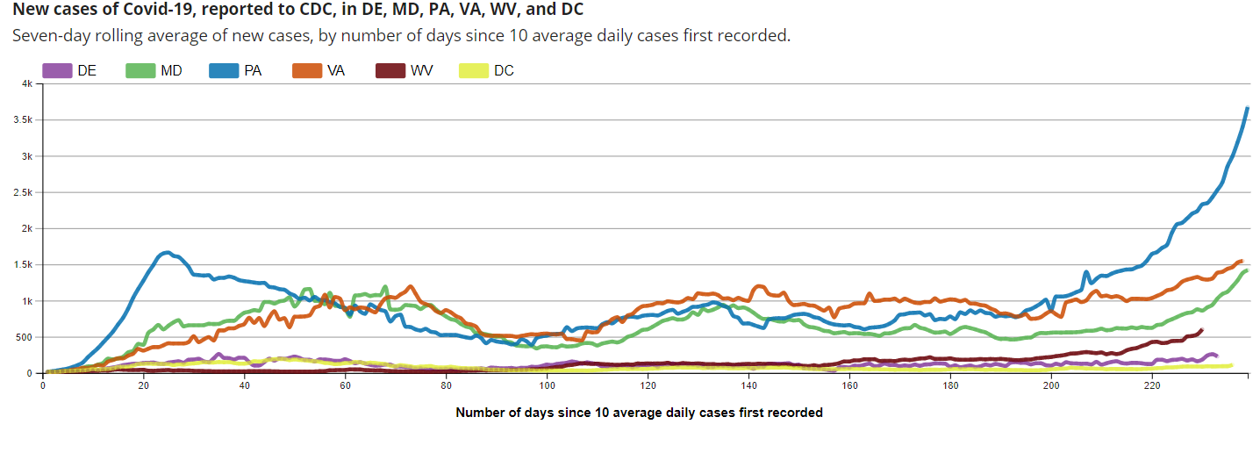
Regional Trends

Slide 7
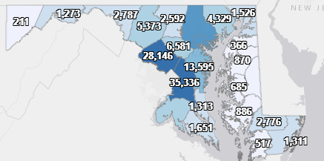
Maryland: COVID-19 Cases
http://health.maryland.gov/coronavirus
Data current as of 11/13/2020
Cases: 151,769
  1,869 new
Deaths: 4,124
  12 new
Hospitalizations: 18,281
  Current: 914 ( up 51)
Total tests performed: 3,793,532
Case rate: 23.5 per 100,000

Slide 8
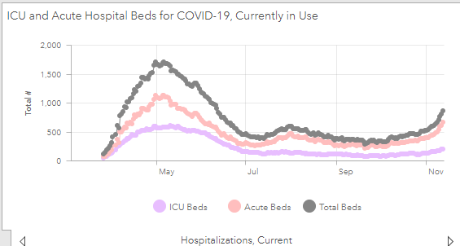
https://coronavirus.maryland.gov/ 11/6/2020

Slide 9
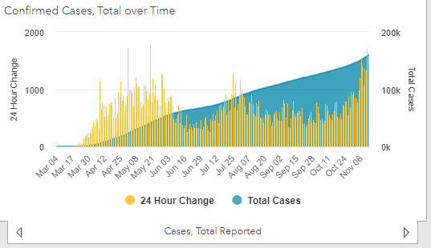

Slide 10
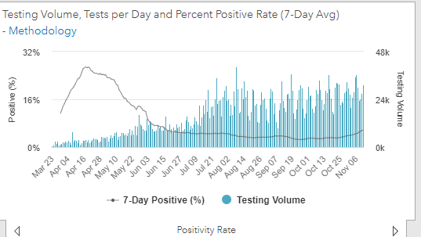
Testing Volume and % Positivity

Slide 11
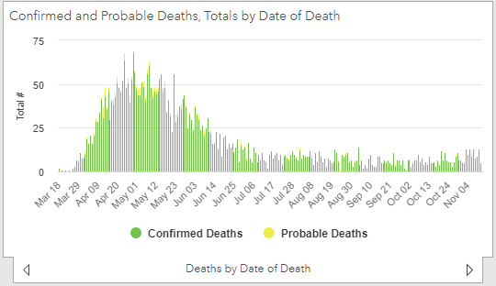
=

Slide 12
Maryland Updates

Slide 13
Amended Orders 11/10
Restaurant capacity reduced from 75% to 50%
Indoor gathering should be limited to less than 25 people
Limit out of state travel to essential purposes
  Quarantine and get tested after returning
Elective admissions that are likely to require prolonged ICU stay, artificial ventilation, or post hospital care in a SNF should be avoided
Hospitals should activate pandemic plans when they reach 85% staffed bed capacity, including triaging patients and (with the informed consent of the patient), move patients to appropriate settings

Slide 14
Amended Orders 11/10 Continued
When an outbreak occurs in a nursing home, a nursing home shall coordinate with hospital(s) located in the nursing home’s corresponding MIEMSS region to ensure adequate staffing support from the hospital, including direct clinical care, and infection control technical assistance where appropriate to ensure adequate continued care and infection control; such support may include the provision of a certified infection control (CIC) professional to the nursing home. When contacted, a hospital shall render all assistance possible.
All nursing homes shall establish at least one mutual aid arrangement with another nursing home facility to ensure continuity of operations, to include ensuring adequate staffing support.

Slide 15
COVID and Psychiatric Disorders

Slide 16
Bidirectional Associations Between COVID-19 and Psychiatric Disorder
Looked at 62,354 COVID-19 Cases
In patients with no previous psychiatric history, a diagnosis of COVID-19 was associated with increased incidence of a first psychiatric diagnosis in the following 14 to 90 days:
  anxiety disorders, insomnia, and dementia
A psychiatric diagnosis in the previous year was associated with a higher incidence of COVID-19 diagnosis
Survivors of COVID-19 appear to be at increased risk of psychiatric sequelae, and a psychiatric diagnosis might be an independent risk factor for COVID-19
https://www.thelancet.com/journals/lanpsy/article/PIIS2215-0366(20)30462-4/fulltext

Slide 17
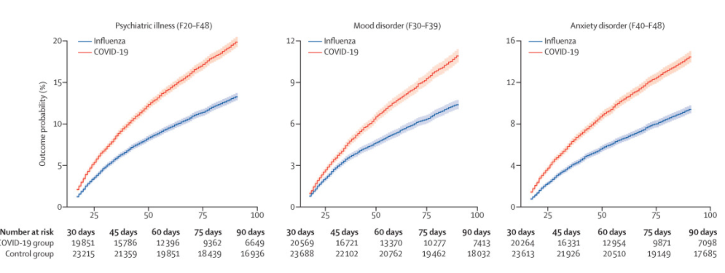
Probability of First or Recurrent Psychiatric Diagnosis (COVID-19 compared with influenza)

Slide 18
Psychiatric history as a risk factor for COVID-19 Infection
We did not anticipate that psychiatric history would be an independent risk factor for COVID-19.
This finding appears robust, being observed in all age strata and in both sexes, and was substantial—a 1·65 times excess.
This result was not related to any specific psychiatric diagnostic category, and was similar regardless of whether the diagnosis was made within 1 or 3 years, and whether or not the known physical risk factors for COVID-19 were present.
Possible explanations for the association include behavioural factors (eg, less adherence to social distancing recommendations) and residual socioeconomic and lifestyle factors (eg, smoking) that are not sufficiently captured by the available data in any of the studies.
It could also be that vulnerability to COVID-19 is increased by the pro-inflammatory state postulated to occur in some forms of psychiatric disorder or be related to psychotropic medication.

Slide 19
Questions?
Email : mdh.ipcovid@Maryland.gov

