Slide 1
Maryland Situation Update on Coronavirus Disease (COVID-19) for BHA
Maryland Department of Health
Infectious Disease Epidemiology and Outbreak Response Bureau
October 8, 2020

Slide 2
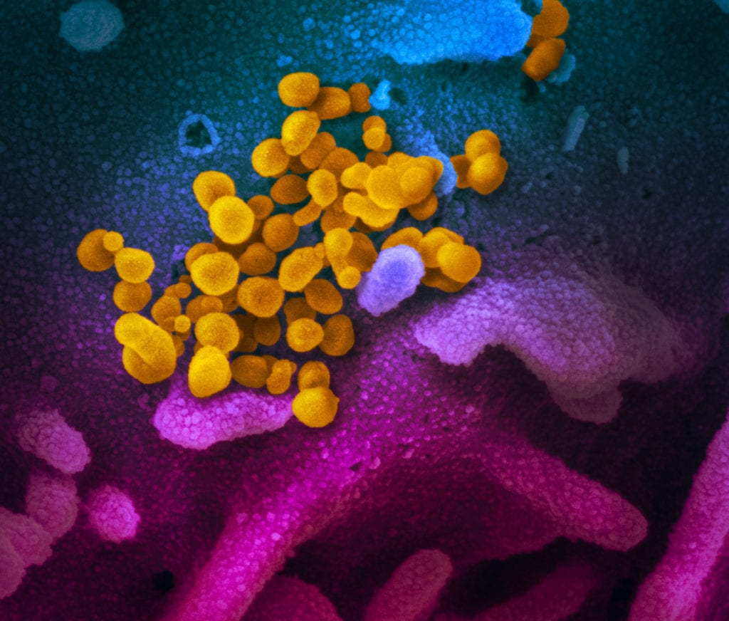
Call Agenda
Picture Courtesy of NIAID-RML
Review current situation of COVID-19
Airborne transmission
Transmission from young people

Slide 3
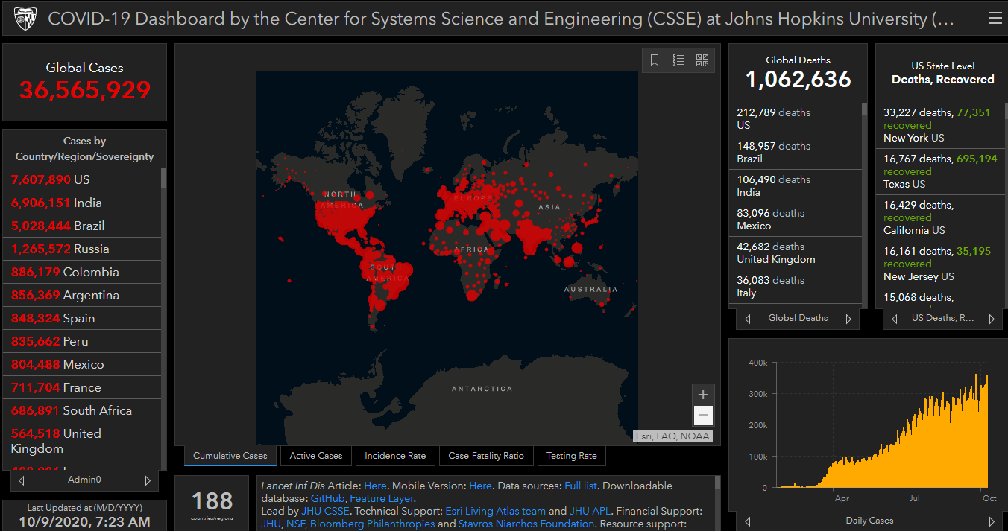
COVID-19 Global Situation Summary

Slide 4
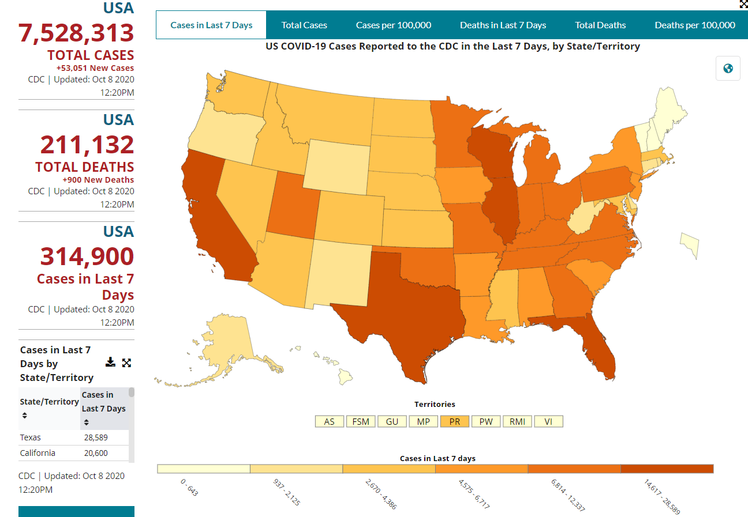
U.S.: COVID-19 Cases
https://www.cdc.gov/coronavirus/2019-ncov/cases-updates/cases-in-us.html Accessed 10/8/2020

Slide 5
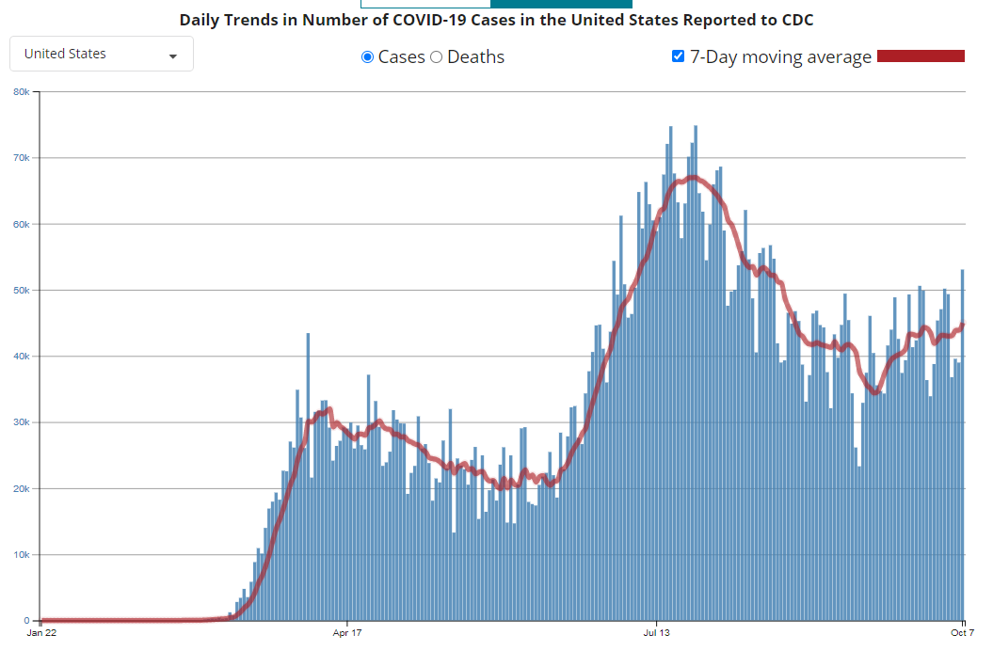
Number of Cases Reported in the USA, by Day

Slide 6
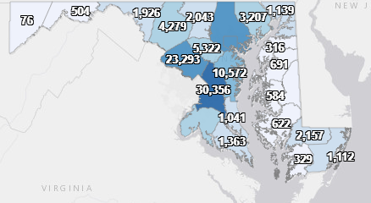
Maryland: COVID-19 Cases
http://health.maryland.gov/coronavirus
Data current as of 10/8/2020
Cases: 130,159
734 new
Deaths: 3,845
10 new
Hospitalizations: 15,768
Current: 391
Total tests 2,829,423

Slide 7
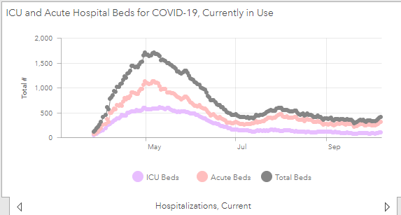

Slide 8
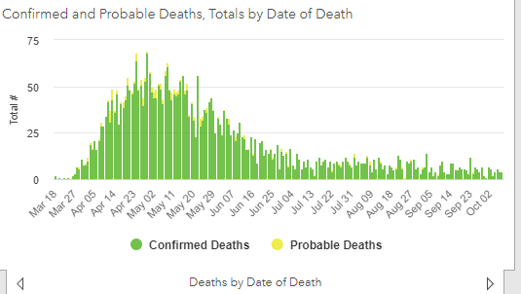

Slide 9
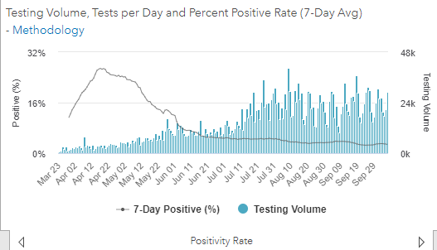
Testing Volume and % Positivity

Slide 10
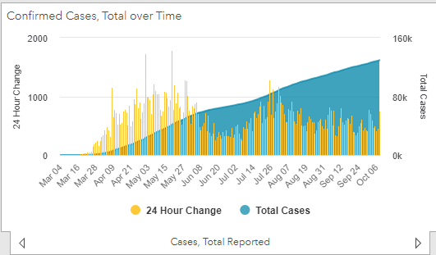

Slide 11
CDC Updates on the Transmission of COVID-19

Slide 12
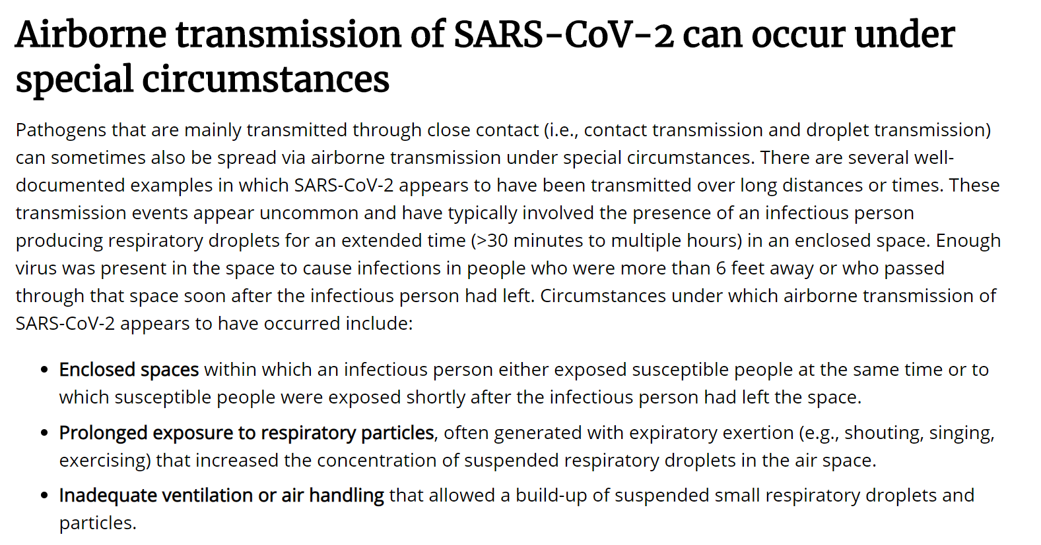
UPDATE: CDC Guidance on Airborne Transmission
Source: https://www.cdc.gov/coronavirus/2019-ncov/more/scientific-brief-sars-cov-2.html, Accessed 10/6/2020

Slide 13
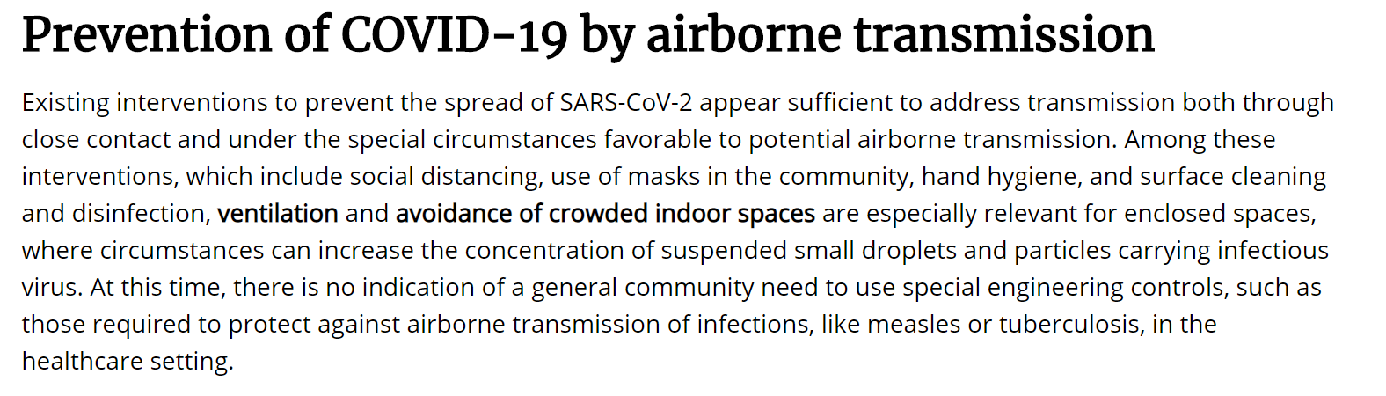
UPDATE: CDC Guidance on Airborne Transmission
Source: https://www.cdc.gov/coronavirus/2019-ncov/more/scientific-brief-sars-cov-2.html, Accessed 10/6/2020

Slide 14
Adolescent with COVID as the source of an outbreak

Slide 15
Roll of young people in COVID transmission
Increasing evidence that children and adolescents can efficiently transmit SARS-CoV2
Case study of a very mildly ill 13 year old (nasal congestion only)
Stayed in a house with 14 family members
No masks
No physical distancing
12 family members from the house got infected
6 relatives who visited outdoors did not get infected
https://www.cdc.gov/mmwr/volumes/69/wr/mm6940e2.htm?s_cid=mm6940e2_w

Slide 16
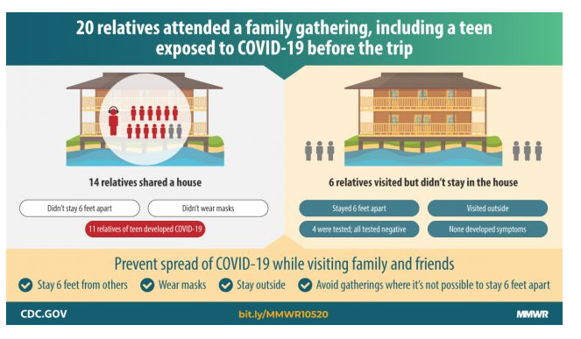

Slide 17
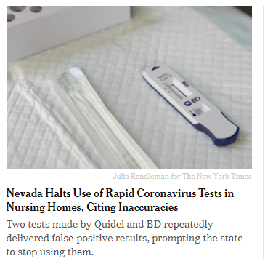
False Positivity of Point of Care Antigen testing
What might be going on here?
User error
Off-label use of the tests for asymptomatic screening really does have poor specificity
Why are false positives bad
May cause inappropriate cohorting (putting someone who is really COVID-19 negative in a unit or room with someone who is COVID +)
False sense of security
Not quarantining someone who needs to be quarantined
https://www.nytimes.com/2020/10/07/health/nevada-covid-testing-nursing-homes.html?surface=home-discovery-vi-prg&fellback=false&req_id=89239411

Slide 18
Questions?
Email : mdh.ipcovid@Maryland.gov

