Slide 1
Maryland Situation Update on Coronavirus Disease (COVID-19) for BHA
Maryland Department of Health
Infectious Disease Epidemiology and Outbreak Response Bureau
October 30, 2020

Slide 2
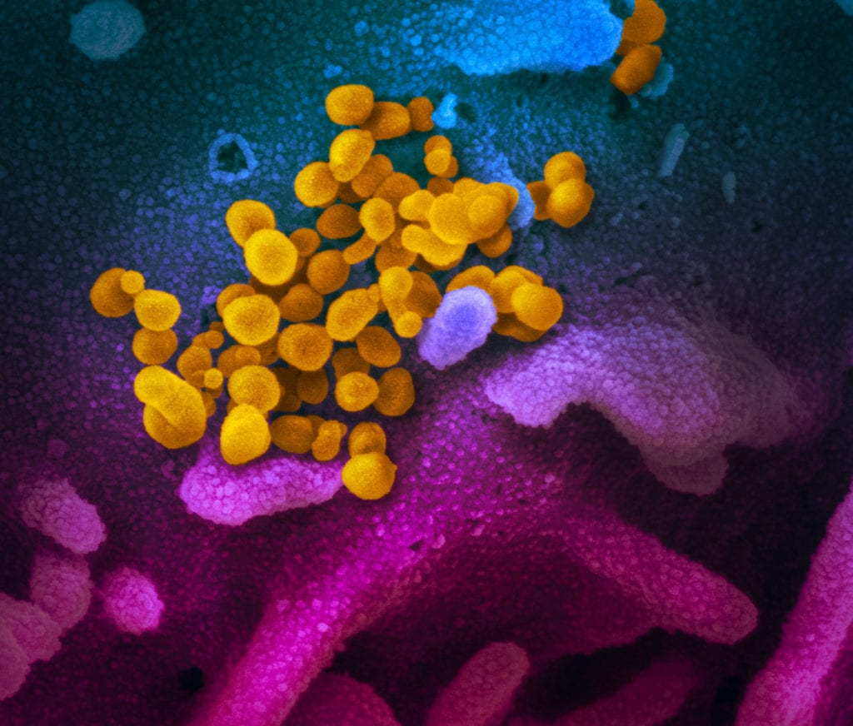
Call Agenda
Picture Courtesy of NIAID-RML
Review current situation of COVID-19
Hospitalizations in HCP
Holiday Celebrations

Slide 3
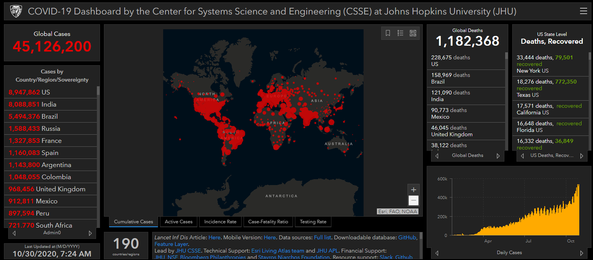
COVID-19 Global Situation Summary

Slide 4
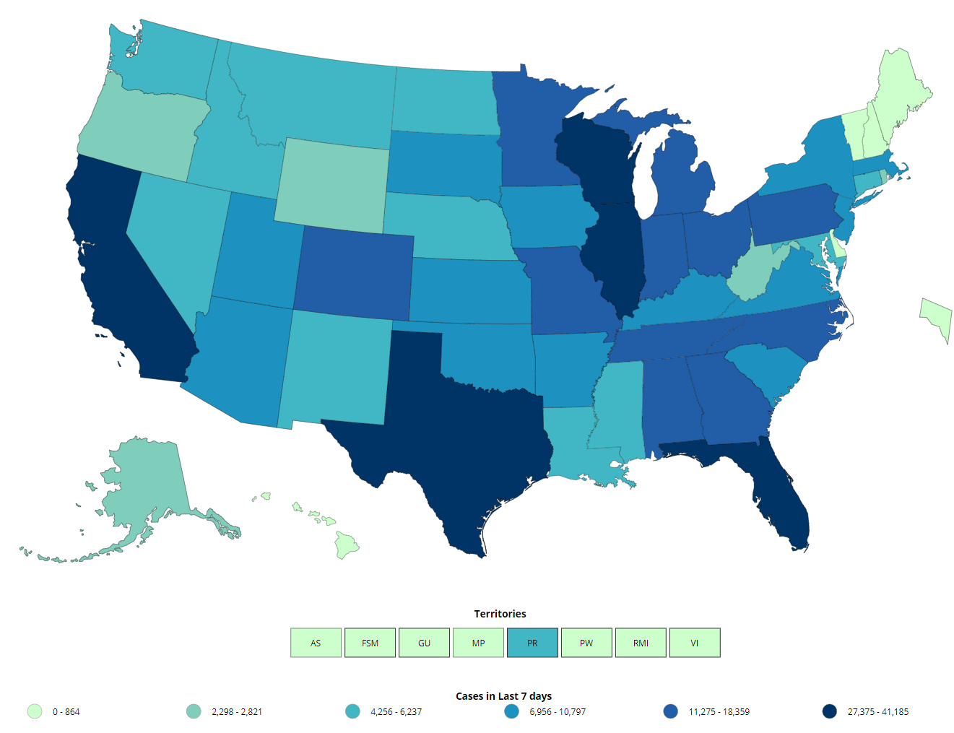
US: COVID-19 Case Rate per 100,000 in the last 7 days
Total Cases: 8,834,393
New 81,599
Total Deaths: 227,045
New 1,060
https://www.cdc.gov/coronavirus/2019-ncov/cases-updates/cases-in-us.html Accessed 10/30/2020

Slide 5
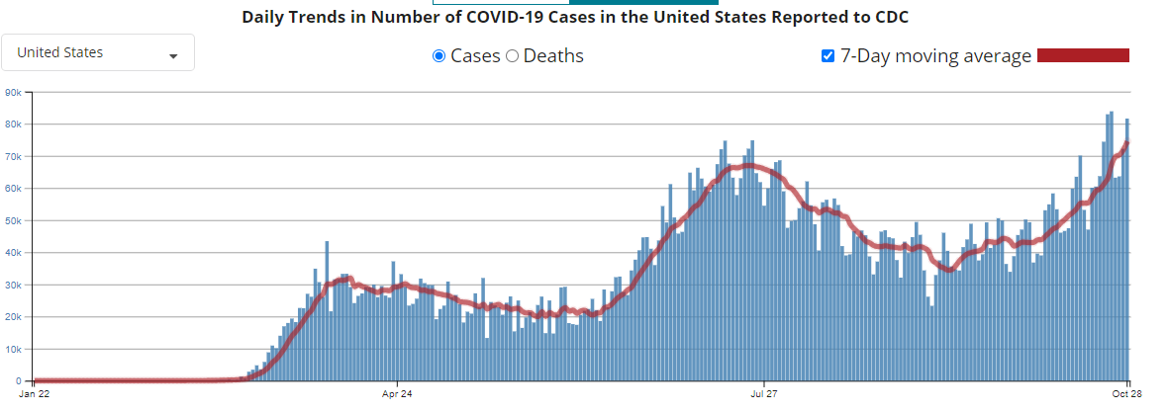
Number of Cases Reported in the USA, by Day

Slide 6
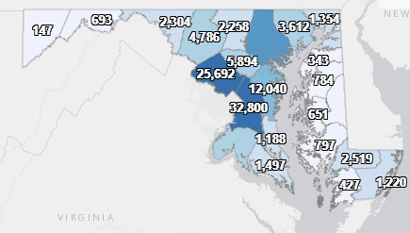
Maryland: COVID-19 Cases
http://health.maryland.gov/coronavirus
Data current as of 10/30/2020
Cases: 144,314
927 new
Deaths: 3,990
10 new
Hospitalizations: 17,023
Current: 513
Total tests performed: 3,389,678
Case rate: 12.8 per 100,000

Slide 7
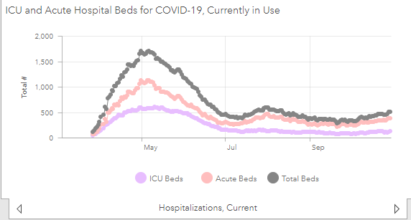
https://coronavirus.maryland.gov/ 10/30/2020

Slide 8
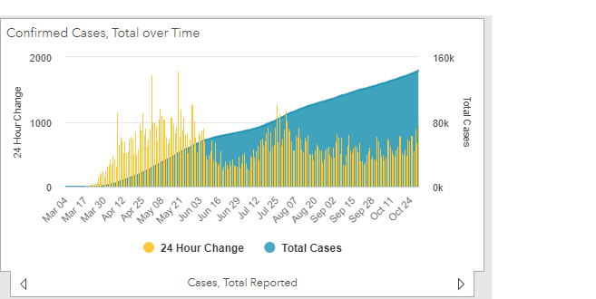

Slide 9
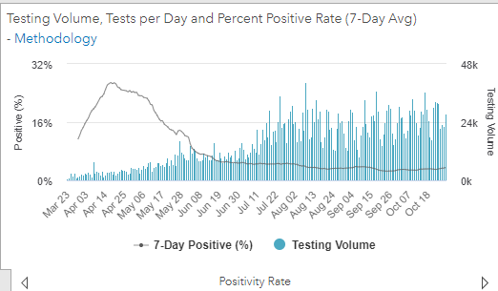
Testing Volume and % Positivity

Slide 10
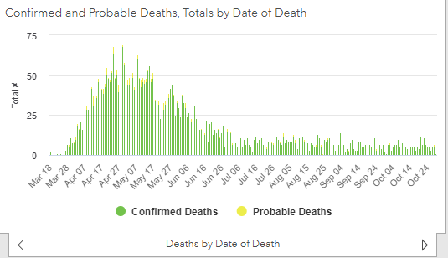

Slide 11
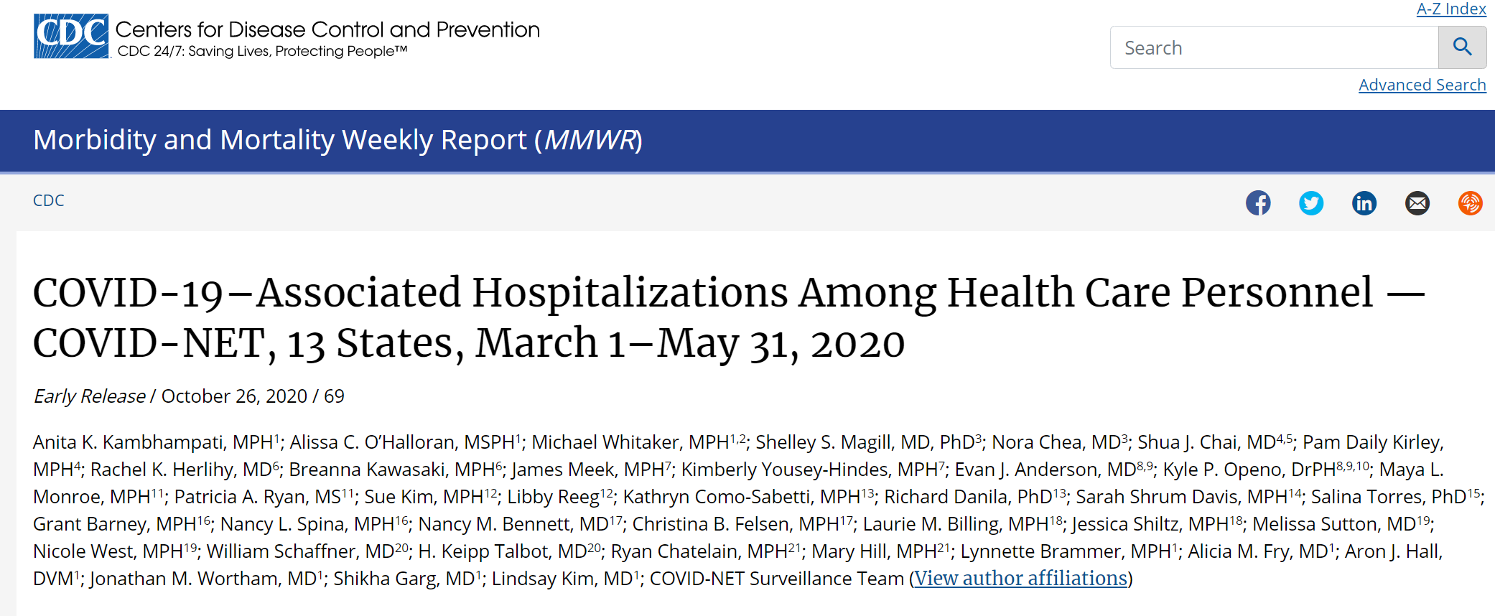
MMWR October 26, 2020
https://www.cdc.gov/mmwr/volumes/69/wr/mm6943e3.htm?s_cid=mm6943e3_w (accessed 10.26.2020)

Slide 12
MMWR October 26, 2020
During March 1–May 31, 2020, HCP accounted for approximately 6% of adults hospitalized with COVID-19 for whom HCP status was documented
The median age of hospitalized HCP (49 years) was substantially lower than that previously reported for hospitalized adults (62 years)
More than two thirds (67.4%) of HCP hospitalized with COVID-19 were generally expected to have direct patient contact, and over one third (36.3%) were in nursing-related occupations.
Approximately 90% of hospitalized HCP reported at least one underlying condition, with obesity being the most common and reported for over two thirds (72.5%) of patients.
A high proportion of hospitalized HCP had indications of severe disease: approximately one in four were admitted to an ICU, and approximately 4% died.
Kambhampati AK, O’Halloran AC, Whitaker M, et al. COVID-19–Associated Hospitalizations Among Health Care Personnel — COVID-NET, 13 States, March 1–May 31, 2020. MMWR Morb Mortal Wkly Rep. ePub: 26 October 2020. DOI: http://dx.doi.org/10.15585/mmwr.mm6943e3 (accessed 10.26.2020)

Slide 13
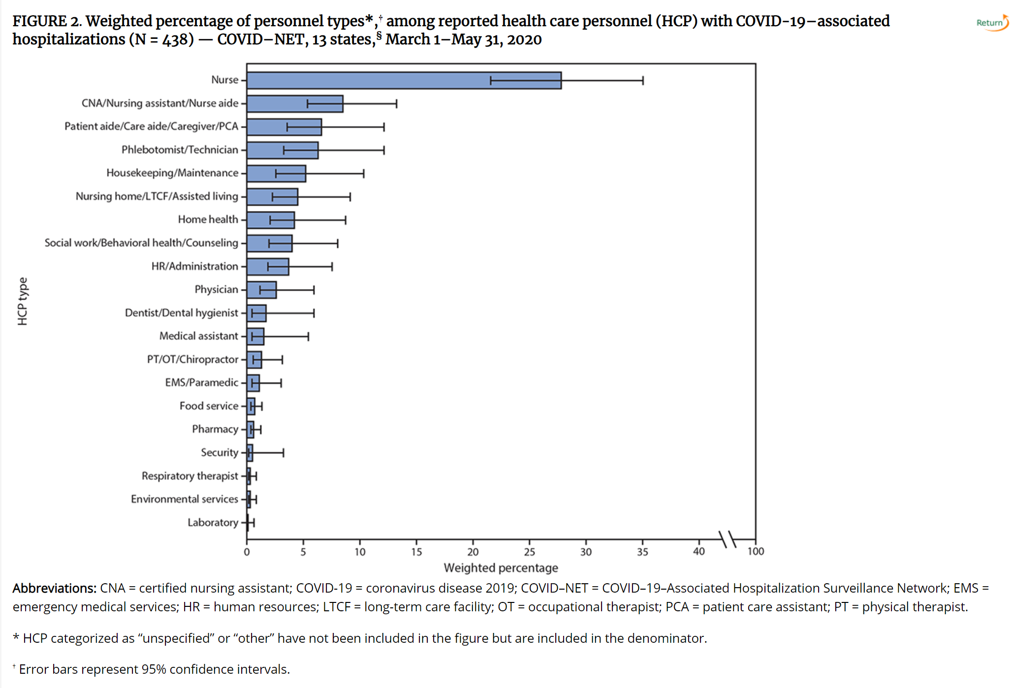
MMWR October 26, 2020
Kambhampati AK, O’Halloran AC, Whitaker M, et al. COVID-19–Associated Hospitalizations Among Health Care Personnel — COVID-NET, 13 States, March 1–May 31, 2020. MMWR Morb Mortal Wkly Rep. ePub: 26 October 2020. DOI: http://dx.doi.org/10.15585/mmwr.mm6943e3 (accessed 10.26.2020)

Slide 14
Webinar
Engaging Infection Control Q&A Event with AMA and CDC
Thursday, October 29 1:00 PM ET
American Medical Association (AMA) President Dr. Susan R. Bailey hosts CDC’s Dr. Mike Bell for a kickoff event for Project Firstline - CDC’s new national training collaborative for infection control.
Register here

Slide 15

Guidance for Safe Fall Holidays

Slide 16
Holiday Celebrations
Risk of virus spread risk at holiday celebrations
Community levels of COVID
Location of the gathering (indoor riskier than outdoor)
Duration of gathering (longer riskier than shorter)
Number of people at the gathering (smaller is safer than large)
Location attendees are traveling from ( hosting local is less risky than wide geographic spread)
Attendee behavior (Masking and distancing can reduce risk)
https://www.cdc.gov/coronavirus/2019-ncov/daily-life-coping/holidays.html

Slide 17
People who should not attend in-person holiday celebrations
People with or exposed to COVID-19 Do not host or participate in any in-person festivities if you or anyone in your household
Has been diagnosed with COVID-19 and has not met the criteria for when it is safe to be around others
Has symptoms of COVID-19
Is waiting for COVID-19 viral test results
May have been exposed to someone with COVID-19 in the last 14 days
People at increased risk for severe illness If you are at increased risk of severe illness from COVID-19, or live or work with someone at increased risk of severe illness, you should
Avoid in-person gatherings with people who do not live in your household
Avoid larger gatherings and consider attending activities that pose lower risk (as described throughout this page) if you decide to attend an in-person gathering with people who do not live in your household

Slide 18
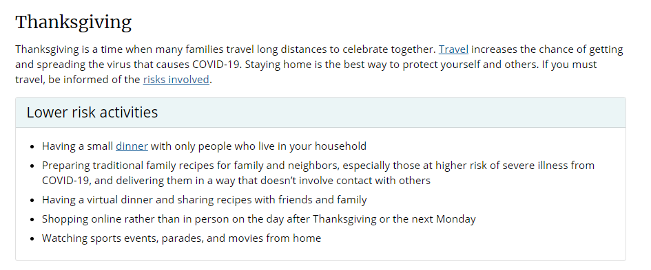

Slide 19
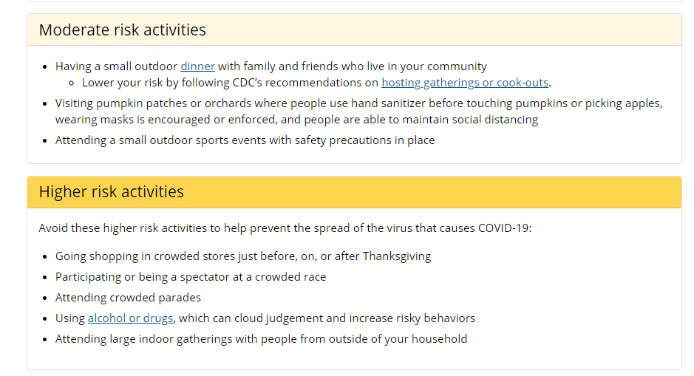

Slide 20
Questions?
Email : mdh.ipcovid@Maryland.gov

