Slide 1
Maryland Situation Update on Coronavirus Disease (COVID-19) for BHA
Maryland Department of Health
Infectious Disease Epidemiology and Outbreak Response Bureau
October 1, 2021

Slide 2

Call Agenda
Epi summary
COVID-19 Booster updates
Schools and Mask Policies
Q and A
https://covidlink.maryland.gov/content/vaccine/govax/

Slide 3
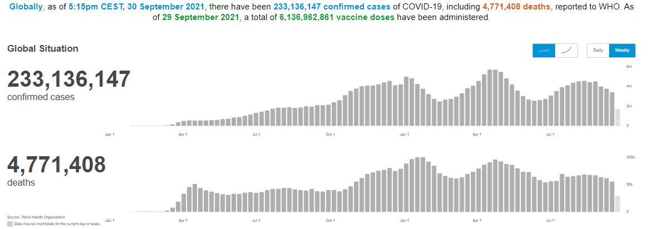
Worldwide: COVID-19
Source: https://covid19.who.int/ accessed 10/1/21

Slide 4
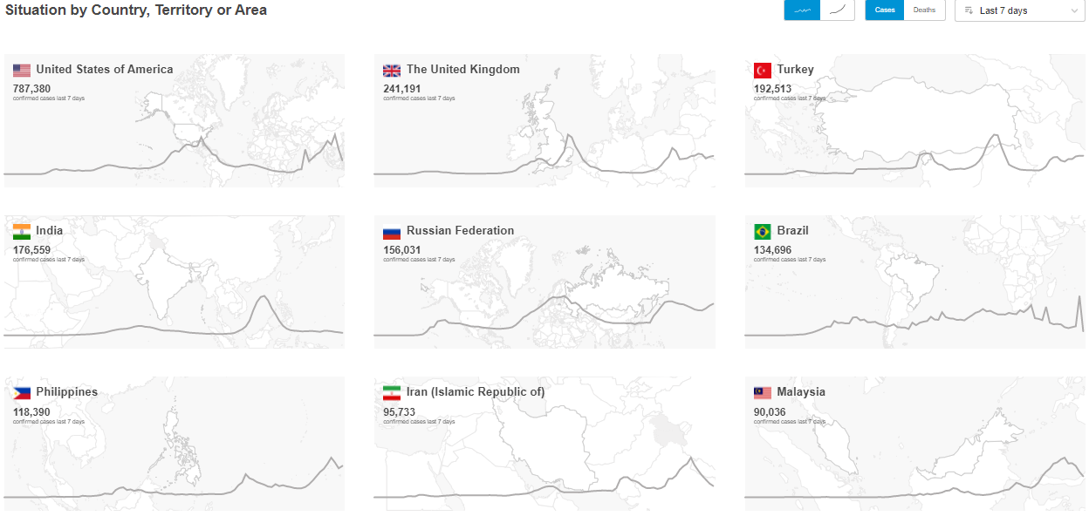
Worldwide: COVID-19
Source: https://covid19.who.int/ accessed 10/1/21

Slide 5
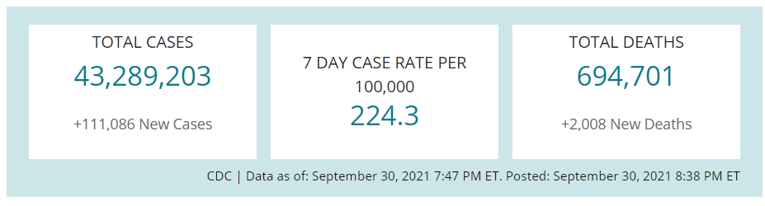
US Case Counts and Rates
https://www.cdc.gov/coronavirus/2019-ncov/cases-updates/cases-in-us.html 10/1/2021

Slide 6
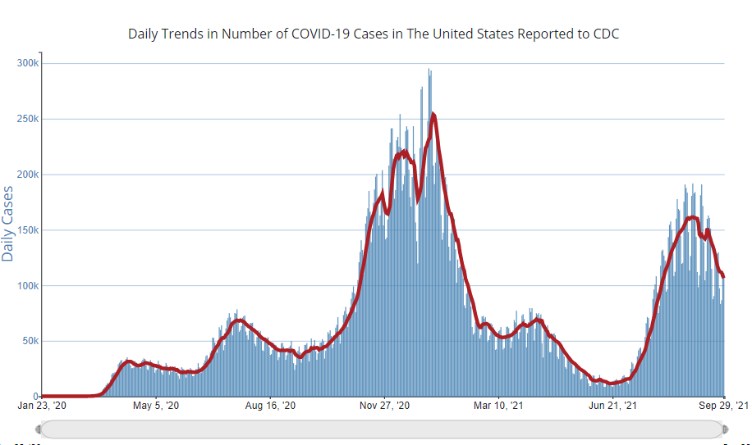
Number of Cases Reported in the USA, by Day
https://covid.cdc.gov/covid-data-tracker/#trends_dailytrendscases Updated 10/1/2021

Slide 7


Community Transmission
https://covid.cdc.gov/covid-data-tracker/#county-view 10/1/2021

Slide 8
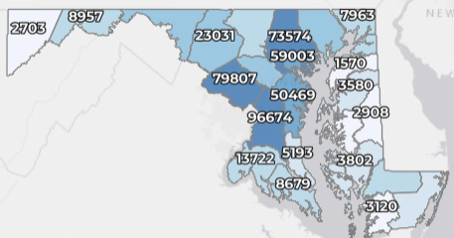
Maryland: COVID-19 Cases
http://health.maryland.gov/coronavirus
Data current as of 10/1/2021
Cases: 533,870
1,530 new
Deaths: 10,229
17 new
Hospitalizations: 48,715
Current: 776 (down 21)
Case rate: 20.7 per 100,000
Percent Positivity: 4.09%

Slide 9
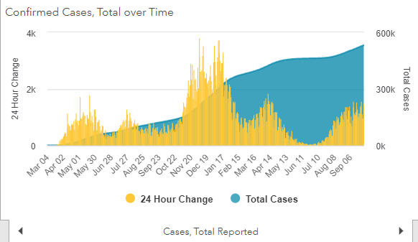
Maryland: COVID-19
Source: https://coronavirus.maryland.gov/, accessed 10/1/21

Slide 10
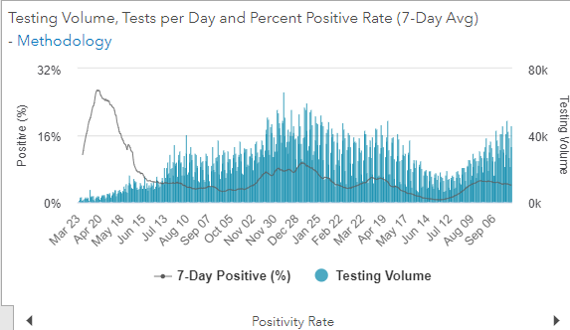
Maryland: COVID-19
Source: https://coronavirus.maryland.gov/, accessed 10/1/21

Slide 11
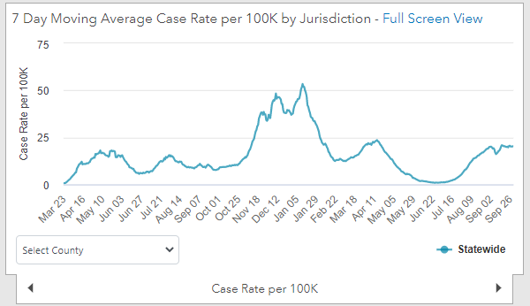
Maryland: COVID-19
9/17/21: 20.3 per 100k
Low: 6/24/21 at 0.90 per 100K
High: 1/12/21 at 53.39 per 100k
Source: https://coronavirus.maryland.gov/, accessed 10/1/21

Slide 12
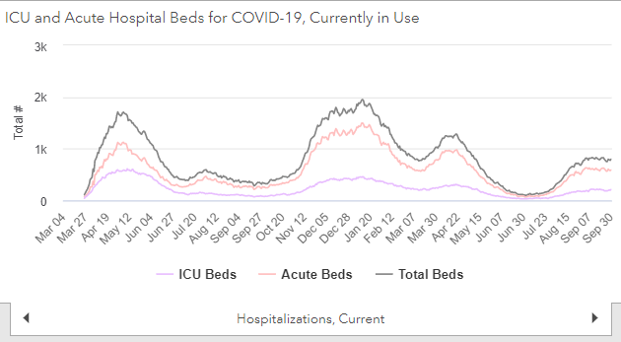
Maryland: COVID-19
Source: https://coronavirus.maryland.gov/, accessed 10/1/21

Slide 13
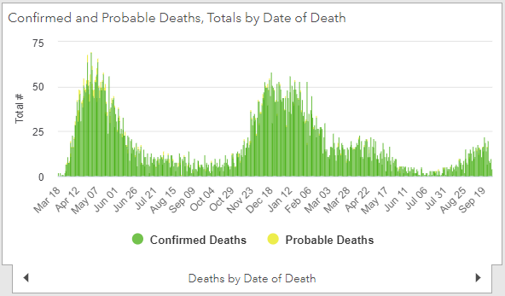
Maryland: COVID-19
Source: https://coronavirus.maryland.gov/, accessed 10/1/21

Slide 14
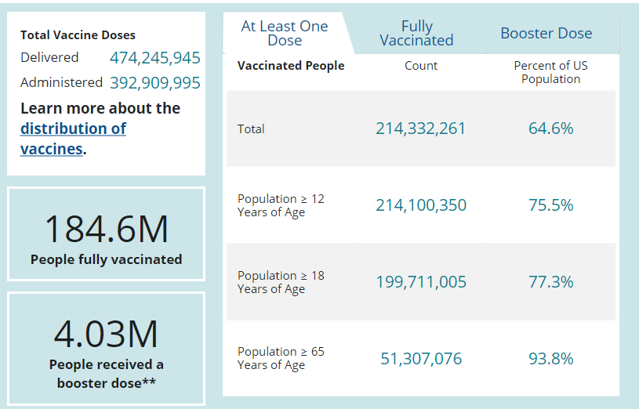
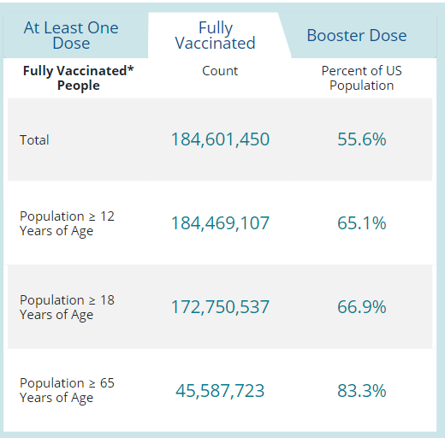
US: COVID-19 Vaccinations
Source: https://covid.cdc.gov/covid-data-tracker/#vaccinations accessed 10/1/21

Slide 15
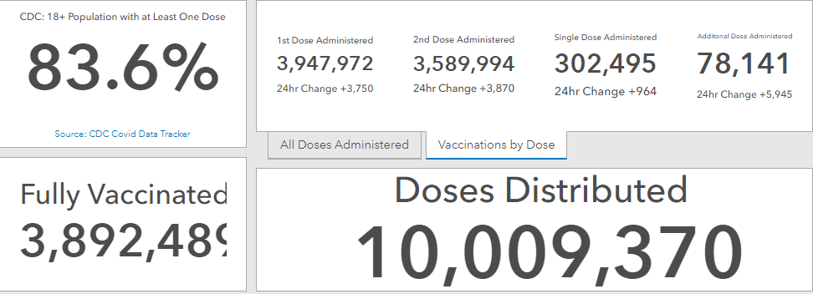
Maryland Vaccine Dashboard
https://coronavirus.maryland.gov/#Vaccine accessed 10/1/2021

Slide 16
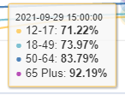
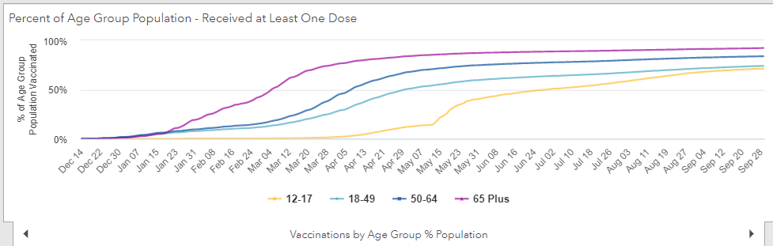
Percent of age groups with at least one dose
https://coronavirus.maryland.gov/#Vaccine 10/1/2021

Slide 17
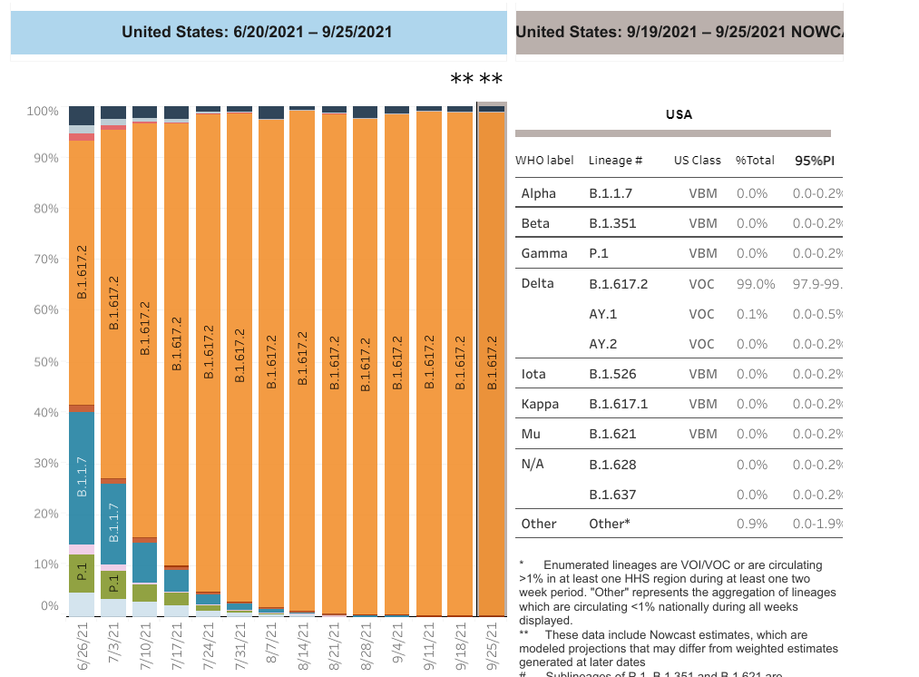

US: Delta Variant
https://covid.cdc.gov/covid-data-tracker/#variant-proportions Accessed 10/1/21
Delta 99.1%

Slide 18
ACIP Recommendations for Pfizer Boosters

Slide 19
Pfizer COVID-19 Vaccine Booster
Booster doses should not distract from our most important focus of primary vaccination in the United States and around the world
These recommendations only apply to people who previously received a Pfizer-BioNTech primary series
Everyone is still considered fully vaccinated two weeks after their second dose in a 2-shot series
https://www.cdc.gov/media/releases/2021/p0924-booster-recommendations-.html

Slide 20
Pfizer COVID-19 Vaccine Booster
ACIP Recommendations
CDC recommends that the following groups should receive a booster shot of Pfizer-BioNTech’s COVID-19 Vaccine at least 6 months after completing their Pfizer-BioNTech primary series (i.e., the first 2 doses of a COVID-19 vaccine):
people aged 65 years and older
residents aged 18 years and older in long-term care settings
people aged 50–64 years with underlying medical conditions
https://www.cdc.gov/coronavirus/2019-ncov/vaccines/booster-shot.html

Slide 21
Pfizer COVID-19 Vaccine Booster
ACIP Recommendations
CDC also recommends that the following groups may receive a booster shot of Pfizer-BioNTech’s COVID-19 Vaccine at least 6 months after completing their Pfizer-BioNTech primary series, based on their individual benefits and risks:
people aged 18–49 years with underlying medical conditions
people aged 18–64 years at increased risk for COVID-19 exposure and transmission because of occupational or institutional setting
https://www.cdc.gov/coronavirus/2019-ncov/vaccines/booster-shot.html

Slide 22
Occupational and Institutional Setting
First responders (healthcare workers, firefighters, police, congregate care staff)
Education staff (teachers, support staff, daycare workers)
Food and agriculture workers
Manufacturing workers
Corrections workers
U.S. Postal Service workers
Public transit workers
Grocery store workers
*List could be updated in the future
https://www.cdc.gov/coronavirus/2019-ncov/vaccines/booster-shot.html

Slide 23
Unresolved Issues
Boosters for Moderna and Janssen
“Mix and Match” vaccination strategies
Boosters for broader populations
Boosters for immunocompromised individuals (i.e. boosters 6 months after the 3rd dose)
Frequency or need for recurrent boosters

Slide 24
Association Between School Outbreaks and Mask Use Policies

Slide 25
COVID-19–Related School Closures and Learning Modality Changes — United States, August 1–September 17, 2021
Most (96%) public and private schools have remained open for full in-person learning.
However, an estimated 1,800 schools have had school closures attributable to COVID-19 outbreaks, affecting the education and well-being of 933,000 students.
To prevent COVID-19 outbreaks in schools, CDC recommends multicomponent prevention strategies, including vaccination, universal indoor masking, screening testing, and physical distancing.
https://www.cdc.gov/mmwr/volumes/70/wr/mm7039e2.htm?s_cid=mm7039e2_w

Slide 26
Association Between K–12 School Mask Policies and School-Associated COVID-19 Outbreaks — Maricopa and Pima Counties, Arizona, July–August 2021
Analysis of 999 schools in Arizona with differing mask policies, open for in person learning between July 15th and August 31st
210 had early mask requirements
309 had late mask requirement
480 had no mask requirement
The odds of a school-associated COVID-19 outbreak in schools with no mask requirement were 3.5 times higher than those in schools with an early mask requirement
CDC recommends universal indoor masking in K–12 schools
https://www.cdc.gov/mmwr/volumes/70/wr/mm7039e1.htm?s_cid=mm7039e1_w

Slide 27
Pediatric COVID-19 Cases in Counties With and Without School Mask Requirements — United States, July 1–September 4, 2021
Counties without school mask requirements experienced larger increases in pediatric COVID-19 case rates after the start of school compared with counties that had school mask requirements (p<0.001).
The average change from week −1 (1–7 days before the start of school) to week 1 (7–13 days after the start of school) for counties with school mask requirements (16.32 cases per 100,000 children and adolescents aged <18 years per day) was 18.53 cases per 100,000 per day lower than the average change for counties without school mask requirements (34.85 per 100,000 per day) (p<0.001).
After controlling for covariates, school mask requirements remained associated with lower daily case rates of pediatric COVID-19 (β = −1.31; 95% confidence interval = −1.51 to −1.11) (p<0.001).
https://www.cdc.gov/mmwr/volumes/70/wr/mm7039e3.htm?s_cid=mm7039e3_w

Slide 28
Questions?
mdh.ipcovid@maryland.gov

