Slide 1
Maryland Situation Update on
Coronavirus Disease (COVID-19) for BHA
Maryland Department of Health
Infectious Disease Epidemiology and Outbreak Response Bureau
October 16, 2020

Slide 2
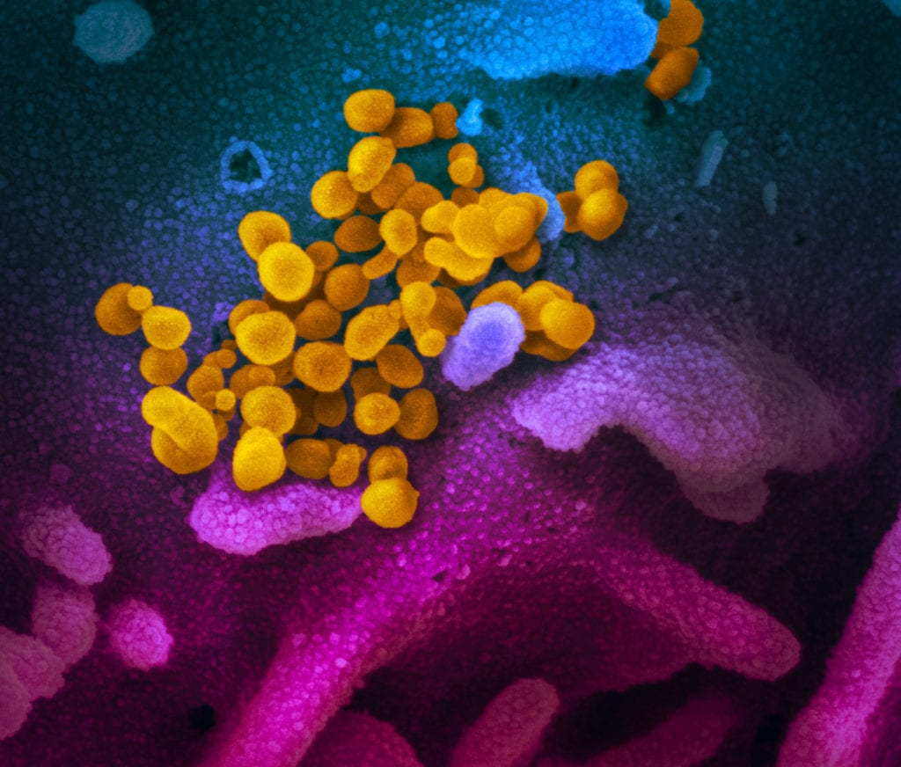
Call Agenda
Picture Courtesy of NIAID-RML
Review current situation of COVID-19
Assessing respiratory illness in flu season
Guidance documents for BHA /facilities

Slide 3
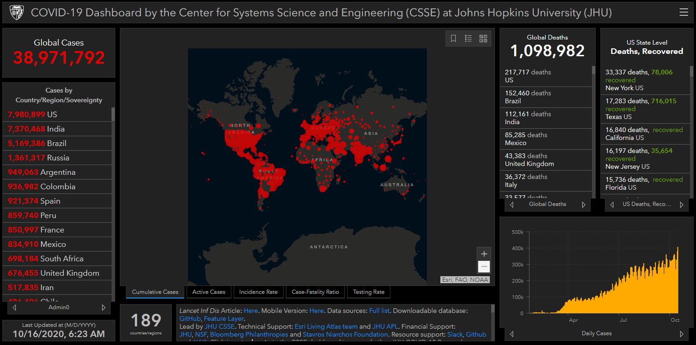
COVID-19 Global Situation Summary

Slide 4
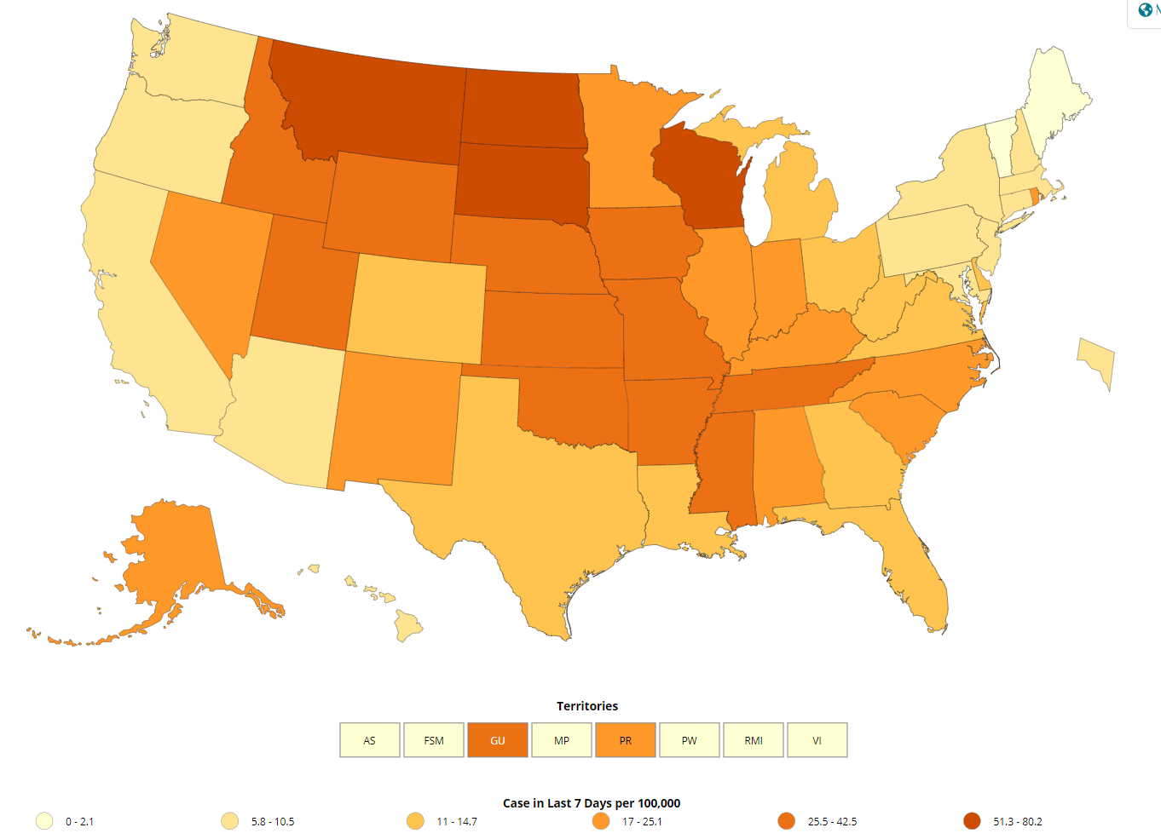
US: COVID-19 Case Rate per 100,000 in the last 7 days
https://www.cdc.gov/coronavirus/2019-ncov/cases-updates/cases-in-us.html Accessed 10/16/2020

Slide 5
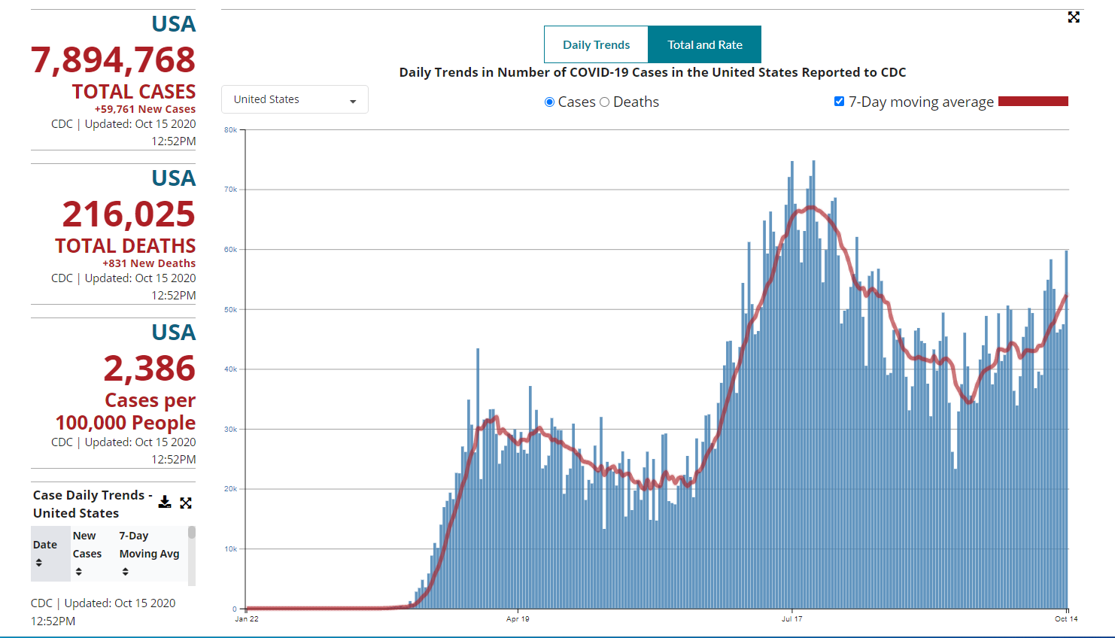
Number of Cases Reported in the USA, by Day

Slide 6
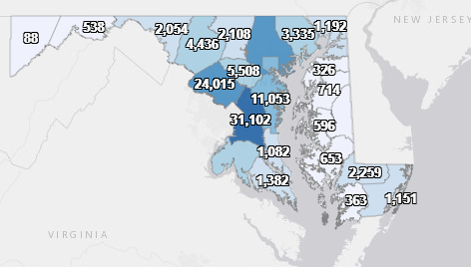
Maryland: COVID-19 Cases
http://health.maryland.gov/coronavirus
Data current as of 10/16/2020
Cases: 134,329
  781 new
Deaths: 3,887
  4 new
Hospitalizations: 16,288
  Current: 415
Total tests performed: 3,013,107
Total people tested: 1,782,457

Slide 7
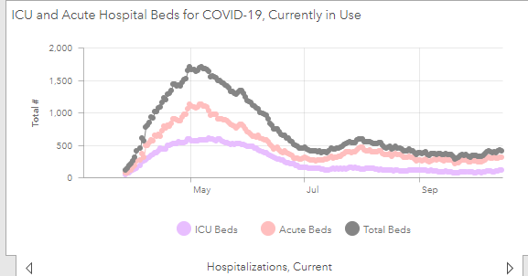
https://coronavirus.maryland.gov/ 10/16/2020

Slide 8
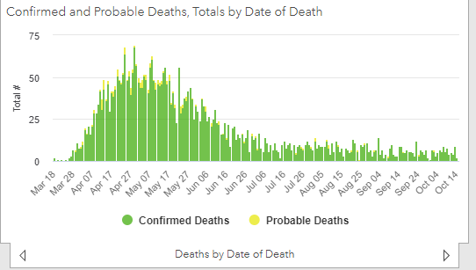

Slide 9
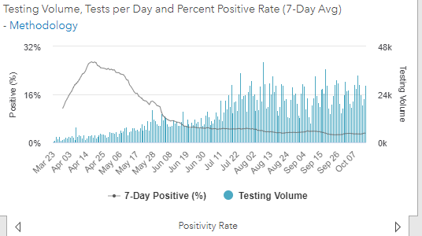
Testing Volume and % Positivity

Slide 10
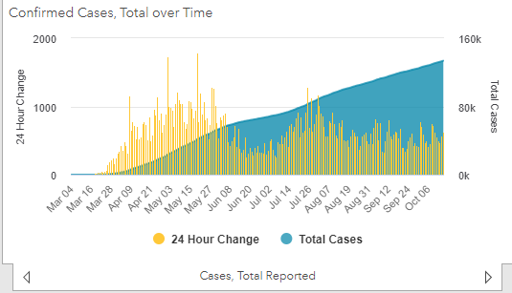

Slide 11
Influenza, COVID, and Undiagnosed Respiratory Illness

Slide 12
Symptomatic Individuals
Test for both influenza and COVID-19
  Rapid flu test
  COVID-19 PCR
Isolate/exclude from work/ exclude from in-person visits until test results come back
For residential setting, isolate in a private room
  Staff should wear mask, eye protection, gown, and gloves if coming into direct contact with the patient

Slide 13
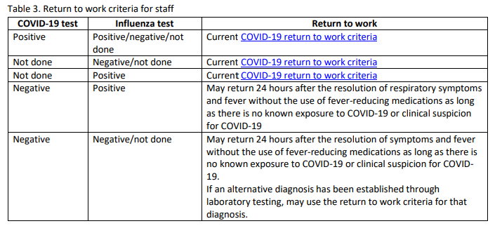
What happens if staff tests …
https://phpa.health.maryland.gov/IDEHASharedDocuments/Respiratory-outbreak-guidance_October-2020_FINAL.pdf

Slide 14
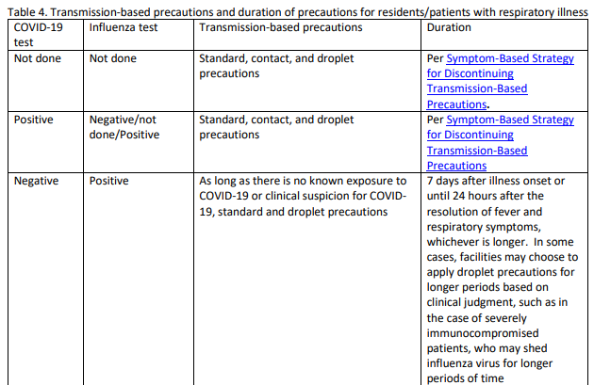
What happens if residents test…

Slide 15
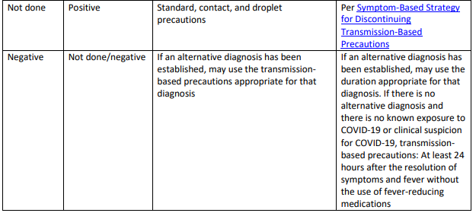
What happens if residents test…

Slide 16
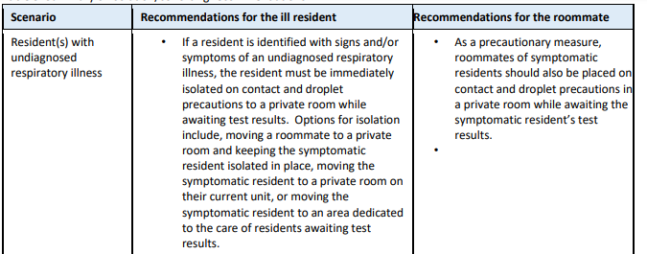
Isolation and Cohorting Respiratory Illness
https://phpa.health.maryland.gov/IDEHASharedDocuments/Respiratory-outbreak-guidance_October-2020_FINAL.pdf

Slide 17
Behavioral Health – Specific Guidance

Slide 18
What would you like to see addressed?
Testing
PPE
Resident placement
  COVID+
  New admits
Exclusion criteria for staff
What else?

Slide 19
Questions?
Email : mdh.ipcovid@Maryland.gov

