Slide 1
Maryland Situation Update on Coronavirus Disease (COVID-19) for BHA
Maryland Department of Health
Infectious Disease Epidemiology and Outbreak Response Bureau
October 15, 2021

Slide 2

Call Agenda
Epi summary
Trends in Anxiety and Depression
COVID-19 Booster updates
Q and A
https://covidlink.maryland.gov/content/vaccine/govax/

Slide 3
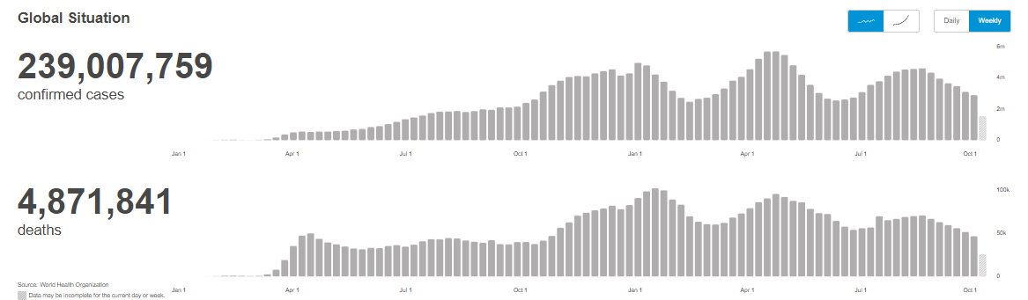
Worldwide: COVID-19
Source: https://covid19.who.int/ accessed 10/15/21

Slide 4
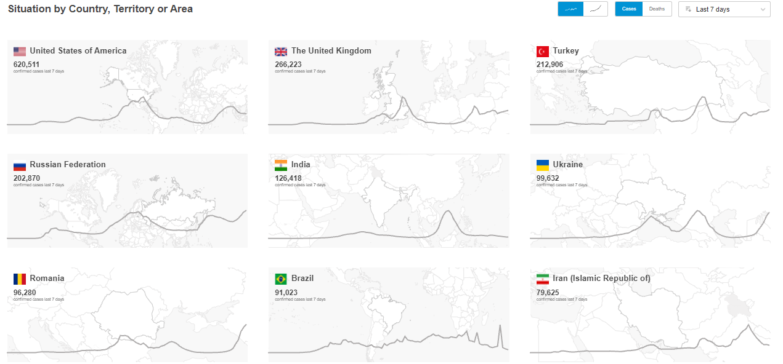
Worldwide: COVID-19
Source: https://covid19.who.int/ accessed 10/15/21

Slide 5
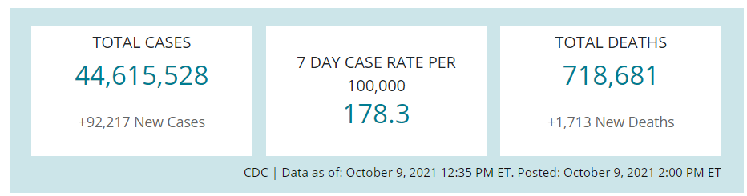
US Case Counts and Rates
https://www.cdc.gov/coronavirus/2019-ncov/cases-updates/cases-in-us.html 10/15/2021

Slide 6
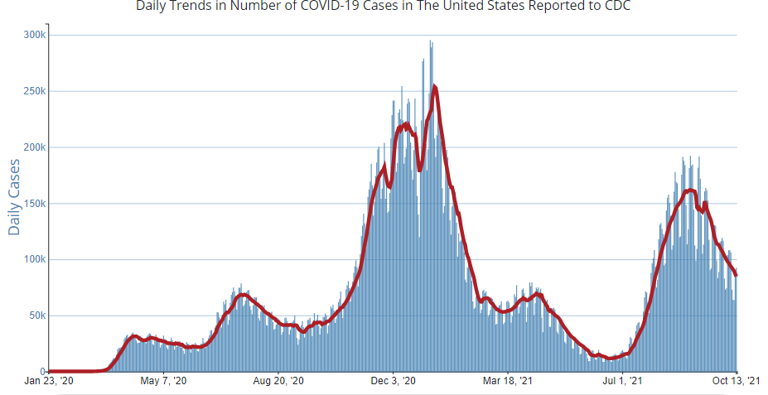
Number of Cases Reported in the USA, by Day
https://covid.cdc.gov/covid-data-tracker/#trends_dailytrendscases Updated 10/15/2021

Slide 7


Community Transmission
https://covid.cdc.gov/covid-data-tracker/#county-view 10/15/2021

Slide 8
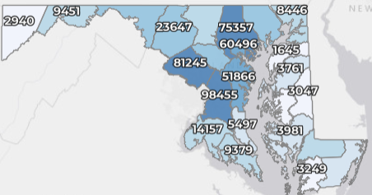
Maryland: COVID-19 Cases
http://health.maryland.gov/coronavirus
Data current as of 10/15/2021
Cases: 548,743
1,068 new
Deaths: 10,450
18 new
Hospitalizations: 48,715
Current: 729 (down 23)
Case rate: 16.8 per 100,000
Percent Positivity: 2.95%

Slide 9
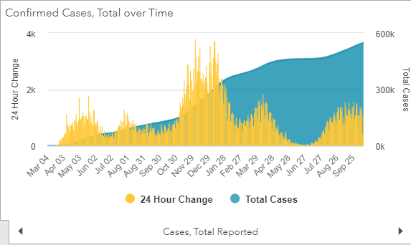
Maryland: COVID-19
Source: https://coronavirus.maryland.gov/, accessed 10/15/21

Slide 10
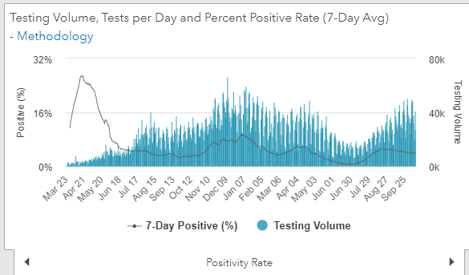
Maryland: COVID-19
Source: https://coronavirus.maryland.gov/, accessed 10/15/21

Slide 11
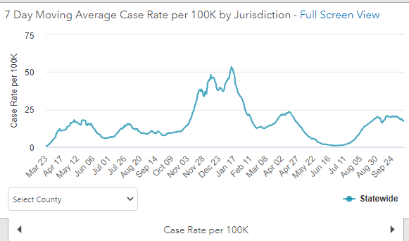
Maryland: COVID-19
10/15/21: 16.8 per 100k
Low: 6/24/21 at 0.90 per 100K
High: 1/12/21 at 53.39 per 100k
Source: https://coronavirus.maryland.gov/, accessed 10/15/21

Slide 12
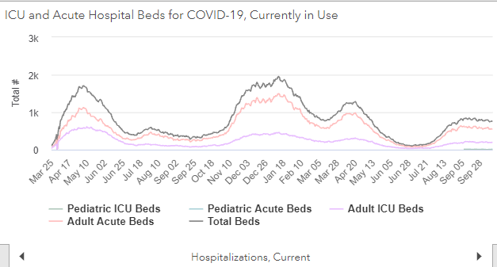
Maryland: COVID-19
Source: https://coronavirus.maryland.gov/, accessed 10/15/21

Slide 13
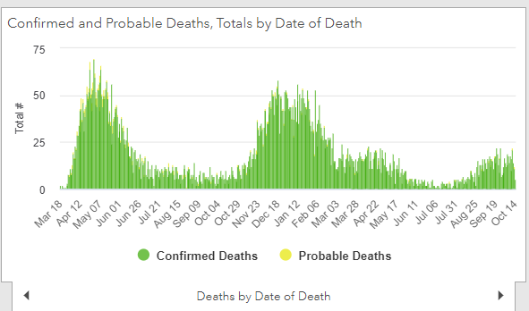
Maryland: COVID-19
Source: https://coronavirus.maryland.gov/, accessed 10/15/21

Slide 14
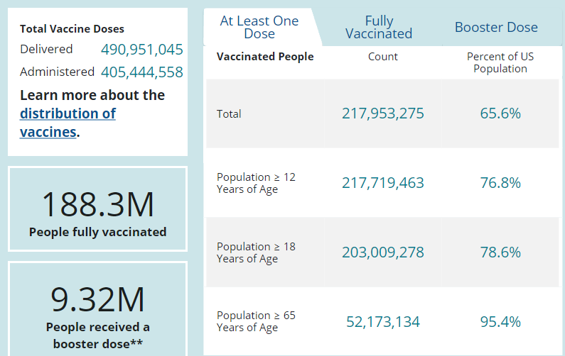
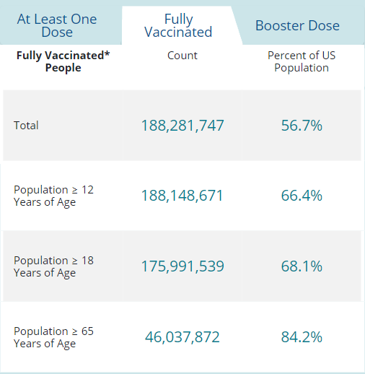
US: COVID-19 Vaccinations
Source: https://covid.cdc.gov/covid-data-tracker/#vaccinations accessed 10/15/21

Slide 15
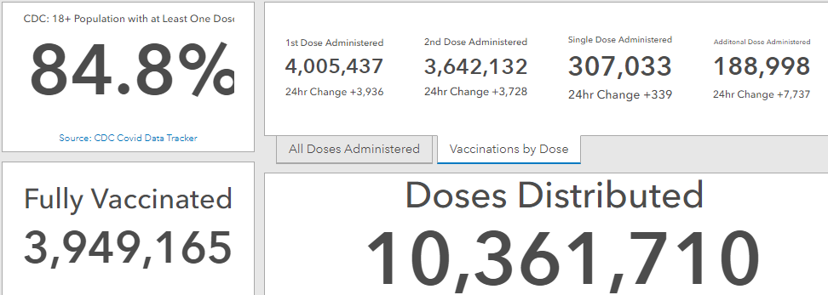
Maryland Vaccine Dashboard
https://coronavirus.maryland.gov/#Vaccine accessed 10/15/2021

Slide 16
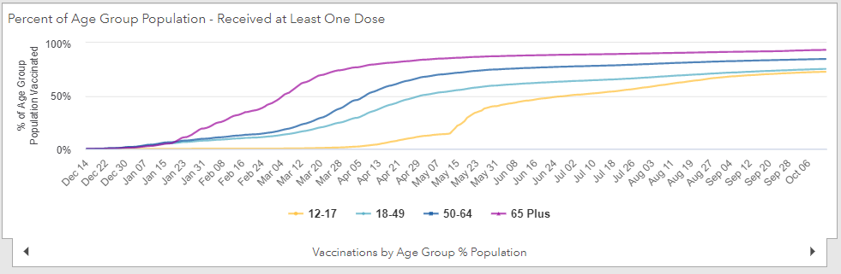
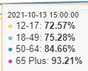
Percent of age groups with at least one dose
https://coronavirus.maryland.gov/#Vaccine 10/1/2021

Slide 17
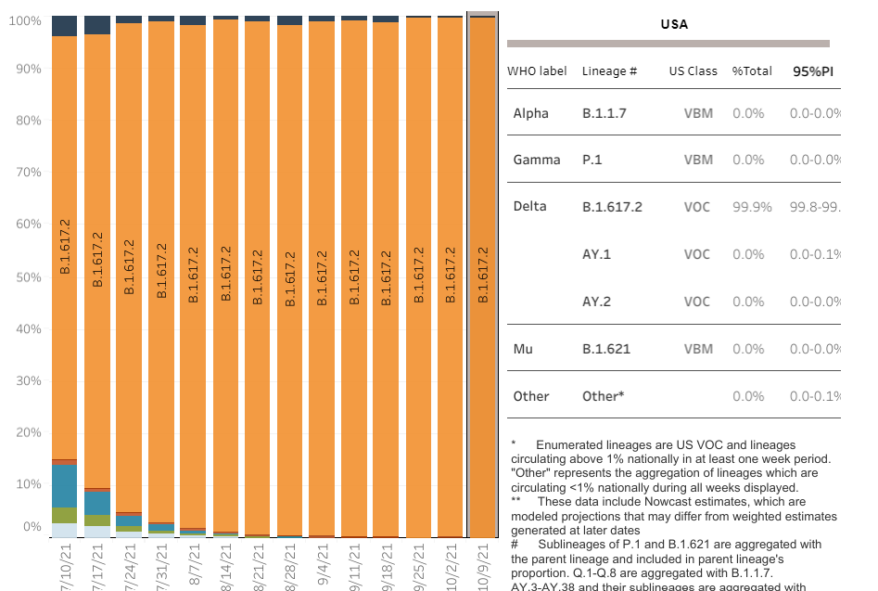

US: Delta Variant
https://covid.cdc.gov/covid-data-tracker/#variant-proportions Accessed 10/15/21
Delta 99.9%

Slide 18
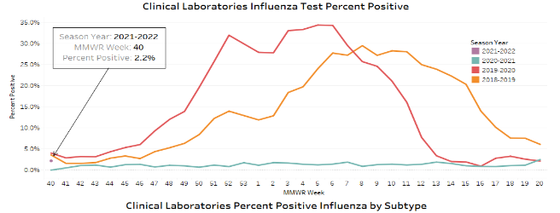
Happy First Day of Flu Season

Slide 19
National and State Trends in Anxiety and Depression Severity Scores Among Adults During the COVID-19 Pandemic —USA, 2020–2021
Recent studies indicate an increase in the percentage of adults who reported clinically relevant symptoms of anxiety and depression during the COVID-19 pandemic
Nationally, the average anxiety severity score increased 13% from August 19–31, 2020, to December 9–21, 2020 (average percent change [APC] per survey wave = 1.5%) and then decreased 26.8% from December 9–21, 2020, to May 26–June 7, 2021 (APC = –3.1%)
The average depression severity score increased 14.8% from August 19–31, 2020, to December 9–21, 2020 (APC = 1.7%) and then decreased 24.8% from December 9–21, 2020, to May 26–June 7, 2021 (APC = –2.8%)
https://www.cdc.gov/mmwr/volumes/70/wr/mm7040e3.htm?s_cid=mm7040e3_w

Slide 20
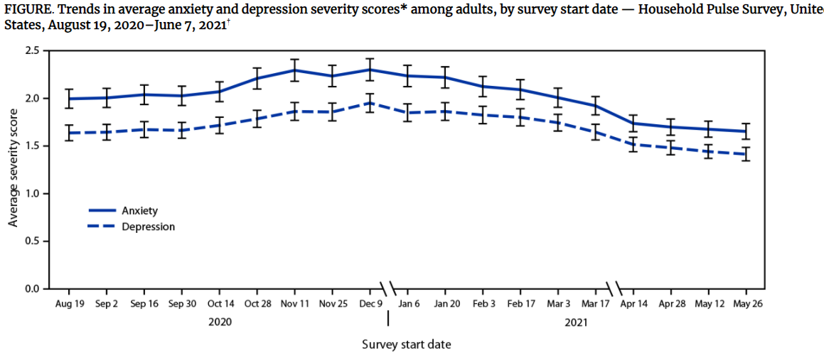

Slide 21
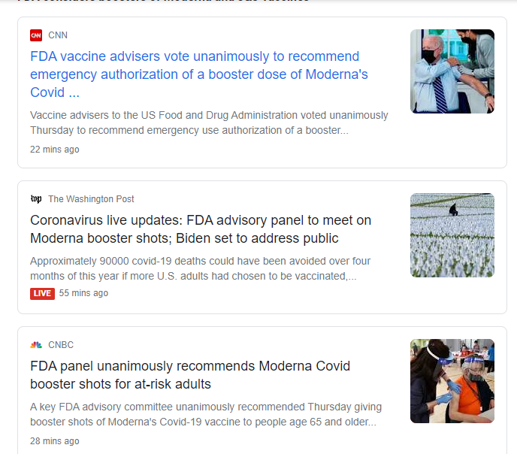
Boosters

Slide 22
Moderna Booster
Vaccines and Related Biological Products Advisory Committee voted 19-to-0 that the Moderna booster should be authorized for these groups at least six months after receiving their second dose.
The panel also discussed at what point boosters should be recommended to all adults over 18, saying that at this point it is far too soon to consider the matter.
Moderna booster consists of a 50-microgram dose, half the normal dose of the shot.
The FDA is not bound by the votes of its advisory committees, which it convenes to ask for guidance, but it generally follows their advice.
https://www.statnews.com/2021/10/14/fda-advisory-panel-unanimously-endorses-modernas-covid-vaccine-booster-for-some-groups/

Slide 23
Johnson & Johnson
On Friday, the FDA advisory committee will meet to discuss data regarding giving a booster shot to all people who have received the Johnson & Johnson Covid vaccine, as well as a study that suggests it might be possible, or even advantageous, to mix and match boosters of different vaccines.

Slide 24
Heterologous SARS-CoV-2 Booster Vaccination
Preliminary report on Mix and Match booster doses
Homologous boosts provided a wide range of immunogenicity responses, with heterologous boosts providing comparable or higher titers.
Reactogenicity and adverse events were similar across booster groups.
These data suggest that if a vaccine is approved or authorized as a booster, an immune response will be generated regardless of the primary Covid-19 vaccination regimen
https://www.medrxiv.org/content/10.1101/2021.10.10.21264827v1.full.pdf

Slide 25
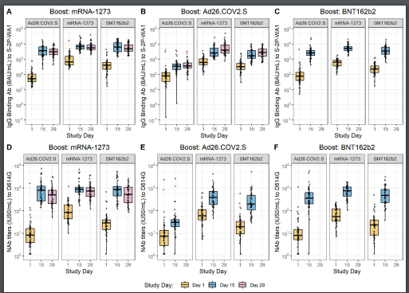
Figure 2 | Binding Antibody and Neutralizing Antibody Titers
https://www.medrxiv.org/content/10.1101/2021.10.10.21264827v1.full.pdf

Slide 26
Questions?
mdh.ipcovid@maryland.gov

