Slide 1
CME Accreditation and Designation
The activity has been planned and implemented in accordance with the Essential Areas and
of the Accreditation Council for Continuing Medical Education (ACCME) through the
joint providership of MedChi, The Maryland State Medical Society and the Behavioral Health
Administration of the Maryland Department of Health. MedChi is accredited by the ACCME to
provide continuing medical education for physicians. CMEs will be available at no cost, as will
Participant Certificates, which for other disciplines may qualify for CEUs or other continuing
education credit, although these are not approved for CEUs by the Maryland Board of Social
Work Examiners. Participants should check with their certifying organizations to see how these
would apply.
MedChi designates this webinar educational activity for a maximum of 1 AMA PRA Category 1
Credits™. Physicians should claim only the credit commensurate with the extent of their
participation in the activity, as should other disciplines who claim credit for Participant
Certificates. For CME/Participant Certificate questions please contact Sherrie Noonan at
sherrie.noonan@maryland.gov.
Webinars jointly sponsored by the Behavioral Health Administration and MedChi

Slide 2
CME Disclosures
Presenters and Planners: Aliya Jones, MD and Steve Whitefield, MD have reported no relevant financial relationships to disclose. Kimberly Prescott, SPHR, SHRM-SCP and Crista Taylor, LCSW have reported no relevant financial relationships to disclose.
MedChi CME Reviewers: The reviewers from the MedChi Committee On Scientific Activities (COSA) for this activity have reported no relevant financial relationships to disclose.
Webinars jointly sponsored by the Behavioral Health Administration and MedChi

Slide 3
Enhancing Self-Care and Leadership Skills for Health Care Managers
Kimberly Prescott, SPHR, SHRM-SCP
President

Slide 4
The Oxygen Mask Principle

Slide 5
Why?

Slide 6
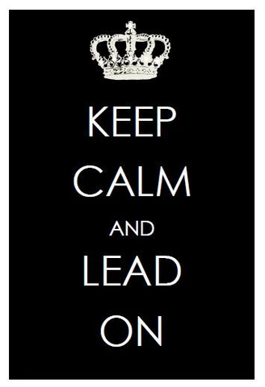
Remain Calm and Optimistic

Slide 7
Set Expectations

Slide 8
Communicate Clearly (and often)

Slide 9
Give Thanks and Praise

Slide 10
Encourage Time-Off

Slide 11
What have you done to foster a culture of self-care with your teams?

Slide 12
Questions?

Slide 13
Thank you.
Kimberly Prescott, SPHR, SHRM-SCP
Founder and President
5305 Village Center Drive, Suite 284 ^{Columbia, Maryland 21044} ^{(443) 599.9088} ^{www.prescotthr.com}

