Slide 1



On behalf of:
Maryland Addiction and Behavioral-health Professionals Certification Board
International Certification & Reciprocity Consortium
Faces & Voices of Recovery.b

Slide 2


Slide 3
Updates from MABPCP
As of August 19th
143 current Certified Peer Recovery Specialists
As of August 20th
203 Registered Peer Supervisors
58 have taken the Supervision Refresher Course
Certified Peer Recovery Specialist – Family Endorsement
Competencies have been developed
Domain development is in progress

Slide 4

Faces & Voices of Recovery: National Recovery Institute
Launched August 2018
The mission of the National Recovery Institute is to increase the knowledge, capacity, and accountability of recovery support providers throughout the United States and territories.
The National Recovery Institute (NRI) Center for Best Practices trainings are endorsed by the IC&RC for use toward initial certification and recertification of the IC&RC Peer Recovery (PR) credential.

Slide 5

The Recovery Voices Count:
Build a powerful recovery advocacy movement
Supporting nonpartisan civic engagement
Local
State
National
To Access:
Connect to the Faces & Voices Website
Search: Recovery Voices Count
Toolkit
Slide Decks

Slide 6
Take the “Thank the Village” challenge!
We challenge you to get out into your community with a sign that reads:
YOU HAVE MADE A DIFFERENCE…YOU ARE MY VILLAGE
Take a picture or a video expressing your gratitude with a person or a place that has been a part of your village, then post the picture or video on the Faces & Voices of Recovery Facebook Page
with the hashtags:
#ThankTheVillage
#FacesandVoices
Let’s show others that we are thankful for their service to our communities and that recovery is possible because of their support!

Slide 7

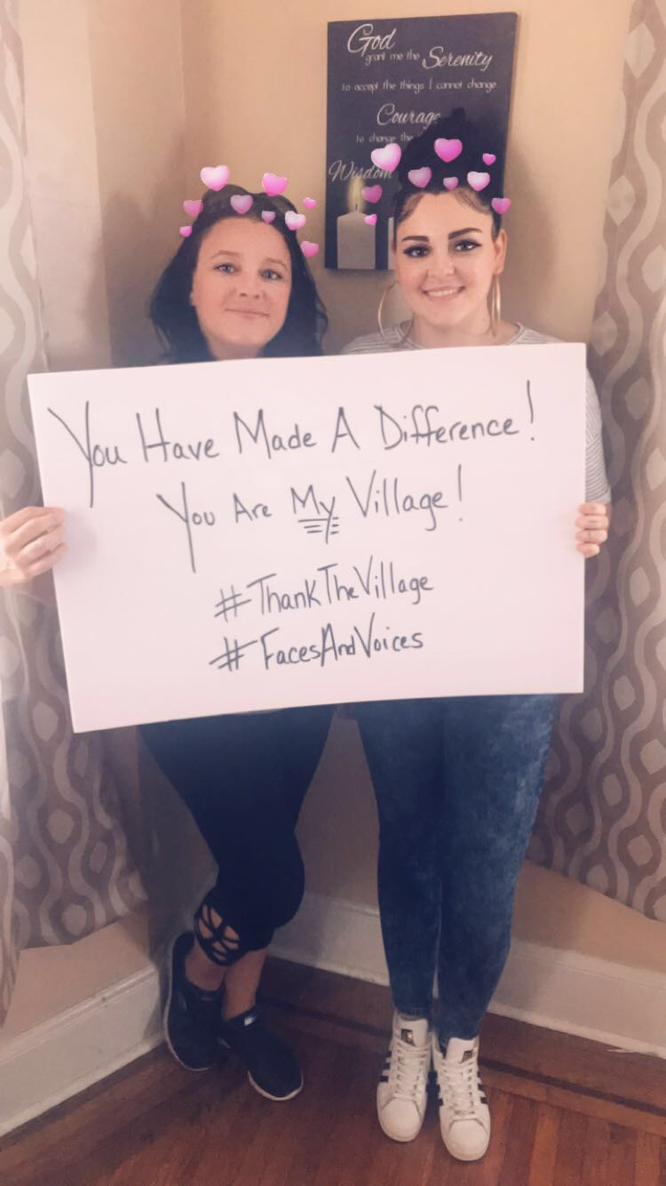
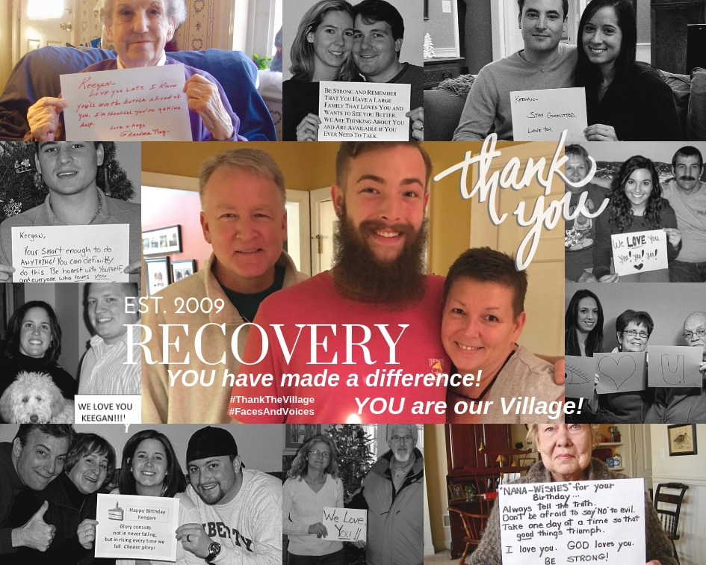

Slide 8
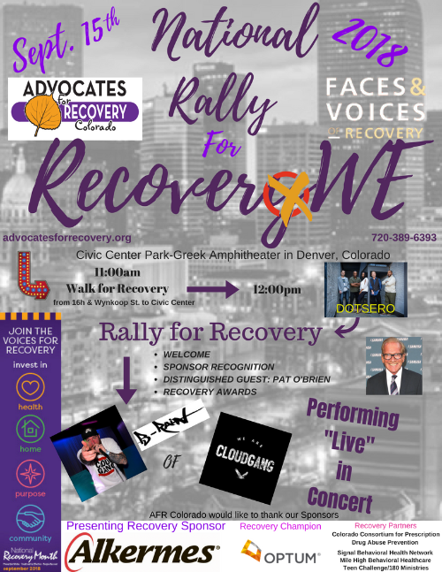
Advocates for Recovery Colorado
2018 Rally for Recovery
National Hub Event
Streaming live on:
Faces & Voices of Recovery Facebook Page

Slide 9

For more information
www.facesandvoicesofrecovery.org
Brandee Izquierdo
Director of Advocacy & Outreach
bizquierdo@facesandvoicesofrecovery.org
1.202.737.0690

