Slide 1
5th Annual Peer Summit
Baltimore North Sheraton – Towson, MD
MARYLAND DEPARTMENT OF HEALTH
Brendan Welsh, CPRS – Director, Consumer Affairs
May 15, 2019

Slide 2
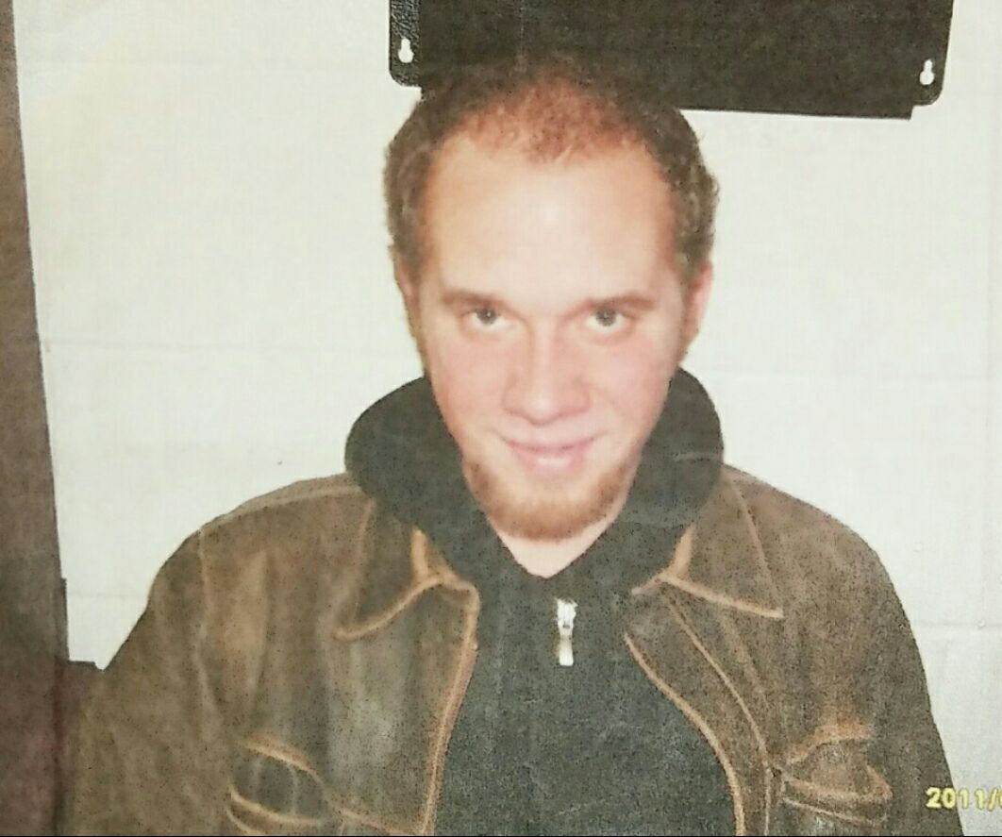
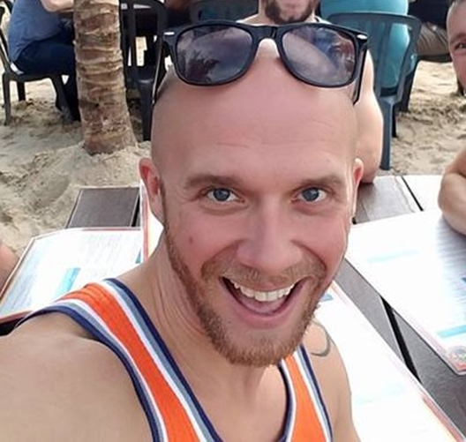
My Recovery Story
Introductions
February 2011
August 2017

Slide 3
Office Organization
Brendan Welsh, CPRS
Director
Oversight of Peer Recovery Support and Wellness Recovery Centers
Adelaide Weber
Coordinator of Special Programs
Training and Educational Programing Development
Vacant Position
Administrative Officer II
Administrative Support for Peer Programing

Slide 4

Primary Functions:
Ensures that all program planning and policy design are influenced by individuals with lived experience. This results in reduced barriers to treatments and supports which ultimately lead to sustained recovery and promote person-centered care within the PBHS.
Responsible for growing and providing support around the utilization of the peer recovery specialist workforce in both behavioral health and non-traditional settings.
Provides administrative oversight for all peer-operated programs and recovery services throughout the State.

Slide 5
Consumer Affairs
Providing input regarding the designing and implementing state and federally funded services and specialized programs;
Development of conditions of awards for funding and monitoring deliverables associated with Peer-run organizations;
Providing technical assistance and guidance to the local jurisdictions and external agencies regarding the development and implementation of Peer-operated supports and services;
Administrative oversight of Wellness Recovery Centers, Recovery Community Centers, and Peer Recovery Services embedded within local HD Programs;
Development, production, and facilitation of CPRS education programs and conferences.
Identifying ongoing and sustainable funding sources to support the growing Peer Recovery Specialist workforce.
Peer Recovery Specialist Workforce at a Glance (as of 01/30/2019)
Certified Peers in the PBHS
101
Non - Certified Peers in PBHS
207
Total Peers in the
PBHS
308

Slide 6

Making Progress
Office of Consumer Affairs
In early 2019, BHA’s Office of Consumer Affairs facilitate 5 regional Listening Sessions with our peers from across the State. From these sessions, we were able to identify the following issues which are hindering the growth of the CPRS workforce.

Slide 7
Making Progress
Office of Consumer Affairs
Perceived stigma within the behavioral health system
  Internalized throughout the peer workforce (MH/SUD & Abstinence/MSR/HR)
  External stigma from providers and organizations
Registered Peer Supervisors Role
State Job Classification
Specific Peer HR Concerns
  Peer Burnout/Self Care
  Salary Levels
  Performing Functions Out of Role
Lack of Operating Standards
  RCC / WRC
  PRS
Training Expansion
  Topics/Content
  Geographical Availability
Funding

Slide 8

SBIRT
Maryland Peer Initiatives
SBIRT Hospital ED Data
(07/01/14 – 03/31/19):
SBIRT Hospital Data
  SBIRT Screenings – 1,294,202
  Positive Screens – 218,755 (17%)
  Brief Interventions – 95,352 (44%)
  Referral to Treatment – 18,537 (19%)
  Linked to Treatment – 7,295 (39%)
Overdose Survivor Outreach Program Results (7/1/17 – 03/31/2019):
547 patients were referred to treatment by peers with a 68% rate of treatment engagement.

Slide 9
SBIRT Expansion
Maryland Peer Initiatives
Hospitals (FY18) | Locations
MedStar - Harbor | Baltimore City
UMMS | Baltimore City
Bon Secours | Baltimore City
MedStar - Franklin Square | Baltimore County
MedStar - Good Samaritan | Baltimore City
MedStar - Union Memorial | Baltimore City
JHH - Bayview | Baltimore City
UMMS – Mid-Town Campus | Baltimore City
MedStar-Montgomery | Montgomery Co.
Mercy Hospital | Baltimore City
Meritus Medical Center | Washington County
Greater Baltimore Medical Ctr. | Baltimore Co.
St. Agnes | Baltimore City
Northwest | Baltimore County
Upper Chesapeake UM | Harford Co.
Hospitals (FY19 Expansion) | Locations
Baltimore Washington Medical Center | Anne Arundel County
John Hopkins Hospital Baltimore | Baltimore City
Suburban Hospital | Montgomery County
UMMS Harford Memorial | Harford County
MedStar – Southern Maryland | Prince George’s Co.
UMMS Prince George’s Hospital | Prince George’s County
Western Maryland Health System | Allegany County
Lifebridge Carroll County Hospital | Carroll County

Slide 10

START Family Mentors (DHS)
Maryland Peer Initiatives

Slide 11

Opioid Workforce Innovation Fund (DLLR)
Maryland Peer Initiatives
Funded through DOL’s National Health Emergency Dislocated Worker Demo Grant ($1.9 Million)
Using funds for Maryland’s Opioid Workforce Innovation Fund programs can receive up to $75,000 to support individuals bridging between the workforce and behavioral health service sector.

Slide 12
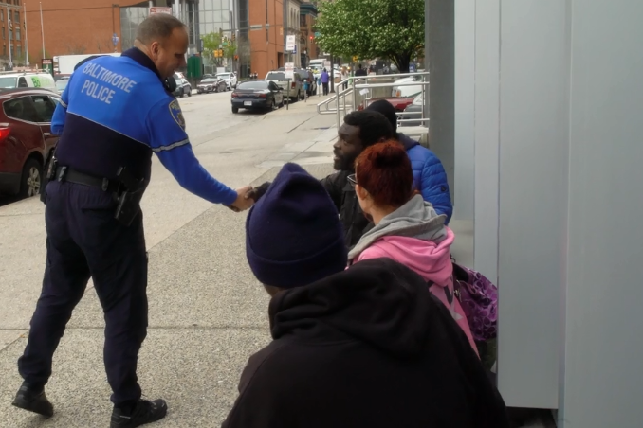
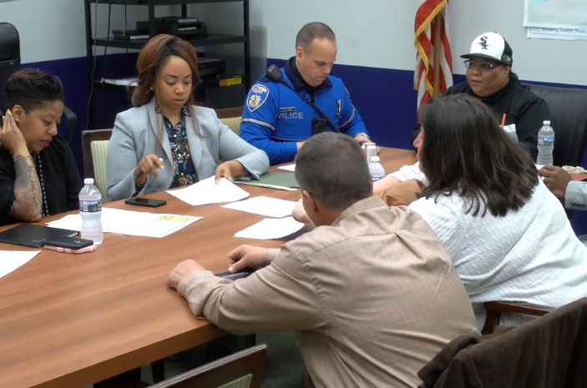
L.E.A.D Expansion
Maryland Peer Initiatives
Provides a way for public safety officials to work with behavioral health providers by diverting low-level drug offenders to treatment and support services, rather than jail and prosecution.
Care is provided through interventions such as assertive community treatment, residential substance use disorder services, case management, and medication assisted treatment.
Peer Recovery Specialist work as community liaisons helping to connect LEAD involved individuals with resources used to sustain their ongoing recovery.

Slide 13
SOR 2019
Maryland Peer Initiatives
Crisis Beds
Substance Use Crisis Beds are short-term crisis services embedded within a 3.7 residential facility or inpatient setting. These beds provide stabilization services, enhance existing withdrawal management services (including MAT), expand access to treatment and recovery services, and provide Care Coordination by Certified Peer Recovery Specialists. At the close of FY18, there were a total of 63 Substance Use Crisis Beds and 157 Mental Health Crisis Beds across Maryland. By the end of the FFY19 (Sept. 30), the number of Substance Use Crisis Beds will grow to 77.
Allegany, Anne Arundel, Baltimore City, Carroll, and Kent
24/7 Walk-in Crisis Centers
Establish eight walk-in centers statewide that will provide screening, monitoring, crisis stabilization (including linkages to crisis beds), care coordination to treatment and peer recovery services, MAT services, and transportation assistance to ensure a warm handoff to the appropriate level of care.
Anne Arundel, Baltimore City, Calvert, Carroll, Cecil, Harford, Howard, Washington
Notes:
*the jurisdictions listed in slides 14-17 do not include the jurisdictions we are targeting with the supplement. They are the jurisdictions that we are 100% funding services in and are therefore solely coming from the original SOR Year 1 funding.

Slide 14
SOR 2019
Maryland Peer Initiatives
Safe Stations
Safe Stations will be funded in the following jurisdictions: Anne Arundel County, the Mid-Shore region (5 counties), and Worcester County. Peers will be utilized to provide recovery support services including care coordination.
Harm Reduction Grants
Harm Reduction is a set of strategies that meet people where they are in their drug use to improve health and quality of life outcomes. Services are provided with a nonjudgmental approach and continues to engage individuals regardless of their use status. These services may include: Peer outreach/street-level engagement; Drop-in centers; Motivational interviewing training; Harm Reduction Counseling; Care coordination; Healthcare and social care access; and Buprenorphine induction. Local Health Departments and non-profits are able to apply for the grants. Applications are due May 30th.
Notes:
*Local Health Officers received a memo on May 2nd regarding the Harm Reduction Grants - if anyone would like to apply or have more information, their LHO should be a great resource!

Slide 15
SOR 2019
Maryland Peer Initiatives
Emergency Department (ED) SBIRT
SOR Grant funding will expand the SBIRT ED program to an additional eight hospitals in FFY19 and approximately six in FFY20. This expansion will support a total of 32 CPRS positions in FFY19 and an additional 24 potential positions in FFY20.
Anne Arundel, Baltimore City, Carroll, Harford, Prince George’s (2), Montgomery, and Allegany
OB/GYN SBIRT Expansion
SOR Grant Initiative: Expand Maryland’s current OB/GYN SBIRT program to 9 additional practices and Mercy Hospital’s mother-baby unit. The MDH plans on expanding the successful hospital peer recovery coach model to a pilot program in hospital mother-baby units.
Baltimore City, Baltimore County, and Washington

Slide 16
SOR 2019
Maryland Peer Initiatives
Recovery Housing Expansion
A lack of access to safe, supportive, recovery oriented housing is often a significant barrier to individuals who have an opioid or substance use disorder. As a result of limited housing options, many individuals remain in toxic living situations which results in disease progression and overdose. MDH solicited proposals from the local jurisdictions to support peer and/or provider run certified recovery housing for those recovering from a substance use disorder. 15 recovery houses will be established to serve the adult population by the end of FFY19.
Anne Arundel, Calvert, Caroline, Frederick, Howard, Kent, MidShore/Dorchester, Montgomery, Queen Anne’s, St. Mary’s, Talbot, and Worcester

Slide 17

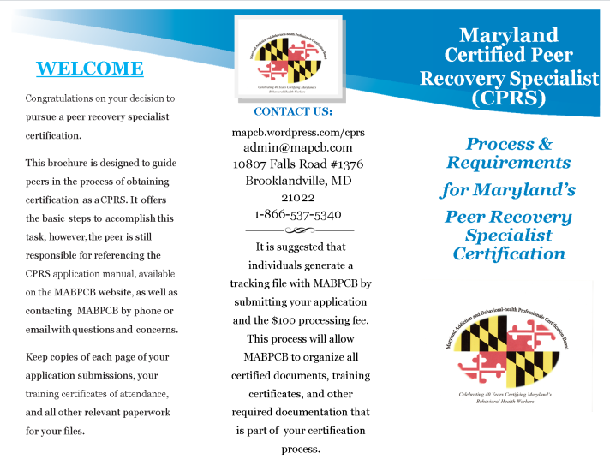
Marketing Toolkit
Making Progress
Developed marketing materials to provide community information:
  CPRS Requirements Guide
  CPRS Overview Guide
Office website expansion:
  Training Archives
  ListServe Resource Management
  Social Media Resource Management

Slide 18

OCA Website
Resources for Peer Professionals
Offers resources to individuals who are interested in a number of ongoing projects within the Office of Consumer Affairs (OCA), including:
CPRS Program
Marketing Brochures and Toolkits
PRSS ListServe Contact Information
Wellness and Recovery Action Plan (WRAP)
CPRS Annual Summit
Consumer Quality Teams
Carroll Conquest Outstanding Leadership Award
Archived Training Information
https://bha.health.maryland.gov/ Pages/Consumer-Affairs.aspx

Slide 19

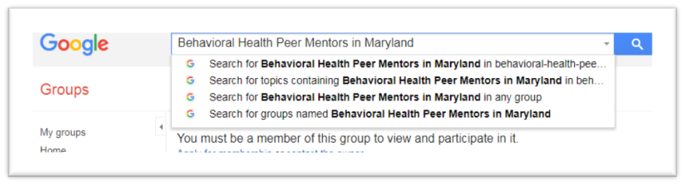
OCA ListServe
Resources for Peer Professionals
This Google Group hosts:
  Upcoming Peer Training
  Peer Employment Opportunities
  Recovery Advocacy Events

Slide 20

Facebook
Resources for Peer Professionals

Slide 21

MABPCB Website
Maryland’s Certified Peer Recovery Specialist Credential
The CPRS credentialing board’s website offers resources to people who are interested in certification and other related components of the CPRS credential, including:
Applications for certification
  CPRS Application
  RPS Application
  CPRS Recertification Application
  Educational Provider Application
Upcoming Training Calendar
CPRS and Approved Peer Supervisor Rosters
Peer Employment Opportunities
Ethics Policy and Procedures for the CPRS
Board Information and Updates
https://mapcb.wordpress.com/cprs

Slide 22

Recovery Month
Stay Tuned...
SAVE THE DATE Friday, Sept. 6
Join us as we come together to celebrate the hope that Recovery brings to individuals, families, and our communities.

Slide 23
Daily Agenda
09:00 am – 10:15 am: Opening Remarks (M/E)
10:15 am – 10:30 am: BREAK
10:30 am – 12:00 pm: Keynote – Arthur H. Woodward Jr., MSW (Eth)
12:00 pm – 01:00 pm: LUNCH
01:00 pm – 02:15 pm: Workshops (Domain Identifiers in Folders)
02:15 pm – 02:30 pm: BREAK
02:30 pm – 03:45 pm: Plenary – Tricia Christiansen & Lisa Pace (Adv)

Slide 24
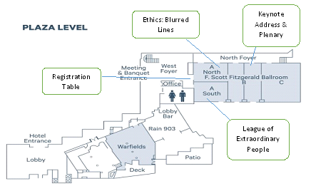
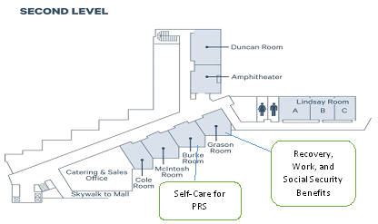
Workshop Breakouts
PLAZA LEVEL
Ethics: Blurred Lines (Ethics)
  FS Fitzgerald Ballroom A NORTH
League of Extraordinary People (Adv)
  FS Fitzgerald Ballroom A SOUTH
SECOND LEVEL
Self-care for PRS (Recovery/Wellness)
  Burke Room
Recovery, Work, & Social Security (M/E)
  Grason Room

Slide 25
Notes & Reminders
Checkout is at 12:00 pm Thursday
Parking – Validation stamp available at the front desk
Venue Map – Located inside your conference folder
Room Monitors will redirect you to a different workshop when a room becomes full.
  Workshops are available on a first come first serve basis and seats will not be “saved” for friends or coworkers.
Awarding of CEU’s / Domain Identification
  Agendas are labeled with domains for all programing eligible for CEU’s
  Must sign in with room monitors for each workshop attended
  Must stay for the entire event.
  Must turn in conference evaluation at the registration table to receive CEU certificate at the conclusion of the second days programming.
  No certificates will be mailed or emailed after the event.
  Please refer to the FAQ’s sheet in your folder if you have questions about the CEU process related to the Peer Summit.
Notes:
· CEU certificates are only available at the end of the 2 day conference on Thursday.
· Total CEU’s for the 2019 Summit equal 10.5 total hours.
· CEU domain breakdown is determined by which workshop the participant attends.
· Domains for all conference programing are listed on the daily conference agendas.
· Please note each day has a separate agenda.
Daily CEU Breakdown (x 2 Days)
· Welcoming Remarks 1.25 CEU
· Keynote Address 1.5 CEU
· Workshops 1.25 CEU
· Plenary Sessions 1.25 CEU
· When submitting training information to the MABPCB for certification or recertification each domain must be identified separately.
Couple of final reminders...
Please turn cell phones to vibrate
Hands up – Focus your attention.
Restrooms are located...

Slide 26


Adelaide Weber
Special Recognition
Presented by: Jackie Pettis RN, MSN, CPRS

Slide 27

Break
Be back in 15 mins...

Slide 28
Questions
Maryland’s Certified Peer Recovery Specialist Credential
Brendan Welsh, CPRS
Director—Office of Consumer Affairs
Behavioral Health Administration
Maryland Department of Health
brendan.welsh@maryland.gov
Cell: 443-274-8218

Slide 29
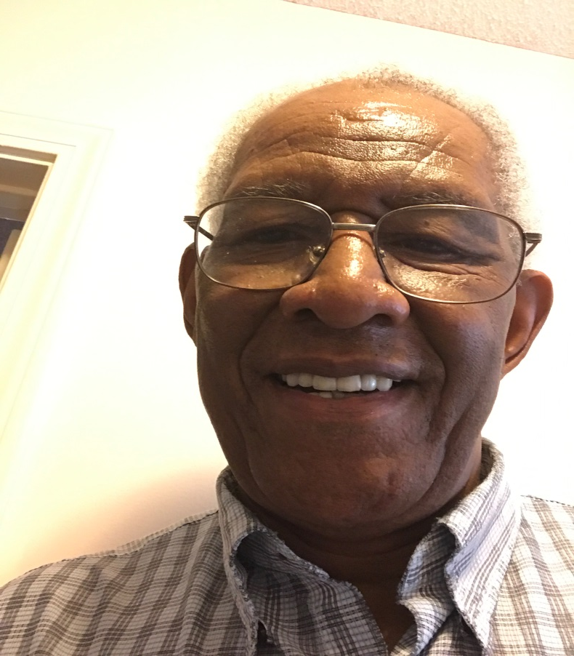
Keynote Address
Developing Cultural Responsiveness With Humility
Arthur H. Woodward Jr., MSW, SOULcial Worker
Middletown, CT
Notes:
Arthur H. Woodard Jr. graduated with his MSW, from the University Of Connecticut School Of Social work in 1984. A self-identified SOULcial Worker who’s practice has evolved through personal, educational, clinical, and practical experience.
Arthur identifies as a human Be-ing in long term recovery since 1978 from addiction and stress.
A Master Recovery Coach and Trainer, Arthur is engaged in learning, practicing and teaching Recovery and Care to those who seek it.
In this role Arthur has facilitated over 40 CCAR Recovery Coach Academies and over 30 Training Of Trainers since his own CCAR training experience in January 2009.
His trainings have taken him across the country having trained recovery coaches in Connecticut, Massachusetts, Maryland, Iowa, Illinois and New York.
Arthur notes that he facilitates Recovery Coach Academy’s and TOTs in the role of Recovery Coach. He remains a Learner and Doer even when training others to provide recovery support.
In his role as a Recovery Coaching Consultant with CCAR, Arthur has developed and delivered Recovery Coach Performance Support Services to CCAR volunteers and RCA graduates. He provides this support to CCAR’s 3 Recovery Community Centers monthly by facilitating an hour and a half collaborative learning opportunity to enhance and strengthen recovery coaching science and skills. In addition Arthur delivers a monthly hour-long CCAR CART Webinar to subscribed CCAR members. These webinars are intended to enhance and strengthen recovery coaches’ in the developing their Art of Coaching Recovery.
Arthur encourages Recovery Coaches and those in training to practice learning, living and leading Recovery as a means for supporting their performance in helping a peer’s recovery and their self-care.
He models active listening skills, asks good questions, and manages his stuff while treating Recovery Coaches and those in training as Resources.
Arthur reminds himself that he teaches best what he most needs to learn and when he teaches he has the opportunity to learn twice.
Ladies and Gentlemen it is my pleasure to introduce Arthur Woodward

